Slide 1
Involving patients in decision-making II: the role of patient organisations from the local to the European level
Roberta Savli
Director of Strategy and Policy, European Federation of Allergy and Airways Diseases Patients’ Associations
roberta.savli@efanet.org @robertasavli

Slide 2
Outline
The 5 Ws of patients’ involvement
The role of patients’ organisations
Global, regional, national & local decision-making
Case-study: patient participation in the EU

Slide 3
The 5 Ws of patients’ involvement
Where?
What?
Why?
When?
Who?
Initially in the US, later in Europe and currently in other parts of the world
Individual patients, patients’ advocates and organisations
“Nothing about us without us”
Unique perspective, human face and impact on everyday life
1950s, early days of cancer research and treatment

Slide 4
“Nothing about us without us”
From a paternalistic approach where patients were passive spectators…
Only healthcare experts are qualified to diagnose and treat diseases
All decisions rely entirely on the knowledge of healthcare professionals
Patients are passive recipient of care, social stigma, blaming and shaming
…to a patient-centred model where they are key players in healthcare changes
Individualistic model: patients’ right to be involved in all decisions influencing their health
Instrumental model: patients’ suggestions will increase cost-effectiveness of healthcare systems
Democratic model: accountable health policy decisions based on patients’ needs and concerns
Expert patient model: unique expertise of living with the disease, end users of treatments
Notes:
Blaming and shaming diseases: for instance, COPD patients have for long being considered as responsible of their own disease (long-term and heavy smokers), the same applies to type-2 diabetes
Different reasons why patients need to be involved, all leading to the same patient-centred model

Slide 5
Evidence?
Empowered patients make informed choices
Seeking early diagnosis
Avoiding emergency visits and hospitalisations
Recovering faster due to self-management
Low patients’ health literacy accounts for 3-5% of total healthcare costs per year
Increasing number of actors supporting patients’ involvement
Quality standards for guideline development
Editorial in medical journals
Research articles
Public authorities

Slide 6
Better quality of life
Involvement of medical and social care teams
Patient guided self-management
Better health outcomes
PATIENT
PARTICIPATION
PATIENT
EXPERIENCE
PATIENT INVOLVEMENT MAKES SENSE
Notes:
The involvement of the medical and social care teams is crucial (e.g.: pharmacist, nurse, specialists nurse, GP, specialist, dietician, physiotherapist, social carer)
Managing everyday and special situations/environments allows for a better quality of life

Slide 7
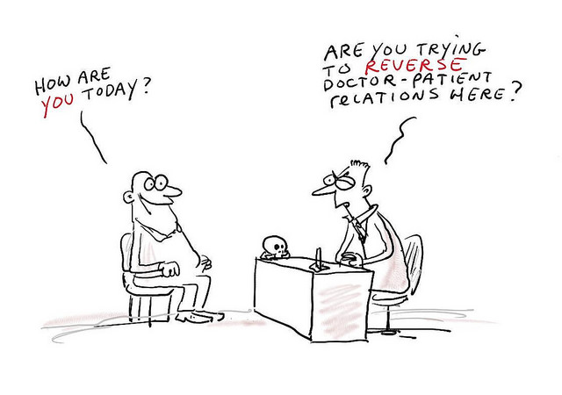
Common mistakes…
Last minute
Tokenistic
Not planned
Not resourced
No training
Increasing power asymmetries
Meaningful patient involvement: from the beginning to the end, key role in all aspects of health decisions
Notes:
Despite having more and more evidence of the usefulness of patients’ involvement, there are still some challenges and common mistakes
Tokenism is the practice of making only a symbolic effort to be inclusive to members of minority groups, especially by recruiting a small number of people from underrepresented groups

Slide 8
Patient-centred journey
Consultation
Dialogue
Revision
Implementation
Information
Planning
Review

Slide 9
The role of patients’ organisations
Advocate to highlight needs, safeguard rights and participation of patients
Engage patients as the ones living with the disease – unique perspective, human face and impact on everyday life!
Collaborate with researchers – evidence-base policy messages
Provide information and tools (e.g.: EUPATI)

Slide 10
Challenges
Lack of political will for changes
Lack of media interest
Maintaining people’s interest
Lack of funding
Lack of public and policy-making awareness
Representativeness
Independence and transparency
Established patients’ organisations vs emerging networks
Notes:
Representativeness: in whose name are you speaking – what’s your legitimacy? If you are not a patient, can you speak on behalf of patients? If you are a patient, can you speak on behalf of others? Are you not too influenced by your own condition?
Emerging networks keep popping up with the raise of social media. These networks are more flexible than established patients’ organisations and more reactive to hot topics, but at the same time they provide less information on their governance, funding, membership (e.g.: vapers groups)
More in general, patients HAVE to FIGHT to have a seat at the table, to justify themselves, prove themselves, while other stakeholders do not. One thing that should change is the mindset and power balance

Slide 11
Global, regional, national & local decision-making
SOCIAL
DETERMINANTS
Global
International guidelines
Regional
Building blocks for better health: EU, ASEAN, etc.
Political documents & binding legislations: authorisation of medicines, clinical trials, etc.
National
Public health as a national competence
Public health programmes, framework decisions
Local
Subsidiarity principle: as close as possible to the citizens
Organisation of healthcare systems, social care, hospitals, etc.
Political commitments: UN MDGs/SDGs, declarations, etc.
International treaties: WHO FCTC, UNFCCC, etc.
Specific legislations: reimbursement of treatment
Notes:
These are different environments, with different competencies, but patients have always one common goal and one strategy

Slide 12
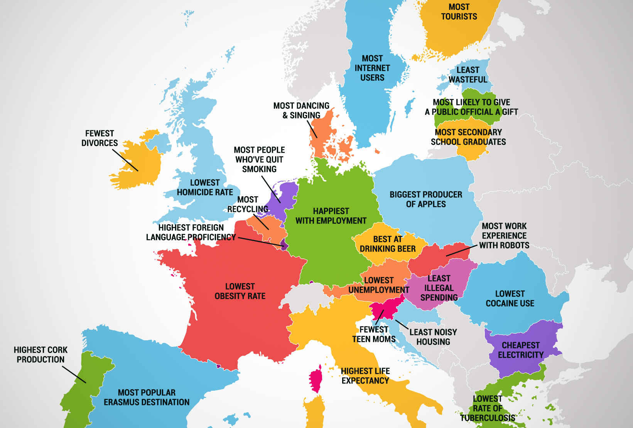
The European Union: “united in diversity”
Or the way to a supranational state?

Slide 13
Economics or politics?
"Europe will not be made all at once, or according to a single plan. It will be built through concrete achievements which first create a de facto solidarity.” [Schuman Declaration, May 9 1950]
With the objective of avoiding war in Europe, from 6 original Member States to 28 (soon 27?) currently, from an economic community to a political organisation
Awarded in 2012 with the Nobel Peace Prize
1952: European Coal and Steel Community
1957: European Atomic Energy Community + European Economic Community
1992: European Union

Slide 14
The Importance of Being EU: the legislative process
European Commission is proposing
European Parliament & Council of the EU are deciding
Commission and Council are implementing
Why is it important?
EU policies channel national decisions
Supremacy of EU law over national legislations
Where to act?
Influence Commission before proposing (EU level)
Influence Parliament while deciding (EU & national level)
Influence Council position (mainly national level)
European Parliemant
Commission
Council of the EU

Slide 15
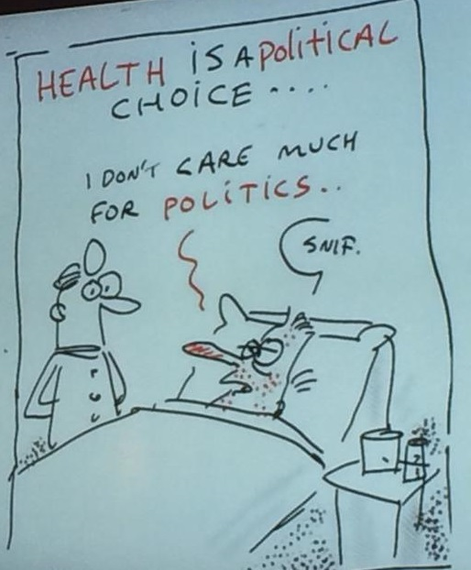
Health in the EU law
Treaty on the European Union
Basic principles, institutions, common foreign and security policy
Treaty on the Functioning of the European Union
Policies, EU external and internal actions, institutional provisions
Charter of Fundamental Rights of the European Union
Political, social and economical rights for EU citizens and residents
Article 168:
Public health as Member States’ competence
Shared competence for common safety concerns
EU competence to support, coordinate or supplement Member States’ activities
Article 35:
Right of access to preventive health care
Right to benefit from medical treatment
Recurrent leitmotif: high level of human health protection shall be ensured in definition and implementation of all Union policies and activities (health in all policies principle)

Slide 16
Health in all policies
Single market
Environment
Research
Justice & home affairs
Regional policy
Agriculture
Energy
Healty life style to people with disabilities and in unfavorable conditions
Air, climate change, chemicals, water
Health as a societal challenge
Indoor air quality
“Overall harmonious development”, limit health inequalities
Healthy and sustainable common agricultural policy, use of pesticides

Slide 17
Rationale: EU single market
Protection of human health through harmonisation of Member States legislations for completion of EU internal market
Pharmaceutical legislation
Directive on the prevention of the entry into the market of falsified medicines
Pharmacovigilance legislation
Clinical trials regulation
Medical devices regulation
Tobacco legislation
Ban on cross-border tobacco advertising and sponsorship
Tobacco products directive
Tobacco taxation
Consumer protection and information
Food labelling legislation
Legislation on the information to patients
Cosmetics regulation
Notes:
Example of patients involvement:
Medical devices legislation: regulation of single use/multiple use medical devices + information to be provided before the implant + stricter control by authorities
Clinical trials legislation: involvement of patients in all stages of trials, including protocol design, informed consent and ethical review
Tobacco products legislation: compulsory pictures on back and front + possibility of plain packaging + minimum size of packs
Food labelling: minimum size of characters + compulsory information on allergens for non-pre-packed food (e.g.: restaurants)

Slide 18
Example: EU tobacco products directive – I
Unity is strength
Create a powerful network & identify common priorities
Before the Commission’s proposal – postponing the indispensable?
Despite necessity of the new directive to adapt the current rules on tobacco, delayed for several months
Scandals & procrastination → tobacco industry behind the scene?
Notes:
Since 2010, when the Commission launched its public consultation on the revision of the current directive, we have been working with key public health NGOs to define a common line. We have responded to the public consultation on tobacco and met with key officials responsible for the dossier in the Commission before the proposal came out to make our voice heard
The current directive on the approximation of laws, regulations and administrative provisions of Member States on the manufacture, presentation and sale of tobacco products dates back to 2001. Since then, several market and scientific developments in the tobacco sector have occurred, showing weakness and loopholes in existing rules [e.g.: novel tobacco products, such as e-cigarettes, entering the EU market and not being properly regulated; new scientific studies on the toxicity of some additives]. In addition, the World Health Organisation’s Framework Convention on Tobacco Control (WHO FCTC), the world’s first international health treaty, was adopted in 2003 and entered into force in 2005. The EU became a party to the FCTC in 2005 and all its Member States ratified it. Modification of the current rules are therefore also required by international commitments. As a result, a revision of the text is explicitly foreseen by article 11 of the current directive, was repeatedly called for by the Council and the European Parliament, and was included in the European Commission’s work plan for 2012. The delay had its climax with the scandal involving the former Health Commissioner Dalli and a Swedish tobacco producer

Slide 19
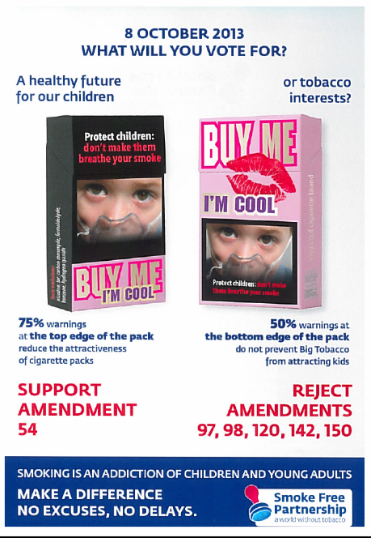
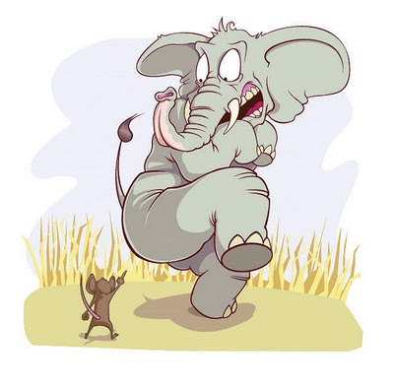
Example: EU tobacco products directive – II
Towards the final decision – the mouse vs the elephant?
Over 150 full-time lobbyists from the tobacco industry vs around 10 public health NGOs BUT positive provisions were introduced
The negotiations phase – sit at the decision-making table!
Working autonomously & with the network
Key word: adaptability
Notes:
We prepared letters addressed to the Health Ministers and the Members of the European Parliament, to be adjusted according to the country of origin of our members, translated and used by them. We met Members of the European Parliament and worked together with other stakeholders to reach out as many policy-makers as possible, in the Ministries at the Member States’ level and in the European Parliament’s political groups. Working with other, even bigger organisations, allowed us to speak in important external events and to collaborate with prestigious counterparts (e.g.: World Health Organisation). EFA on its own reached 20 national Health Ministries and all the Members of the European Parliament. We had direct contacts with 30 Members of the European Parliament. We participated in tens of conferences and had personal chats with WHO representatives
Based on the Commission’s proposals and, especially, on the outcomes of the vote in the responsible ENVI committee in the European Parliament, we had to adjust our priorities. For example, we had to abandon the request for plain packaging as the ENVI committee voted against the initial rapporteur’s proposal. On the same line, we downscaled from 80% to 75%, as accepted by the committee. However, a new priority came up: the need to protect the positioning of these warnings because amendments were proposed to place them on the bottom instead of the top
Our newtork grew more and more. And new means of communication started to be exploited. The leaflet, for instance, was distributed to all Members of the European Parliament in Strasbourg before the political groups took their decisions, before the debate and before the vote. Being perfectly in line with the Commission’s aim, it was shown in the plenary by the Commissioner for Health Borg during his speech. During the ENVI vote we were the first to tweet about the results, our Twitter activity decisively increased during the debate and the vote in the plenary, when we went to Strasbourg together with other public health advocates to follow the vote and then the press conference live
In particular the combined health warnings were big (65% on both sides and put at the top, rather than 30% on the back and 40% on the front), additives are forbidden, pictures are compulsory and some aspects of the package are harmonised

Slide 20
Good practice: EMA
The European Medicines Agency (EMA), responsible for one application, one assessment, one authorisation for medicines in Europe
EMA framework of interaction with patients based on 5 essential elements:
A network of European patients and consumers organisations (eligible organisations, based on eligibility criteria)
A forum of exchange: EMA Patients and Consumers Working Party (PCWP)
A pool of patients acting as experts in their disease and its management
Interaction with the EU Regulatory Network
Capacity-building focusing on training and raising awareness about EU regulatory system (annual training day, online modules and videos)
Ensures patients’ key messages are understood!
Notes:
Eligibility criteria for patients and consumers organisations: non-for-profit status, transparency, patients interests, EU representation

Slide 21
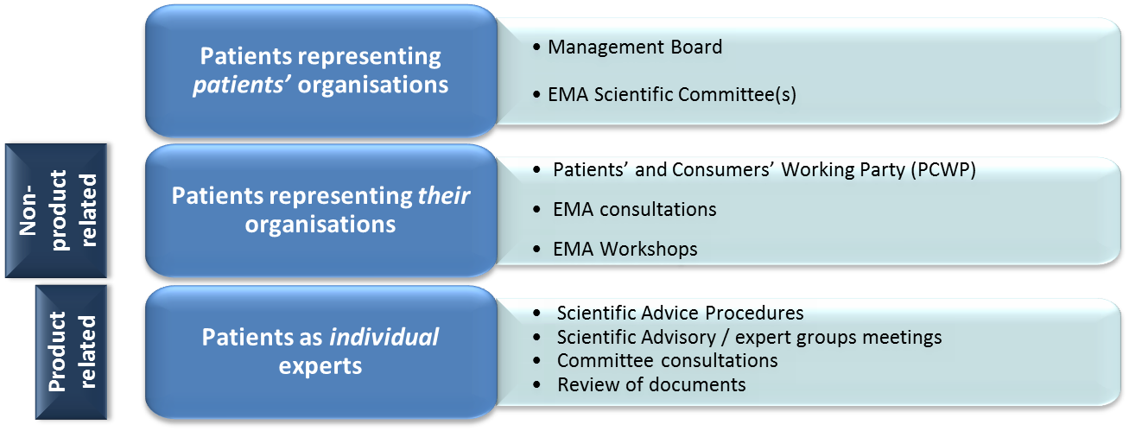
How do patients participate?

Slide 22
Value
Challenges
Finding suitable patients (e.g.: language barrier, availability)
Real life examples provided
Actual impact on the outcomes, more meaningful regulatory framework
Improves quality of information and communication to patients
Bringing patients’ preferences into scientific discussions
Ensuring comprehensive, tailored training and support
Providing a clear definition of patients role in the different activities
Managing potential conflicts of interest
Representation
Documents overload
Too technical?
Strict deadlines
Myths and truths

Slide 23
Questions?
THANK YOU!

Slide 24
European Federation of Allergy and Airways Diseases Patients’ Associations
35 Rue du Congrès
1000 Brussels
Belgium
Tel.: +32 (0)2 227 2712
Email: info@efanet.org
Twitter: @EFA_Patients

