Slide 1
Atopic eczema: burden of disease and individual suffering –
Results from the EFA Atopic Eczema Survey
J Ring,
B Arents, U Mensing, IA Seitz, N Wettemann, G de Carlo, A Zink, A Finkwagner
Johannes.Ring@tum.de
13.09.2018

Slide 2
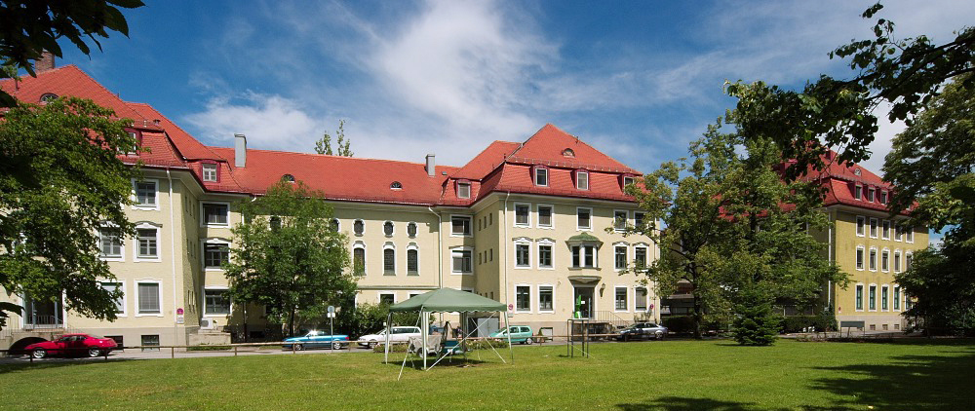
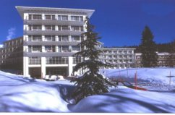




Atopic eczema: burden of disease and individual suffering –
Results from the EFA Atopic Eczema Survey
Johannes Ring
B Arents, U Mensing, IA Seitz, N Wettemann, G de Carlo, A Zink, A Finkwagner
Johannes.Ring@tum.de
Haut- und Allergieklinik Biederstein, TU Muenchen
Christine Kühne Center for Allergy Research and Education (CK-CARE), Davos
Haut-und Laserzentrum an der Oper Perusastr 5 Muenchen
European Federation of Allergy (EFA) Symposium at the EADV Congress
Paris, 13 september 2018

Slide 3
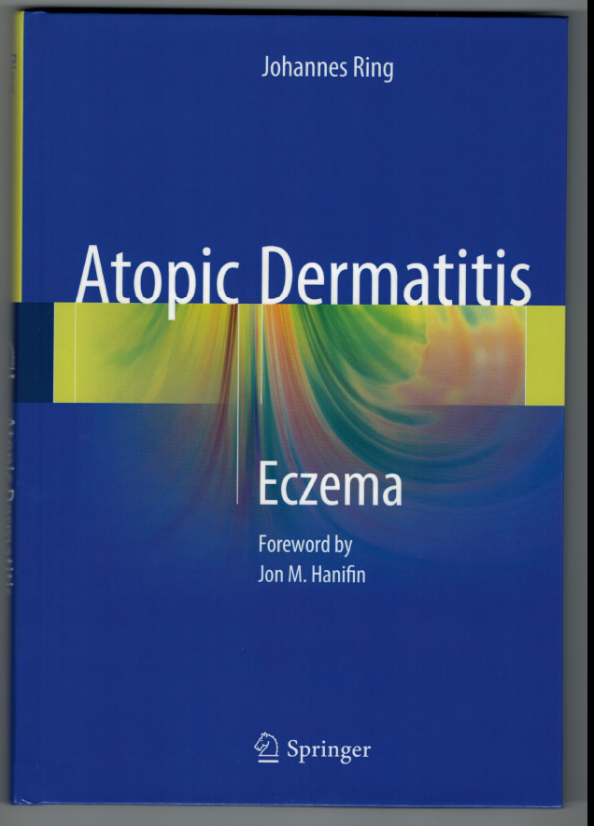
Conflicts of interest
Allergika, Almirall-Hermal, Bencard/Allergy Therapeutics, Celgene, Galderma, GSK-Stiefel, Leo, Mylan, MSD, Novartis,
Phadia-ThermoFisher, Sanofi genzyme
Springer
Berlin
New York
2016

Slide 4
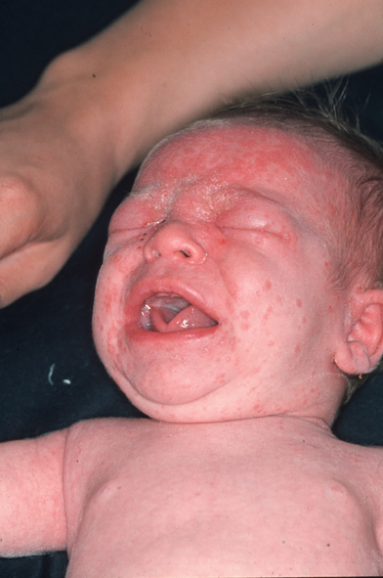
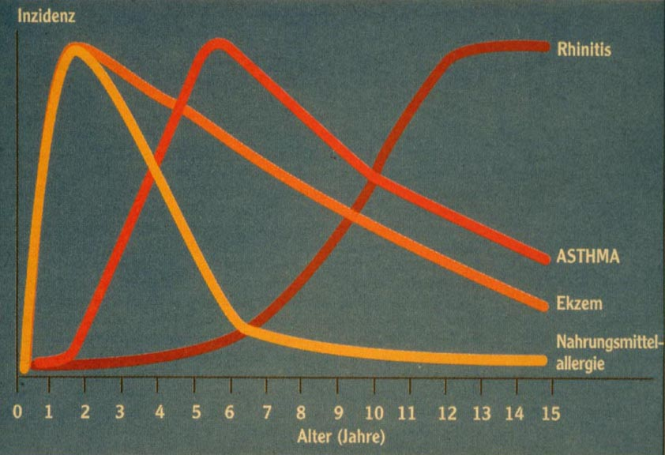
Atopic „March“
Eczema 3rd month

Slide 5
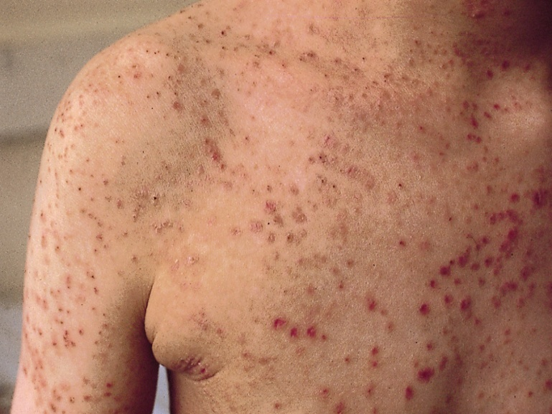
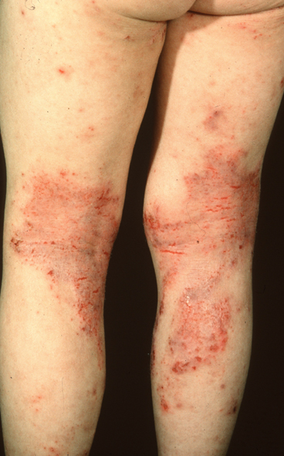
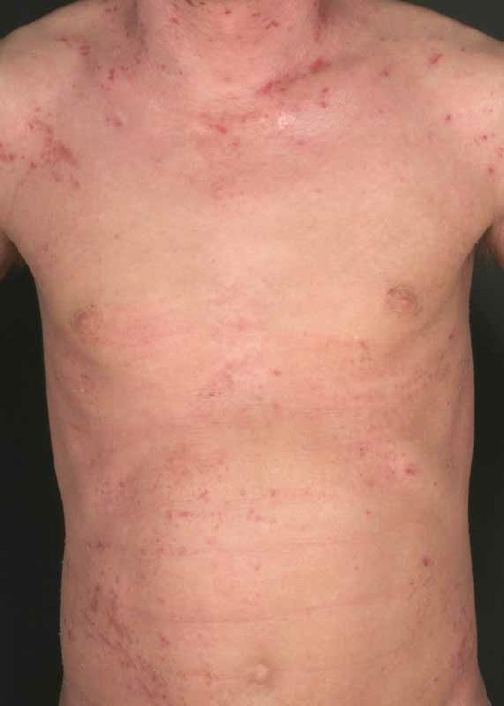

Slide 6
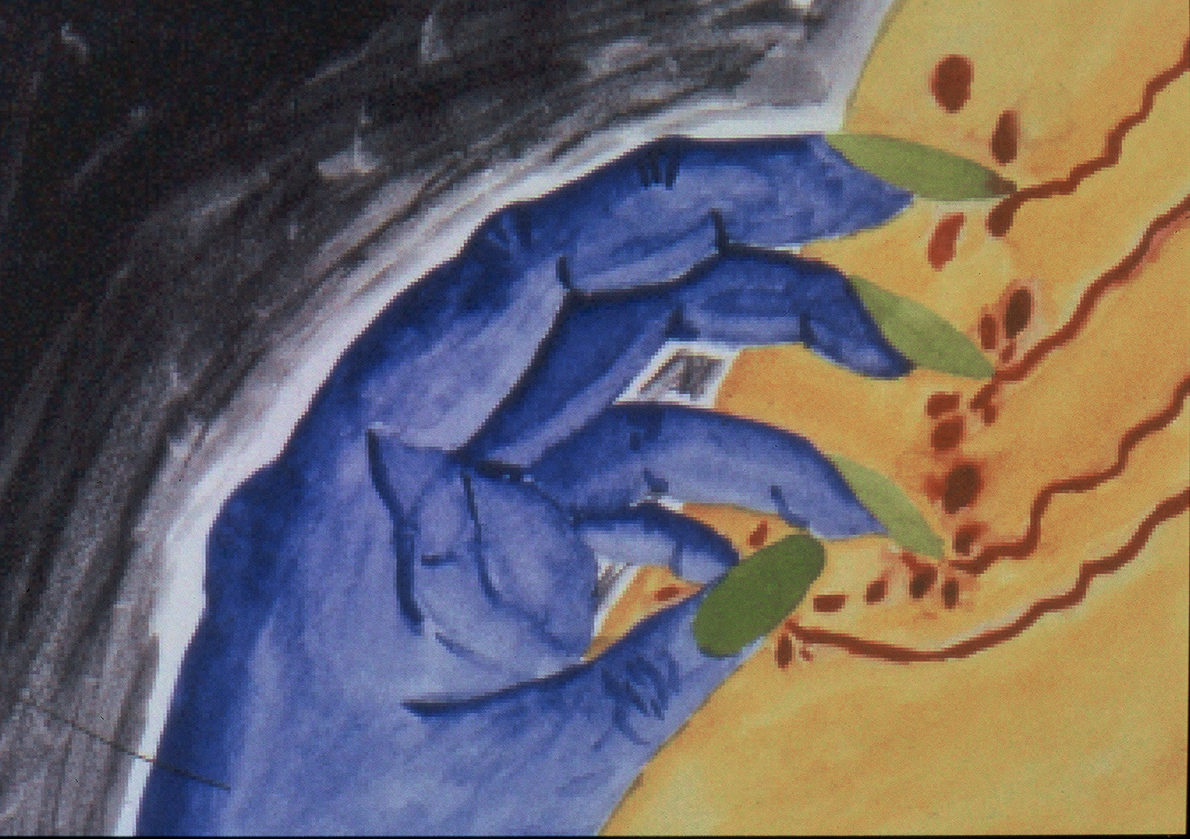

Slide 7
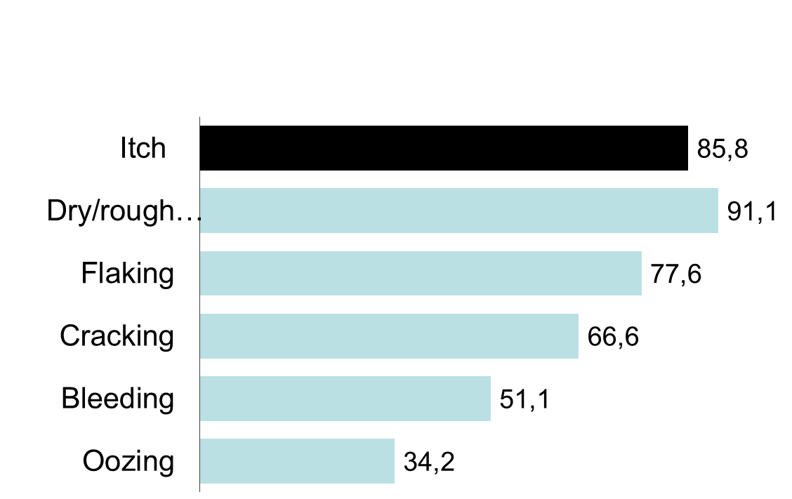
Patient‘s perspective
daily
(N=379)
5–7 days
Per week
(N=380)
Daily symptoms of patients with AE
(% of all patients)

Slide 8
The story of Ernst (56 y)
Since childhood mild atopic eczema, better in puberty
Hay fever against pollen
Sever times anaphylaxis to various foods, avoids restaurants
Rather normal life until 35 y
Stress in occupational life (job)
Relapsing more and more severe exacerbations of eczema. Use of emollients, antihistamines, sulfonates, tar, TCS, TCI, Phototherapy, alternative methods
Long periods of work absenteism
Depressive mood, sleep loss due to severe itch
Development of atopic keratoconjunctivitis, cyclosporine eyedrops
Tx with CyA (3 mg/kg) over several years, when tapered down, new exacerbations, also systemic glucocorticoids
Development of squamous cell carcinoma on sclera, stop cyclosporin
Worsening of eczema
MTX limited success, liver enzymes increase
What to do? Candidate for new immunomodulators, Dupilumab?

Slide 9
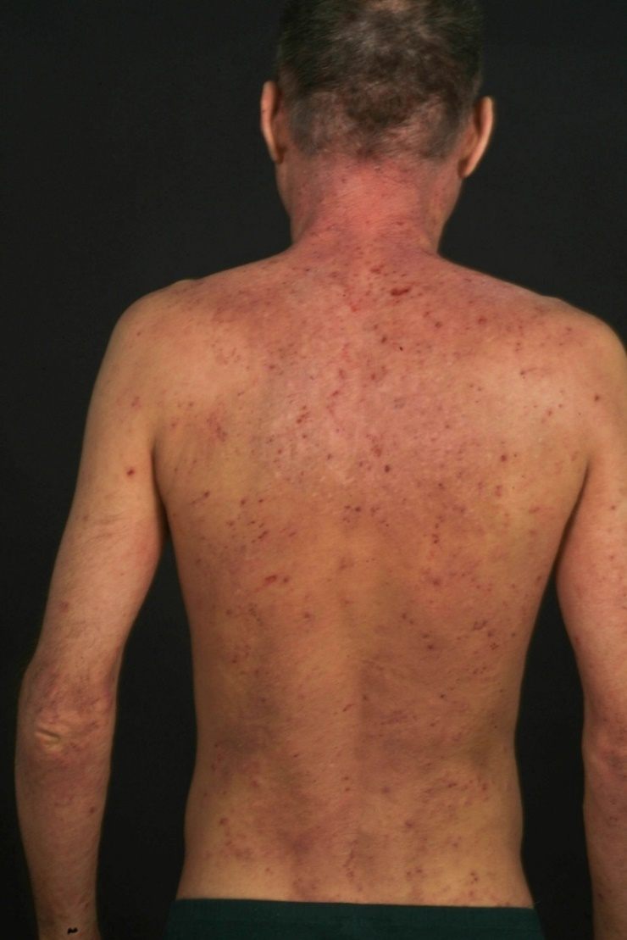
Atopic eczema beyond skin symptoms
„Burden of disease“
Stigmatization, social isolation
sports, leisure restricted
Relationships, Sexuality
Depression
Self-development
Restricted career opportunities
Impaired life achievements
Financial costs (direct, indirect, out of pocket)

Slide 10
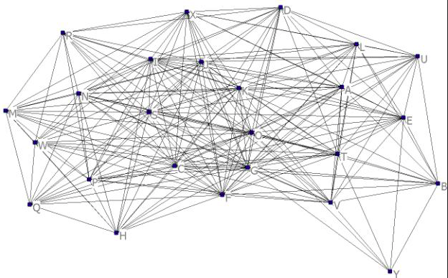
The burden of disease in AE is multi-dimensional
Allergies
Psychologic disturbances
Bacterial infections
Impact on family members
AE symptoms
Viral infections
Loss of productivity
Fungal infections
Cardiovascular disease
Genetic syndromes
Ocular disease
Vitiligo
Tumors
Metabolic disease
Gastrointestinal disease
Hair anomalies
Vieluf D. et al. Complications and Diseases Associated with Atopic Eczema. in “Handbook of Atopic Eczema” (Ring et al eds) Springer, Berlin 2006
From Jan Gutermuth

Slide 11
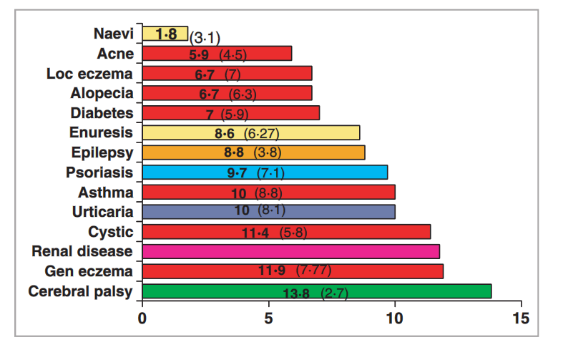
Quality of Life (QoL) impairment due to various diseases in children
Children‘s Life Quality Index scores for 540 children, 379 with chronic skin diseases and 161 with other chronic diseases
Beattie et al. Br J Dermatol 2006

Slide 12









The EFA Atopic Eczema Survey: Countries/number of interviews
N=180 Interviews
N=150 Interviews
N=180 Interviews
N=50 Interviews
N=180 Interviews
N=37 Interviews
N=180 Interviews
N=52 Interviews
N=180 Interviews
Base: total, n=1189

Slide 13
Methods
1189 patients in nine European Countries
Computer Aided Telephone Interview (CATI)
Patient Oriented Eczema Measure (POEM)
Dermatology Life Quality Index (DLQI)
Atopic Eczema Severity and Emotional Consequences (AESEC)

Slide 14
CATI
Questions on the telefone
Interview
Computer-aided telefone interview CATI
Computer-assisted data processing
Notes:
14
One of the hallmark features of AE is an impaired skin barrier with profound changes in skin physiology such as increased epidermal water loss, shift of the pH, low hydratation of the stratum corneum and changes in molecular composition of the stratum corneum

Slide 15
Gender/Age
Gender
Age groups
women
men
Mean=41.86
Base: total, n=1189
Notes:
There are a little bit more women than men in the sample and people aged 18-29 years are marginally lower. The average age is about 42 years in all countries, with some variation in countries with smaller sample sizes (D: 42, FR: 40, ES: 40, IT: 41, UK: 41, NL: 49, DK: 45, SW: 48, CZ: 38)

Slide 16
Other atopic diseases
Nearly eight out of ten AE patients suffer from other atopic diseases, most of them suffer from airways allergy to pollen, house dust mite, animals, food, but also asthma.
From a list (read out):
other (mentioned spontaneous and coded):
Contact allergies
S6. Do you have other atopic diseases like…?
Base: total, n=1189
Notes:
The majority (over three quarters) suffer from additional atopic diseases, especially allergy to pollen, allergy to dust mites, allergy to animals and food allergies. 22% suffer from Asthma.

Slide 17
Other chronic diseases
10% of AE patients have other chronic diseases or conditions.
S7. And do you have any other chronic diseases or conditions? Yes, please specify (open end , spontaneous answer)
Base: total, n=1189, n=118 those who mentioned to have other chronic diseases
Notes:
10% of AE patients have other chronic diseases or conditions.

Slide 18
POEM (Patient-Oriented Eczema Measure) ©*
45% of patients currently have a moderate to severe skin condition
Scoring procedure:
All seven questions are of same impact, using a 0 to 4 rating scale:
No days = 0
1-2 days = 1
3-4 days = 2
5-6 days = 3
Every day = 4
Meaning of score:
0 - 2 = Clear or almost clear
3 to 7 = Mild eczema
8 to 16 = Moderate eczema
17 to 24 = Severe eczema
25 to 28 = Very severe eczema
Total sample distribution:
Mean = 8,71
45%
Base: total, n=1.189
*) © The University of Nottingham
Figures in %

Slide 19
Rating of current status and severity (POEM) - detail
Over the last week …
Q11. (POEM) To get a detailed and valid scoring about the current status and severity of your disease I would like to read out some typical signs and symptoms. Please indicate how many days over the last week you have been suffering from the following signs and symptoms.
Base: total, n=1189
Notes:
In order to evaluate the grade of severity, POEM, a validated and standardized questionnaire, got included. As the single items show respondents specifically suffered from itching and dry skin in the week they got interviewed. Sleeping problems and bleeding, weeping skin has been experienced least.

Slide 20
DLQI (Dermatology Life Quality Index) ©*
Scoring procedure:
Each question was rated in accordance to the below:
Very much = 3 Not answered = 0
A lot = 2
A little = 1 Q7: prevented working/
Not at all = 0 studying = 3
Not relevant = 0
Meaning of score:
0 - 1 = No effect at all on patient‘s life
2 - 5 = Small effect on patient‘s life
6 - 10 = Moderate effect on patient‘s life
11 - 20 = Very large effect on patient‘s life
21 - 30 = Extremely large effect on patient‘s life
Total distribution in the sample
Mean = 7,24
55%
*) © Dermatology Life Quality Index. A Y Finlay, G K Khan, April 1992, www.dermatology.org.uk
Base: total, n=1189
Notes:
In accordance to the DLQI Scoring, more than half of respondents show moderate to large effects on life and nearly one quarter had to struggle with very large to extremely large impacts on their lives. About 45% have no or only small effects on their lives at the time the interviewing took place.

Slide 21
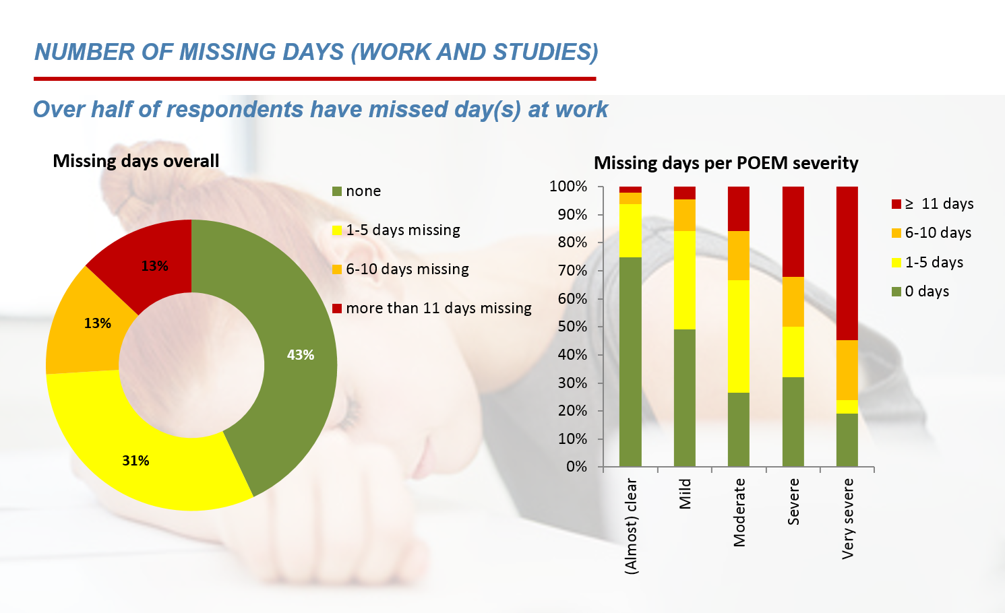

Slide 22

Extra spending in different areas - overview
Extra spending on all-day necessities are very common for AE sufferers. Only 7% has no extra spendings at all.
Personal
hygiene
Washing
powder
Cleaning products
Clothing
Foods
Bedding
Gloves
Base: TP total, n=1.189
Average increase in % per month
+ 18%
+ 8%
+ 9%
+ 8%
+ 6%
+ 7%
+ 7%
Only 7% of respondents has no extra spendings at all
Base: total, n=1.189
Q16. Please consider your spending for everyday necessities. I will read out some corresponding areas. In case you have extra spending in these areas, because of your atopic eczema, please estimate the additional amount per month as a percentage increase.
Figures in %

Slide 23

Out of pocket payment per month on average for several health care aspects (in Euro)
In total, patients pay an extra of 927,12€ (average) per year for health care
Emollients and moisturisers
Travel expenses
In-patient treatment
Medication
Bandages
Doctor/Hospital
Phototherapy
Base: TP total, n=1.189
Average additional payment per month
+
+
+
+
+
+
=
77,26 € / per month
Ø 27,61€
Ø 17,74€
Ø 7,12€
Ø 8,68€
Ø 5,69€
Ø 8,48€
Ø 1,94€
Total sum per year on average = € 927,12 / only 5% do not pay anything out of pocket
Q17. Can you estimate how much money you have to pay out of your pocket per month on average for the following health care aspects for your atopic eczema, because these medical treatments are not (completely) reimbursed by a health care insurer or nattonal health service.
Base: total, n=1.189
Figures in %

Slide 24
Atopic Eczema Severity and Emotional Consequences (AESEC)
No. | Statement | Applies fully | Somewhat applies | Rather not | Does not apply at all | DK/No answer*
Q01 | I feel detached from others | 3% | 17% | 35% | 43% | 1%
Q02 | I try to hide my eczema | 19% | 32% | 30% | 19% | 1%
Q03 | I am self-confident | 33% | 47% | 15% | 4% | 1%
Q04 | I am nervous | 8% | 24% | 41% | 27% | 0%
Q05 | I envy people with normal skin | 36% | 36% | 20% | 7% | 1%
Q06 | I feel I can handle my eczema | 30% | 47% | 17% | 5% | 1%
Q07 | I feel overwhelmed by my eczema | 8% | 23% | 41% | 28% | 1%
Q08 | I am optimistic about my life with eczema | 34% | 42% | 18% | 5% | 0%
Q09 | I try to avoid physical contact or touching other people | 7% | 27% | 35% | 30% | 1%
Q10 | I struggle with my appearance | 10% | 29% | 38% | 22% | 1%
Q11 | I am a relaxed person | 26% | 50% | 18% | 6% | 0%
Q12 | My eczema makes me angry | 15% | 28% | 35% | 21% | 1%
Q13 | I'm afraid of being rejected | 7% | 22% | 36% | 34% | 1%
Q14 | I am a well-rounded person | 32% | 48% | 16% | 3% | 0%
Q15 | I feel guilty about scratching | 11% | 28% | 33% | 28% | 0%
Q16 | I have difficulties concentrating | 5% | 23% | 38% | 33% | 0%
Q17 | I'm in control of my eczema | 28% | 47% | 19% | 6% | 0%
Q18 | I feel sad about having eczema | 17% | 34% | 34% | 16% | 0%
Q19 | I feel I can do what other people can do | 7% | 20% | 41% | 32% | 0%
Q20 | I worry about my life because of my eczema | 6% | 22% | 36% | 35% | 1%
Q21 | I feel embarrassed about my skin appearance | 10% | 30% | 37% | 22% | 1%
Q22 | I have no problem with intimacy | 25% | 35% | 26% | 13% | 2%
Q23 | I feel insecure | 6% | 25% | 41% | 28% | 0%
Q24 | I cope well with my eczema | 32% | 46% | 17% | 4% | 1%
Q25 | I feel trapped because of my eczema | 6% | 22% | 39% | 32% | 1%
Q26 | I feel I am good enough as a person | 41% | 42% | 13% | 4% | 0%
Q27 | I' m afraid of being a burden to my relatives | 5% | 16% | 31% | 48% | 0%
Q28 | Itching drives me crazy | 20% | 37% | 29% | 14% | 0%
* Although per design this answer category was not defined, it was inevitable when using telephone interviews in case people could or would not answer.

Slide 25
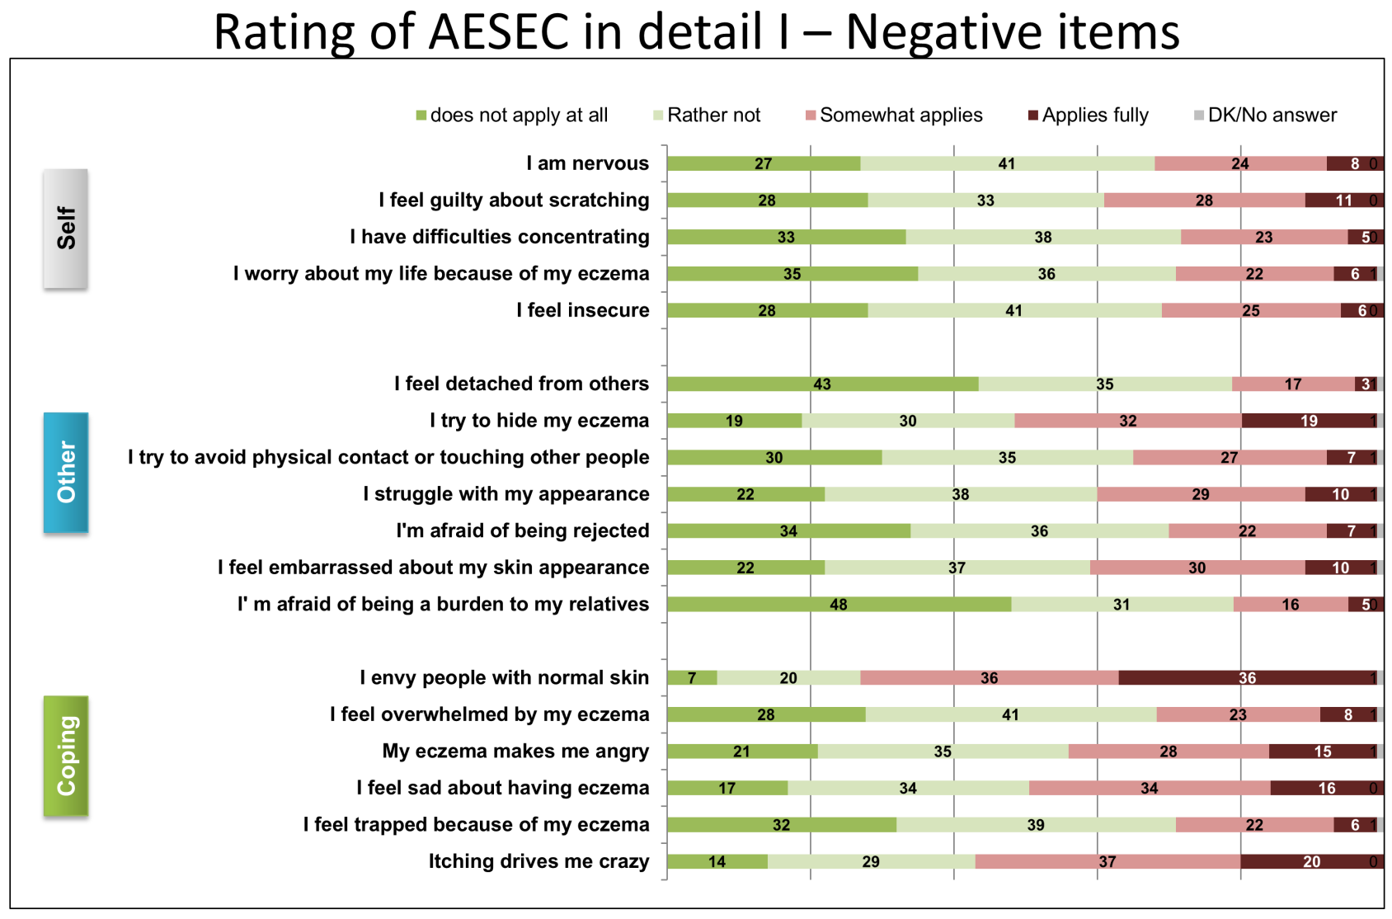
The Atopic Eczema Score of Emotional Consequences (AESEC)

Slide 26
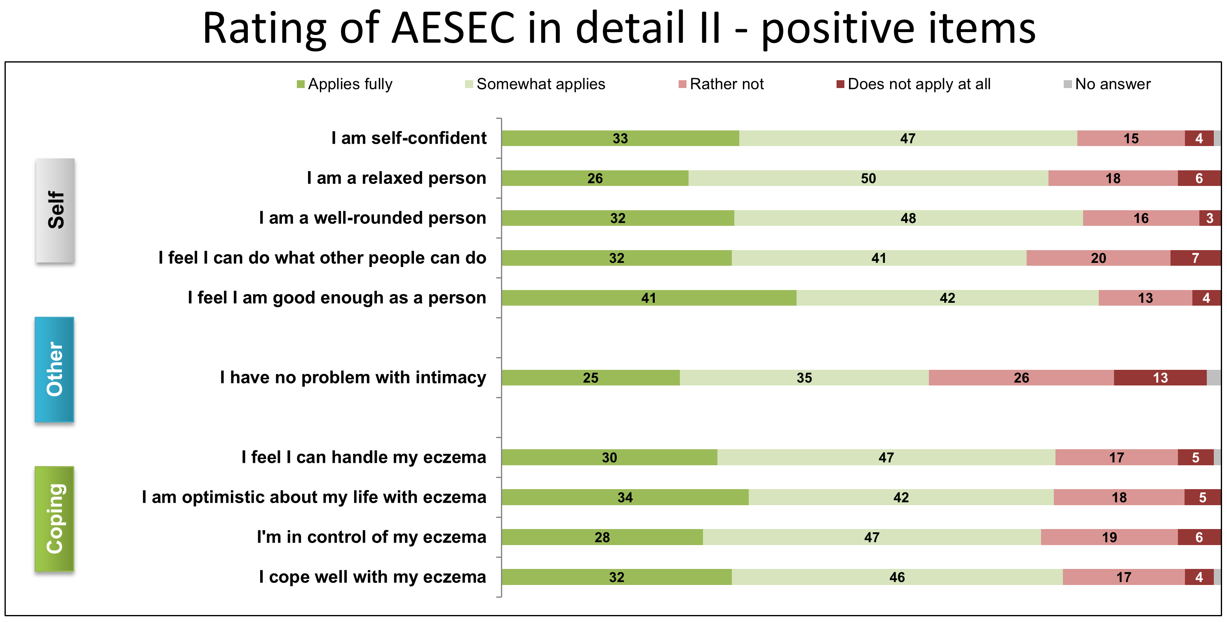
The Atopic Eczema Score of Emotional Consequences (AESEC)

Slide 27
Rating of AESEC Top2-Box – clear/mild vs. moderate to very severe (POEM)
Self
External
Coping
Q13. (AESEC) I will now read out a number of aspects that you may feel apply or do not apply to your life with Atopic Eczema. Please tell me for each individual aspect, the degree to which it applies to your situation.
Base: Clear/mild (n=648), moderate to severe (n=541)

Slide 28
AESEC vs. Current self-reported severity of eczema
Emotional impact correlates with current severity
AESEC Scoring
Base: total, n=1.189
Figures in %

Slide 29

Impact of AE on ability to face life
28% experienced some or more moments when AE
compromised on their ability to face life
IMPACT ON ABILITY TO FACE LIFE
Overall, two thirds of respondents have experienced moments where the AE impacted their ability to face life.
Whereas 40% of sufferers had rather few moments, 28% were more affected and more often experienced depressing moments where the disease compromised on their will to live.
Base: total, n=1.189
Q22. When thinking about your life with atopic eczema, have there been moments when the disease compromised your ability to face life?

Slide 30
Impact on ability to face life - sub-groups
Q22. When thinking about your life with atopic eczema, have there been moments when the disease compromised your ability to face life?
Basis: total, n=1189
Notes:
Finally and in order to support the assessment of the burden of disease, a question about the ability to face life has been added. About a quarter of patients admits many or some moments where the disease compromised on their ability to face life. Especially respondents aged 50+ years and patients with a current severe skin state reveal a negative impact of AE on their will to live. The longer patients suffer from the AE the ability to face life becomes worther. 43% of the patients suffering 40 years and longer has many or even some moments when he disease compromised the ability to face life.

Slide 31
Correlation between POEM and AESEC
There is a consistent correlation between POEM and AESEC
AESEC | POEM „clear/almost clear“ n=195 (=100%) | POEM „mild“ n=453 (=100%) | POEM „moderate“ n=243 (=100) | POEM „(very) severe“ n=182 (=100%) | Total n=1.189 (=100%)
Score 1: 0-27 „no/small“ (n=512) | 67% | 54% | 29% | 17% | 43%
Sore 2: 28-39 „moderate“ (n=320) | 26% | 30% | 27% | 20% | 27%
Score 40-52 „large“ (n=252) | 18% | 14% | 34% | 29% | 21%
Score 4: >= 53 „very large“ (n=140) | 4% | 2% | 10% | 34% | 9%
Ø Mean AESEC | 24 | 28 | 36 | 44 | 32

Slide 32
HADS and POEM

Slide 33
DLQI and POEM

Slide 34
AESEC, POEM and DLQI:
Correlations
 |  |  | Spearman's rho | P | Lower 95% CI | Upper 95% CI
AESEC | - | POEM | 0.466 | < .001 | 0.420 | 0.509
AESEC | - | HADS-D7 | 0.540 | < .001 | 0.498 | 0.579
AESEC | - | DQLI | 0.546 | < .001 | 0.505 | 0.585
POEM | - | HADS-D7 | 0.326 | < .001 | 0.275 | 0.376
POEM | - | DQLI | 0.692 | < .001 | 0.662 | 0.721
HADS-D7 | - | DQLI | 0.461 | < .001 | 0.415 | 0.505

Slide 35
Burden of disease of atopic eczema – not just another parameter
Although atopic eczema is not directly life-threatening, it can ruin a life
Physical, psychological, financial and social consequences lead to marked impairment in quality of life
These aspects have to be considered in dealing with the management of this disease and thinking about possible prevention
We have to be our patients‘ advocats in society

Slide 36
Conclusions
Despite treatment including systemic immunosuppression 45 % of patients still had moderate to severe eczematous skin lesions
55 % had a moderate to extremely large impairment in quality of life
Ca 50 % were suffering individually from emotional consequences: 57 % state that the itching „drives them crazy“, 51 % want to hide their eczema, 39 % feel guilty about the skin condition, 39 % have problems with intimacy.
Of patients suffering actually from severe AE, 88 % stated that this condition compromised their ability to face life
Too many adult patients with a more severe form of atopic eczema (AE) are suffering considerably and more than acceptable.

Slide 37
These are postulates of AE patients for the public
Improve acceptance and understanding of the disease
Provide better and affordable access to adequate health care for this disease and associated problems
Invest in research for more effective treatment and prevention
Help to relieve the psychological and emotional burden going along with this disease

Slide 38

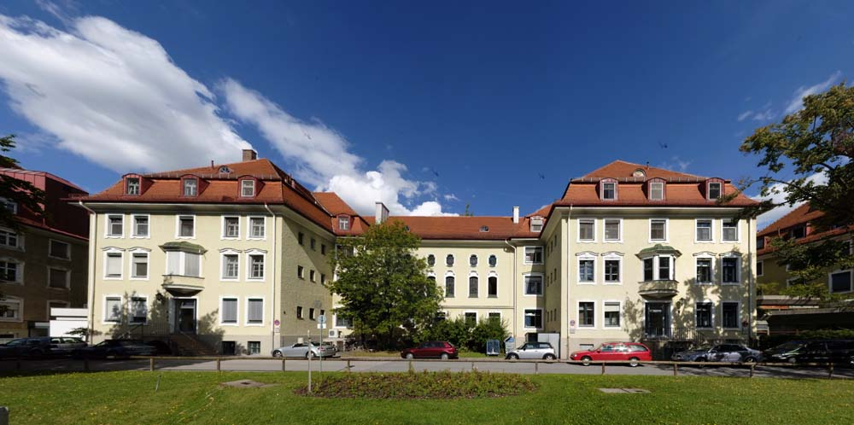


B Arents
U Mensing
IA Seitz
N Wettemann
G de Carlo
A Zink
A Finkwagner
Thank you
Johannes.ring@tum.de

