Slide 1
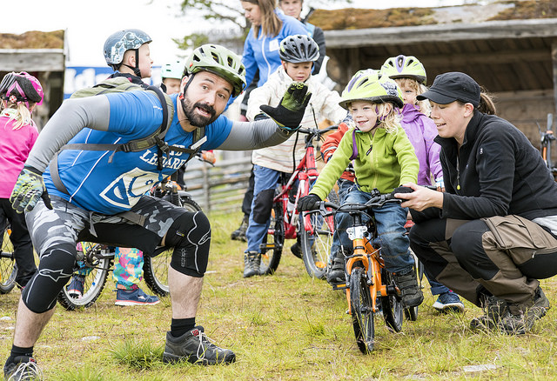
”Outdoor Activity for all” A projekt in cooperation with the Swedish Outdoor Association
Notes:
The name of the project in Sweden is Fralla-Outdoor Activity for al

Slide 2
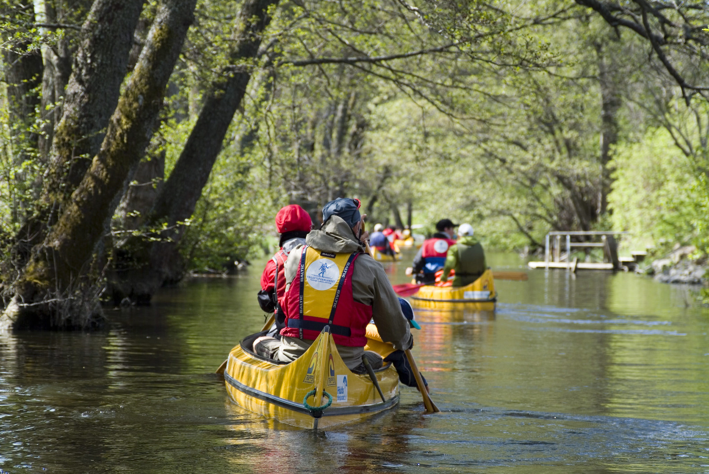
The Swedish Outdoor Association
Non-profit organization, founded 1892
For everyone – regardless of age, etc. previous experience and physical challenges
Thousands of adventures annually
Millions of hours spent outdoors
7000 volounteering guides
Notes:
Some facts! Around 90 000 members in Sweden. They even run schools in some places with the idea that many of the lessons is held outside.

Slide 3
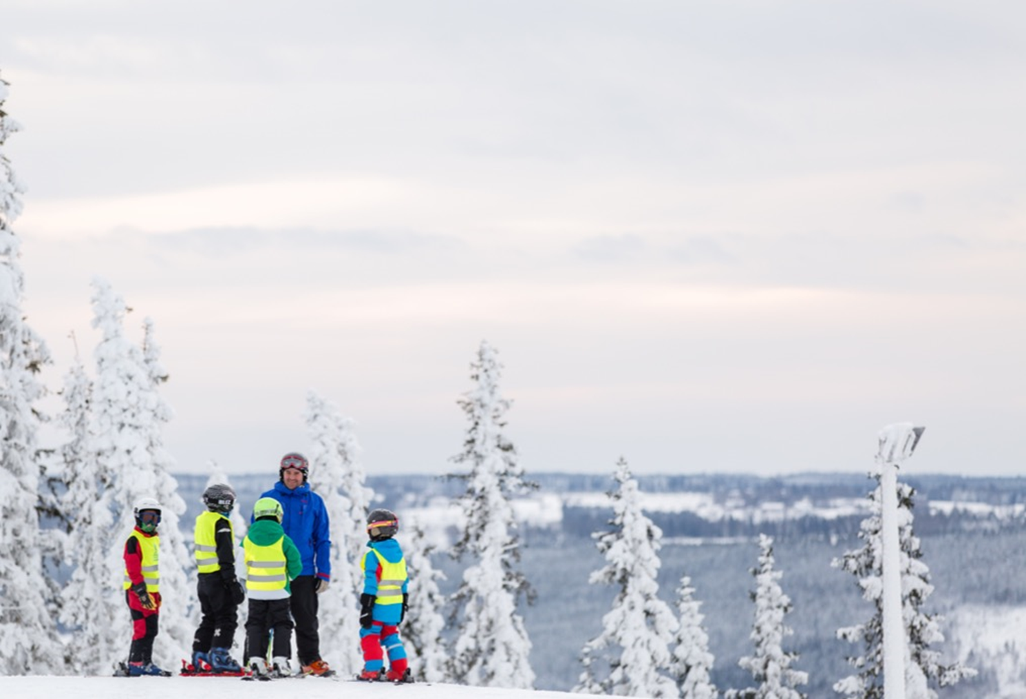
The Swedish Outdoor Association
- Health-physical activity
- Joy-outdoor adventures togheter
- Accessible nature for everyone
Notes:
Friluftsfrämjandets mission. Within Friluftsfrämjandet you can join all outdoor activities except thoose which involves engines and weapons.

Slide 4
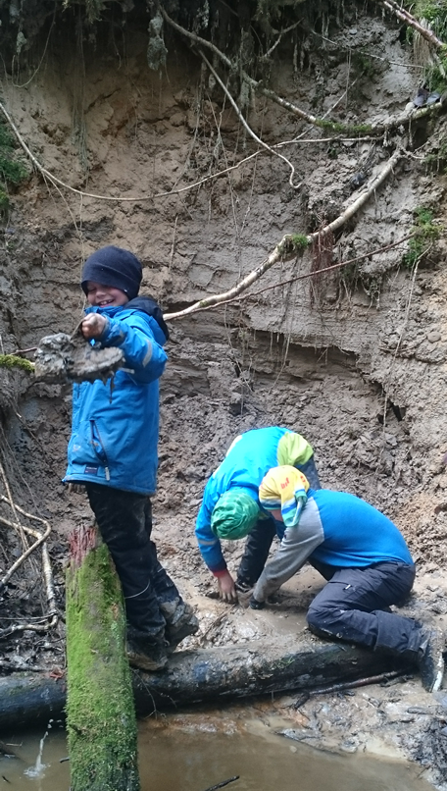
Work in progress
The project is implemented with support from the Postcode Lottery and is a three year pilot project starting in March 2017 until the end of 2019.
We will serve with a modern educational and informative material to make people want to try new adventures.
Right now we try concepts of day camps with different activities like: alpine skiing, hiking, kayaking, MTB and “plogging”.
Notes:
Which kind of material it will be is right now some of the things we work with. Beeing around in our organizations and meeting people, leaders and medical professionals.
Plogging” is a new swedish word wich combine jogging and picking litter. Big in sweden right now.

Slide 5
Goal of the project - health promotion and sustainible development
We want more children and youth to take part in an activ sparetime in our available nature and therby create an engagement for the personal health and our enviroment.
The goal of the project is also to increase awareness of both associations and leaders on how to customize a recreational activity for children and young people with asthma and allergies and other hidden disabilities so that more people have access to nature and outdoor experiences.
The concept will during the project be tested regionally in Östergötland and Jönköping County then be spread across the country after the end of the project.
Notes:
Available nature- In Sweden we have something called Allemansrätten- The Right of Public Access gives everybody the freedom to roam the Swedish countryside.

