Slide 1

Living with skin allergy patient perspectives
Susanna Palkonen, Executive Officer, EFA
Bernd Arents, President, Dutch Association for People with Atopic Dermatitis
www.efanet.org
9 February 2011 WS Skin Allergies & Research Needs DG SANCO Brussels

Slide 2

Living with skin allergy – The Puzzle

Slide 3
Vicious circle of flare ups
Dealing with new environments indoors & out
Tiredness
Lack of information and education
Side-effects of medication
Enjoying sports
Cremes – loads of cremes
Always being prepared
ITCHING
Avoiding triggers
Self-image
Skin taking over as most important issue
Personal hygiene and
cleaning products puzzle
Choice of clothes
Sleepless nights
Problems of intimacy
?
Always taking care of the skin
Irritability
Choice of occupation
Self-esteem

Slide 4
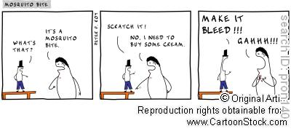
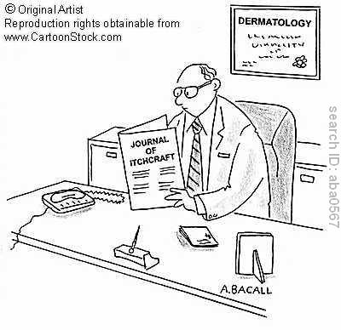
SCRATCHING
Until bleeding
PAIN is A RELIEF from ITCH
Scratching is better than sex

Slide 5
Issues – contact allergy
Chemicals in products for personal hygiene such as shampoos, bath gels, soap etc..
Chemicals used in clothing, such as resins and glues in shoes, and dye in fabrics (indigo is one), but also rubber (elastics)
Chemicals used in news papers and print, such as Rosin (colophony)
Chemicals used for work and work-related contact with water: hair dressers, nurses/doctors, auto mechanics (http://onlinelibrary.wiley.com/doi/10.1111/j.1600-0536.1994.tb00692.x/abstract)
Latex in protective gloves, hair extensions, acrylic/artificial nails, surprise places in health care etc
etc...

Slide 6
Issues – contact allergy
Testing can be tricky since you can only find what you are contact allergic to when you test that specific chemical.
Standardised (European) patch tests are available, but what about allergens that are not in these panels.
Article about a woman who found out after a long search she had a specific allergy to a compound in the seat of her new car http://onlinelibrary.wiley.com/doi/10.1111/j.1525-1470.2010.01213.x/full).
Patch testing for contact allergy is time consuming:
  Day 1: a patch or multiple patches are placed on your back for 48 hours
  Day 3: removal of the patch and inspecting reaction.
  Day 4: 'read' the reaction per allergen.
After you know what you allergic for, then there is the search for products that do not contain the chemical.
People loose jobs or change careers over this issue.

Slide 7
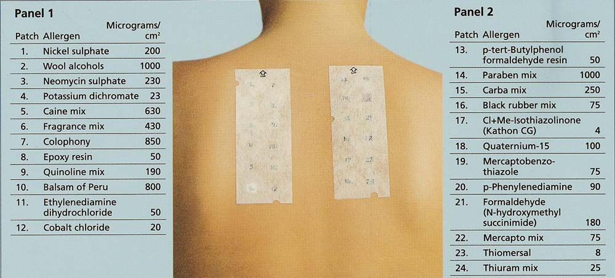
European standardised patch panel 1 & 2

Slide 8
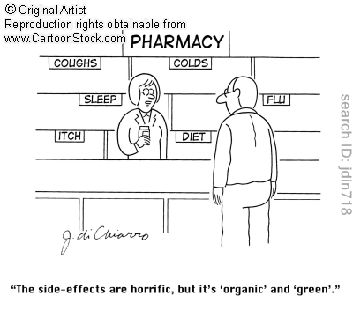
ECO/BIO PRODUCTS – ALLERGY FRIENDLY?
Misleading Allergy Marketing

Slide 9
‘Hypoallergenic’
What is it?
= Causes multiple allergies? Does not cause allergy?
Nothing. There are no rules.

Slide 10
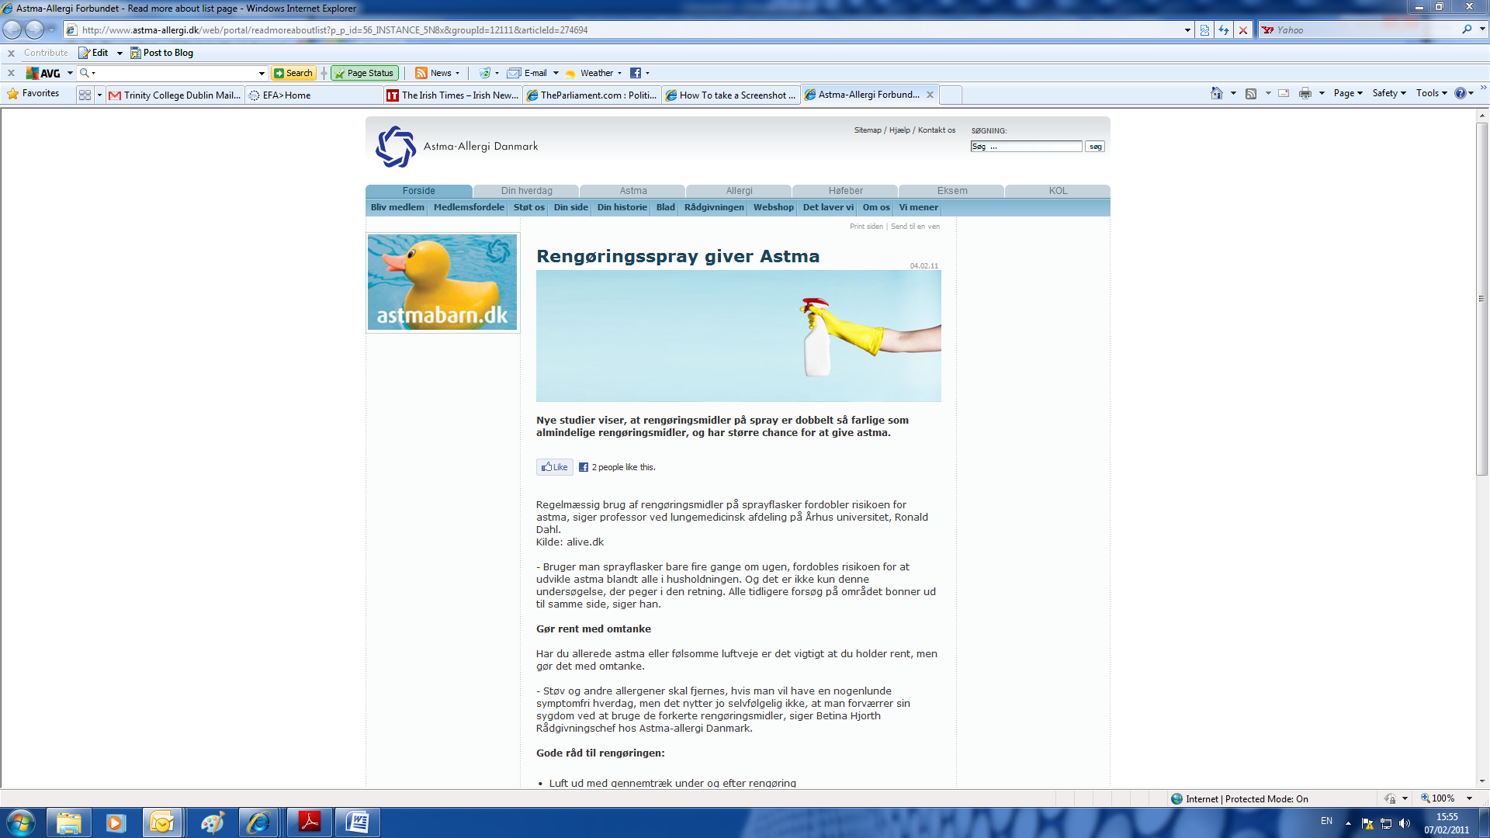
Cleaning spray causes asthma

Slide 11
Putting the pieces together

Slide 12
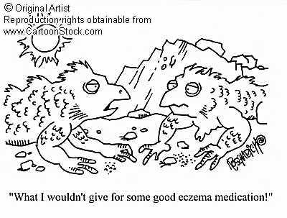
Effective and simple therapies…
1.

Slide 13
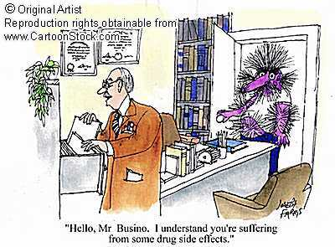
… with little or not serious side-effects
Notes:
Side-effects are another thing – for some people with atopic eczema their skin will permanently loose its protective barriers due to the use of cortisone creams and they will have a permanent flare up.

Slide 14
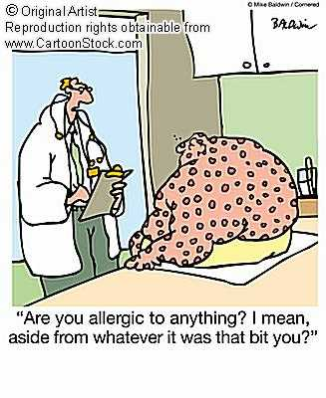
Treating health care professional should have knowledge on allergic diseases; eczema is many times the first manifestation and other allergic diseases such as asthma may follow…
2.

Slide 15
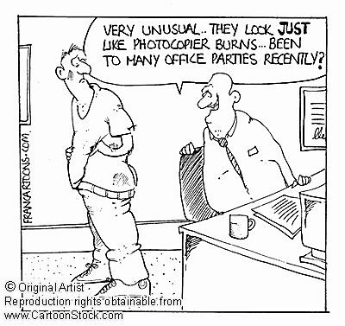
… Strengthen allergology and multidisciplinary collaboration in treatment

Slide 16
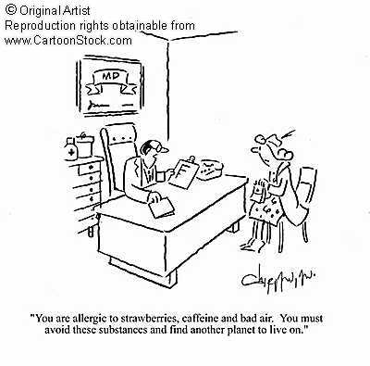
Regulations and information both European and national level on chemicals and other irritants in products, food labelling and our indoor & outdoor environment.
3.

Slide 17
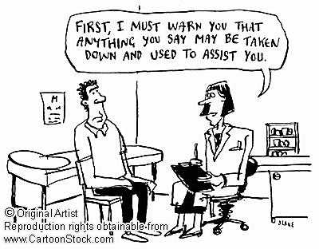
Access to patient education which focuses on living and taking care – not only medication - 5-15 minutes with the doctor will not be enough
4.

Slide 18









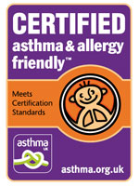

EFA member labeling schemes for products ‘safe for most people with allergy/asthma’
http://allergies.afpral.fr/partenaires/agrement-afpral/42-agrements-produits-afpral.html
http://www.service-allergie-suisse.ch/index.cfm?parents_id=992
http://www.allergia.fi/index.phtml?s=7
http://www.astmaoallergiforbundet.se/RekProdukter.aspx
http://www.naaf.no/no/Tjenester/produktguiden/
http://www.allergyuk.org/prod_intro.aspx
http://www.asthma.org.uk/how_we_help/allergy_friendly_products/index.html
http://dinhverdag.astma-allergi.dk/deklarationer
Detergents, construction products, cleaning products, furnishing, diapers/womens toiletries, bed clothes, bedding, hotels, restaurants, contact lens solutions, washing and cleaning prodcuts, cosmetic products, paints, carpets, ilmanvaihtolaitteet , skin care, hair care, ilmanpuhdistimet, food products and sweets, sun screens, toys…

Slide 19
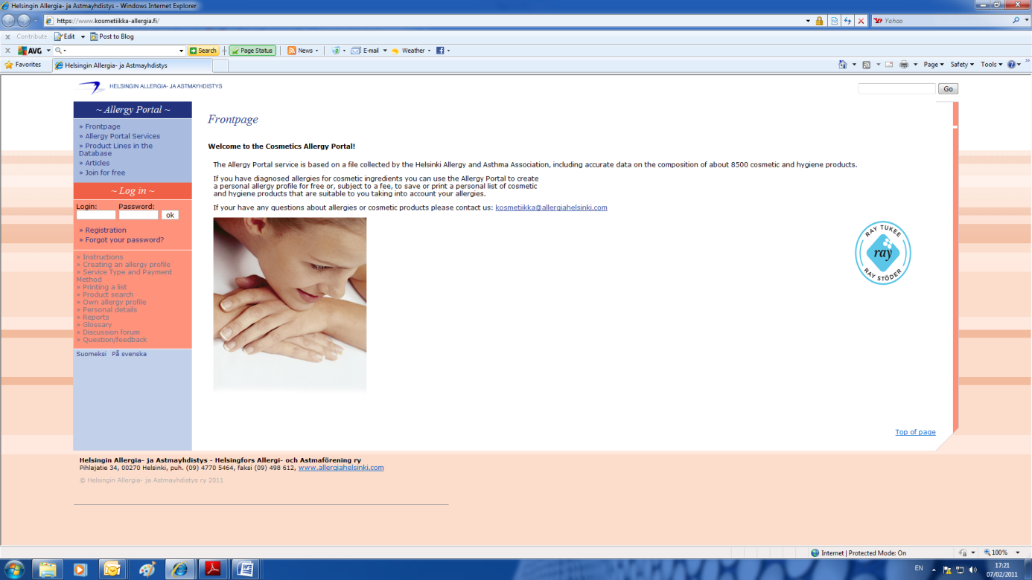

Skin and cosmetic products advice for people with allergy – Allergy portal
Advice and help for people with contact allergy
http://www.kosmetiikka-allergia.fi
Ingredient list of over 8500 cosmetic products, from 80 companies
Get a list of products suitable for your allergy profile

Slide 20
Patient questions
Why? What?
Why me/my kid?
How?
What can I do? Can I do something else than taking loads and loads of medicines?
Will I always have it?
Will my kids get it?
Can it get severe?
Can I live a normal life?
How does environment around me affect…..
How can I choose products that do not induce skin allergy?
The list is longer and personal

Slide 21


EFA strategy – meaningful research
Implementation
Care
Environment
New or improved tools
Impact
PATIENT
Needs & expectations & participation
NEW Knowledge
Understanding
Evaluation & gaps in knowledge
RESEARCH
RESEARCH
needs
POLICY EU & national
Research FP7, FP8
Environment
Care

Slide 22
RESEARCH
Increased understanding of allergy
  Better adherence
  Early & correct diagnosis
  Better targeted treatment, minimum side-effects
  Empowerment
  Better quality of life without restrictions
  Prevention?
  Cure?

Slide 23
EFA mission
Advocate at EU level the needs of people with Allergy, asthma and COPD
Work more and equally with members
Implement best practice
Create patient driven projects
Cooperate with health care professionals, scientists and other stakeholders/NGOs

Slide 24
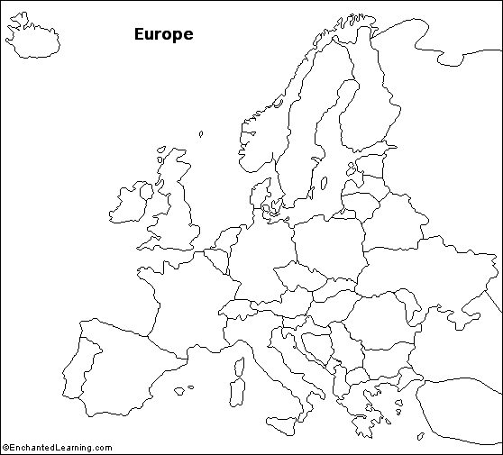


20 countries
34 member organisations
in which over 500.000 patients
& carers
REACH OUT
Notes:
EFA was founded 1991 to give a voice people with allergy and respiratory diseases at European level.
We currently have 34 member organisations in 20 countries, who have over half a million patients and carers as members.

Slide 25
Objectives
For patients
Provides transparent access to information and educational tools in patient-friendly language
Provides opportunities to participate actively in projects
Facilitates communication in patient-friendly language focusing on patient needs
Develops and promotes long term partnership on equal level
Develops training and educational projects
Ensures active participation of patients in all decisions regarding their wellbeing
Acts as liaison between people with allergy, asthma and COPD and EU policy-makers
Negotiates to raise standards of care, environment and research
Communicates and updates about patient needs
For Healthcare
Professionals/
Scientists
  For Policy makers

Slide 26
EFA projects 2011: Allergy
EFA Book on (Respiratory) Allergy in Europe, launch event at EP, Call-to-action
GA²P Global Asthma & Allergy Patient Platform
EFA Campaign to influence EU food allergen labeling: ‘may contain..’, non-prepacked food
Partnership research projects:
  FP7: Mechanisms in the Development of Allergy MeDALL, Unbiased Biomarkers in the Prediction of Respiratory Disease Outcome U-BIOPRED, AirPROM
  Public Health Programme: Health Vent Health Based Ventilation Guidelines for Europe,

Slide 27
EU Health priorities
Prevention
Inequalities
Health in all policies
Innovation
Chronic diseases
Healthy ageing
Sustainability of health systems & economies
eHealth

Slide 28
REGULATE HEALTHY INDOOR AIR & ESTABLISH GUIDELINES
REGULATE & ABOLISH TOBACCO & SECOND HAND SMOKE
RESEARCH ON CARE, CURE, PREVENTION and CARE EFFECTIVENESS
SHARE BEST PRACTICES ON CARE & BENCHMARK
PATIENT PARTICIPATION in policy & CORE FUNDING of PATIENT GROUPS!
LABEL FOOD ALLERGENS CLEARLY including recipe changes & REGULATE ‘MAY CONTAIN’
SUPPORT COMPREHENSIVE NATIONAL PROGRAMMES
ENSURE HEALTHY OUTDOOR AIR & MITIGATE CLIMATE CHANGE
ALL PRODUCTS INTRODUCED IN EU safe for people with allergy & respiratory
EFA EU Policy goal
ALLERGY and RESPIRATORY DISEASES in ALL POLICIES
EU role: European strategy &
programme on allergy, asthma & COPD respiratory diseases
Support for 2nd EU Environment & Health Action Plan
Work with all stakeholders

Slide 29
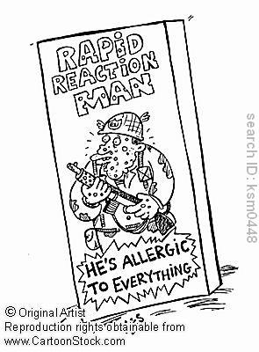

THANK YOU.
EFA
35 Rue du Congrès
000 Brussels, Belgium
www.efanet.org

