Slide 1




People want care.
Where it comes from is secondary
Breda Flood
EFA President
breda.flood@efanet.org
Athens, 24th May 2014

Slide 2
Disclosures for Breda Flood
In compliance with COI policy, IPCRG 2014 requires the following disclosures to the session audience:
Research Support/P.I. | No relevant conflicts of interest to declare
Employee | No relevant conflicts of interest to declare
Consultant | No relevant conflicts of interest to declare
Major Stockholder | No relevant conflicts of interest to declare
Speakers Bureau | No relevant conflicts of interest to declare
Honoraria | No relevant conflicts of interest to declare
Scientific Advisory Board | I have attended BI & Novartis patient advisory groups
Presentation includes discussion of the following off-label use of a drug or medical device: <N/A>

Slide 3
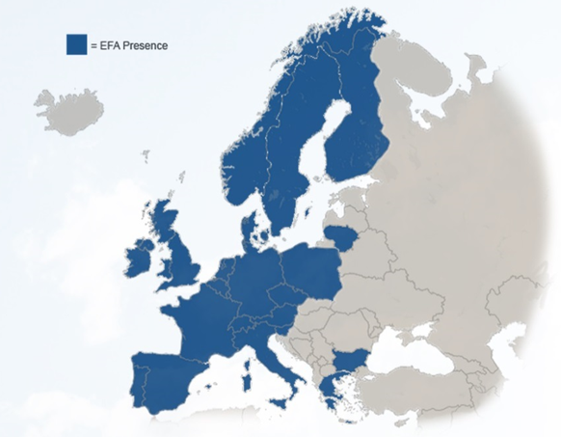
Who is EFA
The European Federation of Allergy and Airways Diseases Patients Associations (EFA) is a European network of 35 allergy, asthma and chronic obstructive pulmonary disease (COPD) patient organisations in 22 European countries, representing 400,000 patients in Europe
Founded in 1991, EFA unites patient associations at the European level and seeks to improve the health and quality of life for patients and their families by facilitating collaboration and sharing knowledge and experiences
EFA has its Central Office in Brussels, Belgium

Slide 4

EFA´s mission
EFA is dedicated to making Europe a place where people with allergy, asthma and COPD:
  have the right to the best quality of care and safe environment
  live uncompromised lives and
  are actively involved in all decisions influencing their health

Slide 5
Allergy, asthma and COPD patients
30 million of children and adults up to 45 years old have asthma
    and one third of the population will develop asthma before the age of 20 years
44 million people suffer from COPD in Europe,
    which is predicted to become the third cause of death worldwide by 2030
  113 million people suffer from allergic rhinitis and 68 million from allergic asthma in the European Union,
      1 in every 2 Europeans will suffer from allergy by 2015 and it is very likely to be under-diagnosed & undertreated
Patients are better educated and
seek high quality healthcare

Slide 6
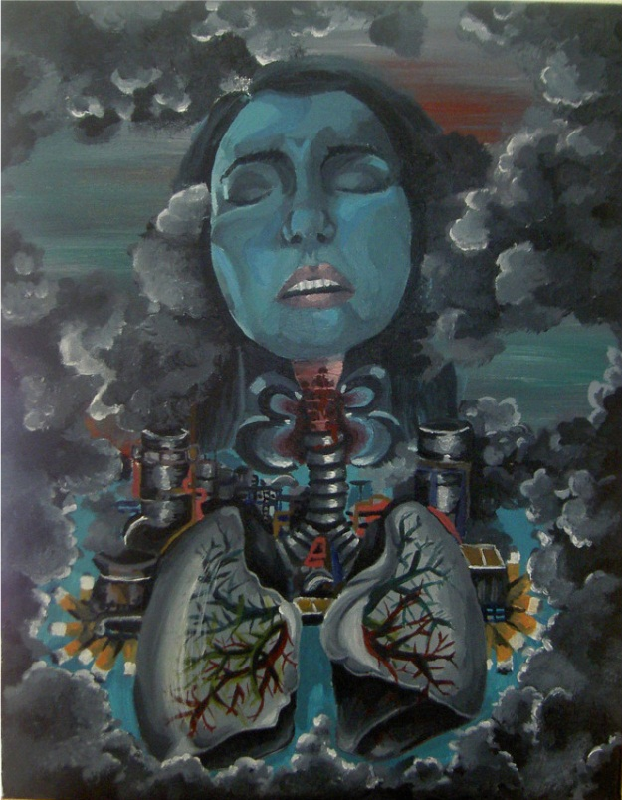
Patient’s daily life
“I have more than 10 different medicines for my asthma,
that I have to take
almost every day”
Marije Kootstra, 17 years old, Netherlands
Winner of the Art Contest 2011,
on what it is like to have asthma

Slide 7
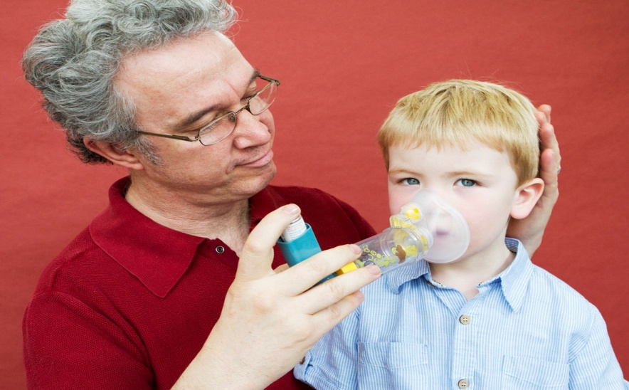
Patient’s position on primary care
Primary care is the key step for patients seeking help:
Acts as a first step towards a correct diagnosis, which is absolutely essential for proper treatment
A general practitioner is often located close to home and is aware of the patients’ and their families’ health problems
Source of credibility in the view of patients
Ideal to coordinate care when
several levels are involved
Key role of follow-up
appointments to ensure
patients’ conditions are
continuously monitored

Slide 8
Challenges for patients at primary care services
Limited number of primary specialists
Rigid healthcare system
Symptoms treated in isolation
Trivialization of disease
Improper diagnosis
Patients are more informed and educated today and have higher expectations for their doctor.
In a recent study on “Internet Access and use by COPD patients”, participants who used the Internet more frequently reported perceived needs, including:
dissatisfaction with their physician feeling that their doctor was not sympathetic, not a good listener more difficult to reach, difficult to make appointments with
their diagnosis was delayed
dissatisfaction with their treatment, and
Feeling that they were poorly treated by the healthcare system
Complex nature of disease comorbidities

Slide 9
What patients need from healthcare professionals
Patients need and want to be empowered through:
Early and correct diagnosis
Coordination and dialogue
Access to primary healthcare is quick and easy: to avoid worsening scenarios
Follow-up between healthcare primary and secondary professionals
Follow-up between the patient and their general practitioner
Treatment
Patients are involved on the decision-making on their condition: informed on treatment options, risks and benefits
Collaboration for health promotion and disease prevention through patient feedback by conducting surveys or use other data collection services
Consultations serve to get overall picture: doctors focused both on symptoms and quality of life
Self-care is encouraged by doctors
Monitoring during treatment with m-Health when possible

Slide 10
What does primary care need to better respond to patients’ expectations?
Fully embrace the patient centred approach: focus on the person, not the system
Establish a wellness service: provide guidance, monitoring and checking tools to enable the patient to control in partnership with the professional
Count on e-Health support: Citizens’ health literacy plays a significant role in health systems. Safe online health portals can educate patients before and after consultations. http://www.patient.co.uk/
Increase investigation at primary healthcare level to expand knowledge on allergy, asthma and COPD
  Develop organic healthcare systems to complement the work of primary care to assure they can effectively diagnose and treat patients
  Higher investment: more professionals informed, educated and trained at primary healthcare can deliver cost-effective outcomes
  Strengthen primary healthcare partnership with patients associations: first-hand neutral patient experience, patient’s preferences have potential to improve primary healthcare decisions

Slide 11

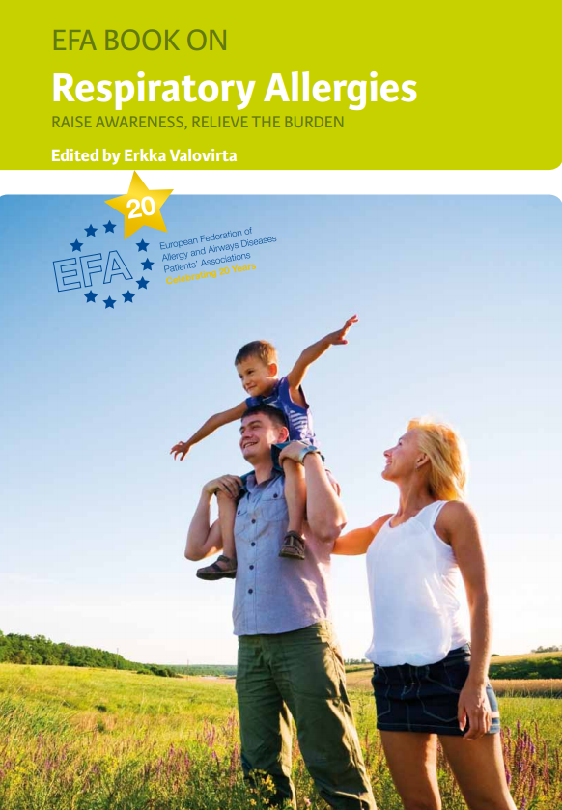
An exemplary approach involving primary healthcare
Finnish National Allergy Program 2008-2018
A comprehensive plan to reduce the burden of allergies and asthma, which aims:
  To increase immunological tolerance
  To change attitudes to support health instead of
  medicalizing common and mild allergy symptoms
  To use the resources for patients with more severe allergic diseases
  To support ALLERGY HEALTH
And involves all stakeholders
EFA Allergy Awareness Project, to build on Finland’s experience
Publication of EFA Book on Respiratory Allergies in Europe
Educational meeting in Helsinki to introduce the Finnish Allergy Programme to other EU countries and discuss future national allergy programmes
Pilot project for pharmacists in Austria – pharmacist role in allergic rhinitis

Slide 12

What does primary care need to better respond to patients’ expectations?
  “The good physician treats the disease;
  the great physician treats the patient who has the disease”
  “He who studies medicine without books sails an uncharted sea, but he who studies medicine without patients
  does not go to sea at all!”
  William Osler
  Canadian physician, 1849-1919

Slide 13
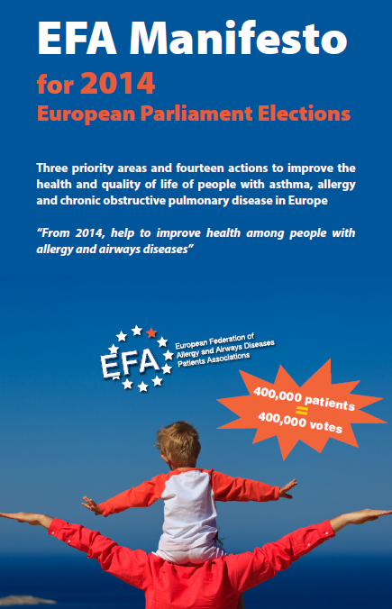
Thank you!
Sign our Manifesto:
manifesto.efanet.org
And follow us on:
Twitter: EFA_Patients
Facebook: EFA
European Federation of Allergy and Airways Diseases Patients' Associations (EFA)

