Slide 1

Airway Disease PRedicting Outcomes through Patient Specific Computational Modelling
Gaye Laverick and Chris Brightling
Participant and Coordinator
Leicester, UK
Notes:
Need to be able to highlight Cycle 1

Slide 2
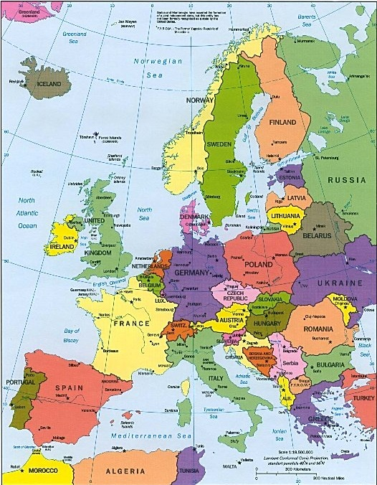
www.airprom.european-lung-foundation.org
Consortium Membership
11 EU countries
25 Academic partners
3 SMEs
3 Large industry partners
European Respiratory Society
2 patient organisations ELF, EFA
European Approach Essential
Breadth of expertise
Clinical validation
Exploitation
■
■
■
■
■
■
■
■
■
■
■
Notes:
Need to be able to highlight Cycle 1

Slide 3
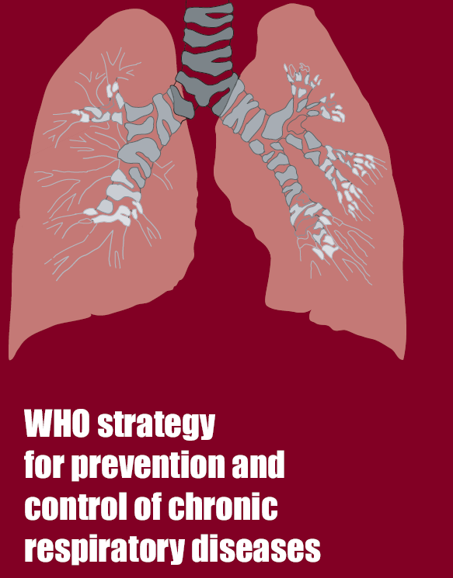

Airway Disease PRedicting Outcomes through Patient Specific Computational Modelling
AirPROM
Validated models to predict airways disease progression and response to treatment
Platform to translate patient-specific tools
Personalised management of airways disease.
Notes:
Abstract.
The airways diseases asthma and chronic obstructive pulmonary disease affect over 400 million people world-wide and cause considerable morbidity and mortality. Airways disease costs the European Union in excess of €56 billion per annum. Current therapies are inadequate and we do not have sufficient tools to predict disease progression or response to current or future therapies. Our consortium, Airway Disease PRedicting Outcomes through Patient Specific Computational Modelling (AirPROM), brings together the exisiting clinical consortia (EvA FP7, U-BIOPRED IMI and BTS Severe Asthma), and expertise in physiology, radiology, image analysis, bioengineering, data harmonization, data security and ethics, computational modeling and systems biology. We shall develop an integrated multi-scale model building upon existing models. This airway model will be comprised of an integrated ‘micro-scale’ and ‘macro-scale’ airway model informed and validated by ‘omic data and ex vivo models at the genome-transcriptome-cell-tissue scale and by CT and functional MRI imaging coupled to detailed physiology at the tissue-organ scale utilising Europe’s largest airway disease cohort. Validation will be undertaken cross-sectionally, following interventions and after longitudinal follow-up to incorporate both spatial and temporal dimensions. AirPROM has a comprehensive data management platform and a well-developed ethico-legal framework. Critically, AirPROM has an extensive exploitation plan, involving at its inception and throughout its evolution those that will ‘develop’ and ‘use’ the technologies emerging from this project. AirPROM therefore will bridge the critical gaps in our clinical management of airways disease, by providing validated models to predict disease progression and response to treatment and the platform to translate these patient-specific tools, so as to pave the way to improved, personalised management of airways disease.

Slide 4
Background
Diagnosed with asthma at age 38
Over the next 3-4 years had numerous admissions to hospital
2004 had first referral to Glenfield difficult asthma service in Leicester
Notes:
Need to be able to highlight Cycle 1

Slide 5
Asthma control improved till 2010
Admitted to Peterborough District Hospital with severe asthma attack which required admission to High Dependency Unit.
Following discharge was referred back to Glenfield Difficult asthma clinic.
At this point I started to consider becoming involved in research
Notes:
Need to be able to highlight Cycle 1

Slide 6
How Am I involved in the AIRPROM project
I have been involved in respiratory research studies since 2010
More recently these studies have been part of this project and included new drugs and observational studies
Notes:
Need to be able to highlight Cycle 1

Slide 7
Being involved in the research projects has meant that I have taken part in some new and novel measurements in the area of respiratory disease including :
~ Small airways testing
~ MRI Scan
~ CT scans
~ Thermoplasty
Notes:
Need to be able to highlight Cycle 1

Slide 8
What Capacity have patients been involved in AIRPROM
Patients are a main focus of research projects
With a hope to improve and tailor treatments better to individual patient needs
Notes:
Need to be able to highlight Cycle 1

Slide 9
Iterative Cycle 1
Iterative Cycle 2
Iterative Cycle 3
Integrated
Iterative Cycles
TEST
Multi-Scale Model
TEST
Multi-Scale Model
TEST
VALIDATE
Multi-Scale Model
VALIDATE
VALIDATE
Notes:
Need to be able to highlight Cycle 1

Slide 10
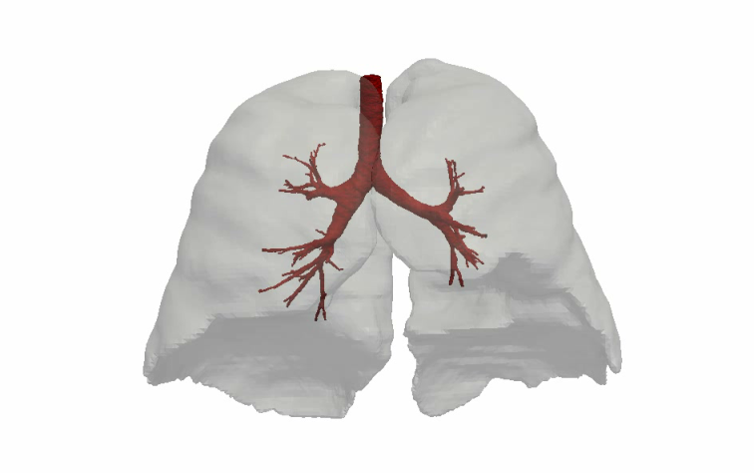
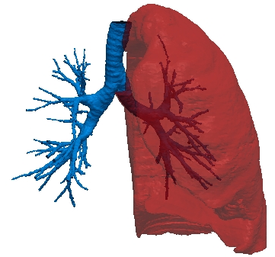
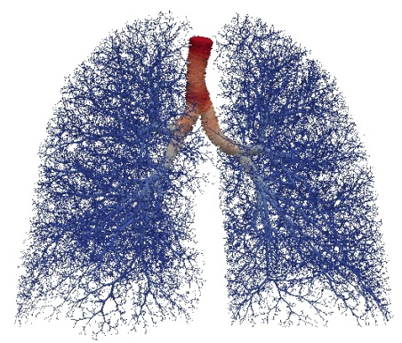
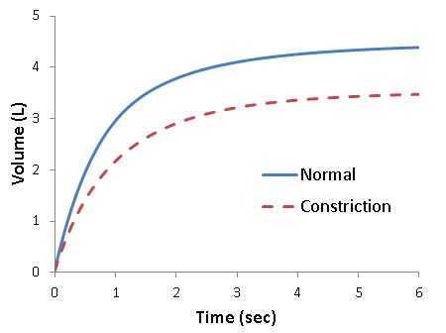
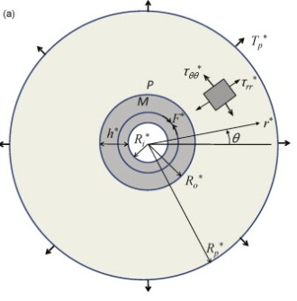
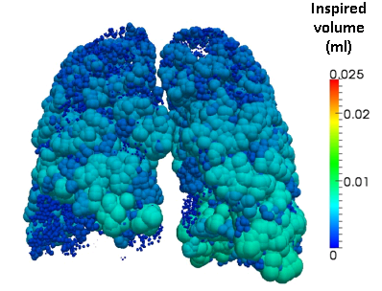
Multi-scale models within AirPROM
Major Airway & Lobar
Segmentations
(Materialise, FluidDa)
Airway Generation
Algorithm (Oxford)
Predictions of Clinical Measures
Multi-scale organ level
model
(Nottingham)
Functional Models
(Oxford)
Notes:
Need to be able to highlight Cycle 1

Slide 11
Why do I get Involved in Research
The opportunity to improve the care and treatments that people with respiratory conditions receive.
To raise my awareness and understanding of respiratory conditions
Being involved in research means you are monitored much more closely
Notes:
Need to be able to highlight Cycle 1

Slide 12
Staff have a better understanding of your condition – are therefore able to respond more appropriately.
Having the opportunity to try new treatments and be involved in studies of how we manage respiratory patients, means that my asthma is often better controlled.
Notes:
Need to be able to highlight Cycle 1

