Slide 1

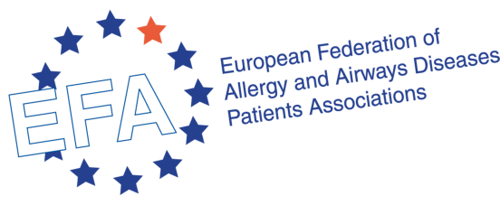

Allergen Labelling
Better labelling to empower people with food allergy in Europe
Roberta Savli, EU Policy Advisor, roberta.savli@efanet.org
European Federation of Allergy and Airways Diseases Patients’ Associations (EFA)

Slide 2

Who is EFA?
The European Federation of Allergy and Airways Diseases Patients’ Associations (EFA)
is an independent non-profit
European alliance of 38 allergy, asthma and
chronic obstructive pulmonary disease (COPD) patients’ associations representing 30% of European citizens currently
living with these diseases.

Slide 3
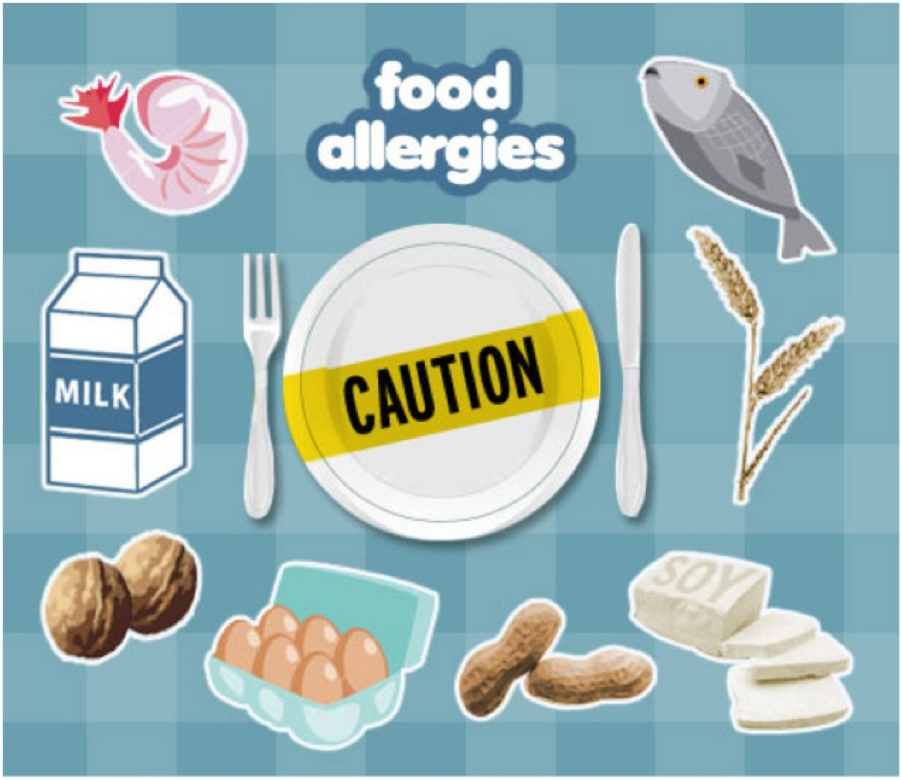
Food allergy across Europe
Up to 25% of European population reacts to food (allergy, hypersensitivity, intolerance)
About 17 million Europeans suffer from food allergies, with 3.5 million of them less than 25 years of age
Over the past ten years, the number of allergic children younger than 5 years has redoubled and the emergency room visits for anaphylactic reactions have increased seven-fold *
* Source: http://bit.ly/ZfKNi9 (accessed on 09 September 2014)
Notes:
Although it is difficult to get aggregated data (both at the European level and taking into account all 14 identified allergens), the European Academy of Allergy and Clinical Immunology (EAACI) has identified that there are about 17 million Europeans affected by food allergy.

Slide 4
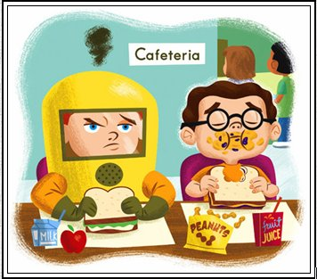
Importance of allergens’ information
Allergy is a “crazy” disease as the immune system of an allergic person fails to distinguish between dangerous substances and harmless ones
BUT
Allergies can make you crazy too! as they might result in poor nutrition and quality of life, fear, restrictions, social isolation, and sometimes even death (anaphylaxis)
No cure for food allergy
Protection = abstention
Consumers suffering from allergy or intolerance must therefore be able to identify the ingredients they are sensitive to
Notes:
Allergies may have several symptoms, ranging from gastro-intestinal problems, eczemas and urticarias to airway obstructions and cardiovascular shocks.

Slide 5
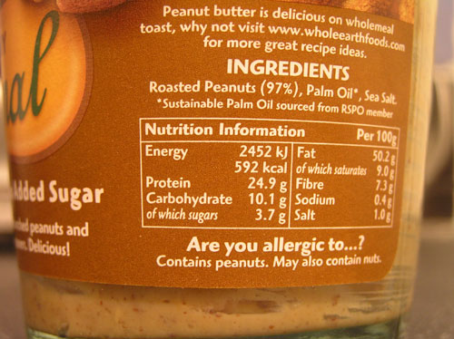
Main issues with food labelling
  Information simply not available or inaccurate
  Readability → too small font, poor contrast
  Cross-contamination, precautionary labelling → not trustworthy, no common practice, limitations to diet
  Changes in recipe and introduction of novel ingredients (lupine) → new allergies
  Complicated and processed food containing unnecessary ingredients
  Not in national language → complicating travelling
Regulation (EU) No 1169/2011 of the European Parliament and of the Council on the provision of food information to consumers, a positive step to improve health and quality of life of people with food allergy

Slide 6
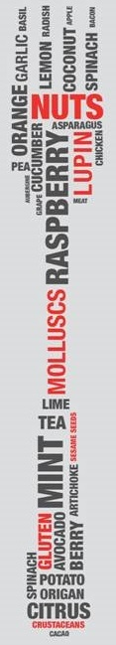
Allergens in pre-packed food
Mandatory indication of substances or products causing allergies or intolerances or derived from them (listed in annex II of new regulation)
Emphasising allergens within the ingredients’ list through a typeset that clearly distinguishes them from the rest of ingredients (novelty as of 13 December 2014)
EFA request: bolding allergens, the best way to highlight them and attract allergic consumers’ attention
Where no list of ingredients is required, label on the package with the wording “it contains” followed by the name of the allergen
EFA request: ingredients’ list always compulsory (irrespective of the size of the pack and both for pre-packed and non pre-packed food) as many people may be allergic to other substances than those listed in annex II
Labelling not required when the name of the food refers to the allergen
Information on allergens also in case of food distance selling before the purchase is concluded BUT
Notes:
The new regulation requests that the complete list of ingredients should be indicate, but there is an exception for packaging or containers whose surface is inferior to 10 cm2. In such cases, this list shall be provided through other means or made available at the request of the consumer.

Slide 7
List of allergens
The new regulation maintains the same list of allergens, which can now be updated by Commission’s delegated acts – novelty – (possibility for urgency procedure in cases of emerging risks to consumers’ health)
State of play: EFSA draft scientific opinion on the evaluation of allergenic foods and food ingredients for labelling purposes, results of public consultation to be published, final opinion expected by end of 2014
EFA request: review of the list of 14 existing allergens on the basis of the most recent scientific knowledge
Need for reviewing the prevalence of food allergy in Europe with the possibility of identifying “emerging” allergens
Avoid precautionary approaches for novel foods entering the market (e.g.: rapeseed protein and possible allergenicity for people allergic to mustard)
Threshold concentrations of each allergen in food providing an acceptable level of protection for consumers
Notes:
As far as the rapeseed protein is concerned, the European Commission has decided that rapeseed protein containing products are allowed on the market for human use. Although no specific risk of allergic reactions has been identified by EFSA, it was suggested that these products carry a special label saying that people allergic to mustard may have an allergic reaction to the rapeseed protein too. For us, this is limiting the choices of citizens as we can have cross-reactivity with several products and this can create a precedent. Either a substance is an allergen (and therefore listed in annex II of the new regulation, with the provisions this implies) or is not.

Slide 8

Pictograms
Implementing acts may be adopted by the Commission to express information by means of pictograms or symbols instead of words
EFA request: allergens need to be properly mentioned always with their names, but the addition of pictograms can be positive for people travelling across Europe, need to have a harmonised set of pictograms
Cereals containing gluten
Crustaceans
Eggs
Fish
Peanuts
Soybeans
Milk
Nuts
Celery
Mustard
Sesame seeds
Sulphur dioxide
Lupin
Molluscs
David, father of a severe allergic children:
“Whilst we are in our home country, food labelling is a daily activity to keep our son alive; but when we go overseas, things become a lot more difficult.”
Notes:
Recital 59 and article 9.3 of the new regulation may apply to allergens too, although it is made clear that these pictograms might only be added to the name of the allergen.
It is easier to find common and easily understandable pictograms for some allergens, but not for all.

Slide 9
Allergens in non pre-packed food
Member States can decide how the information on allergens should be made available to consumers and its form of expression and presentation for non pre-packed food (novelty as of 13 December 2014)
EFA request:
Written information is the most reliable means of ensuring the provision of detailed information and clear recommendations to the allergic consumer, unless it is possible to talk directly to the person that prepared the food
Sharing best practices among EU Member States’ legislations
Drafting and implementing EU-wide guidelines
7 out of 10 severe reactions happen when people eat out *
* Source: http://bit.ly/1qGwAoT (accessed on 11 September 2014)
Notes:
By setting mandatory requirements on allergens for non pre-packed food, article 44 of the regulation represents a crucial step forward. Indeed, evidence suggests that most food allergy incidents can be traced back to non pre-packed food.

Slide 10
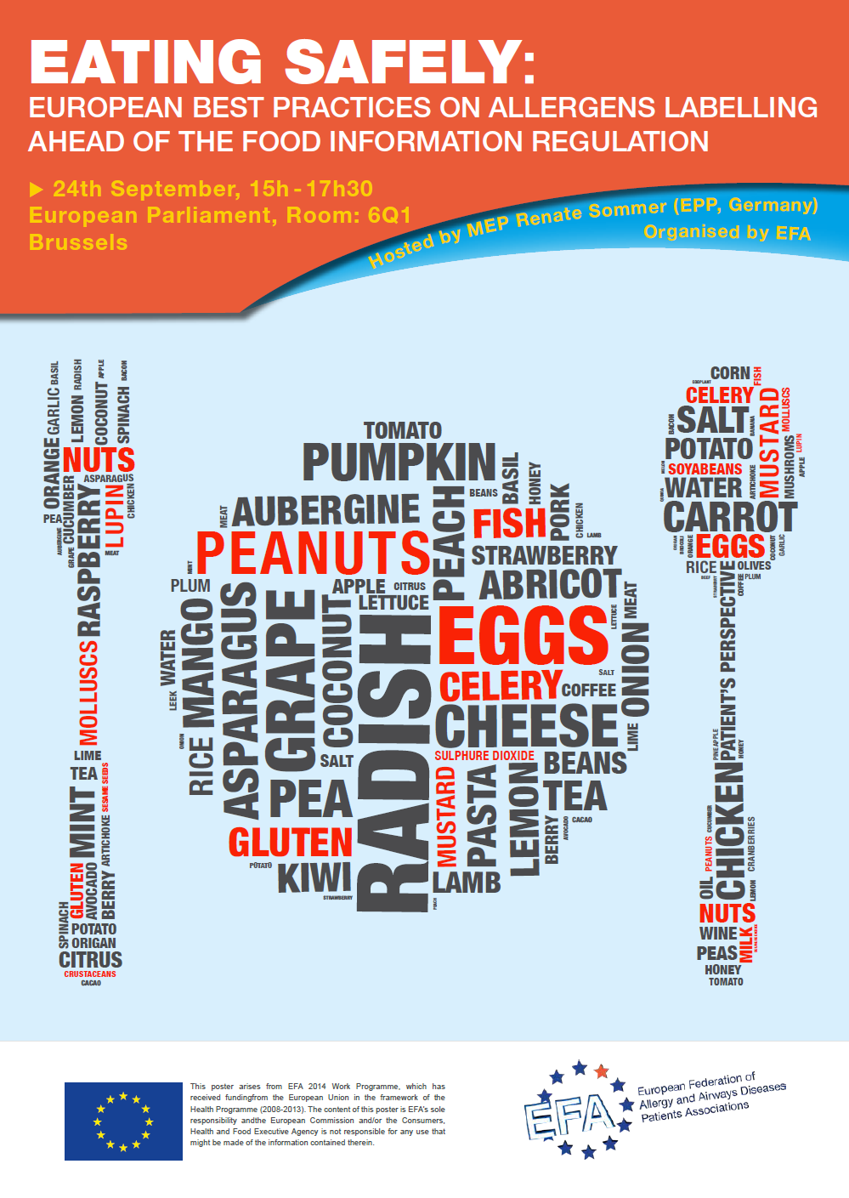
Eating safely – best practices presented at EFA’s event recommendations
Call on Member States to:
Regulate information on allergens for non pre-packed food in a written way – possible flexibility when direct contact with person that has prepared the food
Develop programmes on food allergen management for people working in the food service sector
Label consumption units in pre-packed food
Call on the Commission to:
Follow-up to this event and share Member States best practices
Drafting and implementing EU-wide guidelines

Slide 11
Precautionary labelling
Member States may provide voluntary information on the unintentional presence of allergens, the Commission is required to set harmonised rule on the use of this voluntary information (implementing acts with no deadline)
EFA request:
Long-term: abolishment (complete and accurate information, establishment of “safe thresholds”)
Short-term: possible to use only as ultimate solution after implementation of best-practices to avoid cross-contamination
  Allergen management as part of hygiene/safety manual
  Awareness and practical workplace training on food allergy for workers
  Responsibility of food business operators at each step of the distribution chain
  European guidelines on food allergen management
  * Source: Barnett J et al, Using “may contain” labelling to inform food choice: a qualitative study of nut allergic consumers, BMC Public Health 2011, 11, 734742
Serious reactions, and even deaths, have been caused by food with “may contain” labelling – 8% of people with accidental reactions may attribute it to having ignored a “precautionary labelling *
Notes:
Recital 24 of the regulation, although not legally binding, emphasises the importance for allergic people to receive all the information on the presence of food additives, processing aids and other substances or products with a scientifically proven allergenic or intolerance effect, and therefore recognises the need to regulate precautionary labelling.

Slide 12
Patients’ views on “may contain” labels
  It reduces the choices available to allergic consumers
    Regardless of the label: “may contain” labelling for nuts is included on the packaging of 26% of biscuits and 80% of chocolate
    Reference: Van Hengel AJ, Declaration of allergens on the label of food products purchased on the European market, Trends Food Sci Tech 2007, 18, 96-100
    Unnecessary restrictive diet: 90% of products with “precautionary labelling” do not contain residues of peanuts’ proteins or very small quantities unlikely to cause a clinical reaction
    Reference: Hefle SL et al, Consumer attitudes and risks associated with packaged foods having advisory labelling regarding the presence of peanuts, J Allergy Clin Immunol 2007, 120, 171-176
  It results in frustration and risk-taking behaviours, not depending on age, gender or the severity of the allergy
    Variety of the wording: 80% of parents with nuts allergic children would not let them eat products with “not suitable for” or “may contain” labelling, only 50% would do so with “cannot guarantee nut free” or “may contain traces of” labelling
    Distrustfulness of the message sources
    Implausibility of the labelling
    Previous experience and personal preferences
    Reference: Barnett J et al, Using “may contain” labelling to inform food choice: a qualitative study of nut allergic consumers, BMC Public Health 2011, 11, 734742
THEREFORE
Notes:
In a study from 10 European countries of over 500 types of biscuits and chocolate, “may contain” labelling for nuts is included on the packaging of 26% of biscuits and 80% of chocolate.
“May contain” labels are not taken into consideration by allergic consumers sometimes as food business operators are deemed to use them to discharge any possible liability in case of adverse reactions following the ingestion of their products.
Sometimes they are located on products that legitimately contain the allergen (e.g.: nuts in a packet of peanuts) or on others where it is considered impossible that they actually contain it (e.g.: nuts in a bottle of lemonade).

Slide 13
Patient-centred best practices
Switzerland: Federal law on labelling and advertisement of food products: applying to pre-packed food and non pre-packed products (non-bindingness of the written form)
Obligation to label allergens, even when they have been added involuntarily, upon specified levels
Under these thresholds, precautionary labelling is only authorised if the responsible food business operator can prove that cross-contamination cannot be avoided
United Kingdom: Voluntary Guidance on Allergen Management and Consumer Information – Food Standards Agency
Assess risk from both intentional and unintentional presence of an allergen
Check if the potential allergen is in the ingredient list or is exempt from mandatory labelling
Identify the risk and the possibility to manage it
Communicate the risk through precautionary labelling only if it cannot be managed
Sweden: Voluntary Swedish Food Sector Guidelines for management and labelling of food products with reference to allergy and intolerance – Swedish Food Retailers Federation and Swedish Food Federation
“May contain” labelling as a last resort when the risk of cross-contamination is:
Uncontrollable: the ability to ensure the entire process is considered impossible
Sporadic: the allergen is detected sporadically after product changes
Documented through cleaning controls, test results, or substantiated consumer reaction
Notes:
As regards the best practices collected by EFA, Switzerland is the only European country where legally binding measures apply. The Federal law on labelling and advertisement of food products concerns both pre-packed (article 8) and non pre-packed products (article 36) and obliges to label allergens upon certain levels, even when they have been added involuntarily.
In other European countries, voluntary measures are recommended by Government bodies. This is the case of the United Kingdom, where in July 2006 best practice advises were drafted to help food producers and retailers assess the risks of cross-contamination of a food product with an allergen and to determine whether or not an advisory labelling is appropriate.
The same approach has been followed by France (How to better identify and meet the needs of people intolerant or allergic to certain foods? – National Council of Alimentation, March 2011) and Ireland (Guide to Food Safety Training – Food Safety Authority of Ireland, 2009), respective with the final objective of abolishing precautionary labelling for pre-packed food and establishing thresholds and introducing Hazard Analysis and Critical Control Point (HACCP) systems, food safety/hygiene trainings, allergen management to avoid cross-contamination.
Measures to avoid cross-contamination (HACCP plans, training, recipe changes, receiving, storage and weighing of raw materials, production, premises and equipment, cleaning and controls) and advises to use precautionary labelling were drafted in April 2005 by several Swedish food industry associations.
The same documents were developed in other European countries, such as Italy (Italian Food Sector Guidelines on the Labelling of Allergens – FEDERALIMENTARE, November 2009), The Netherlands (Guidelines on Additional Labelling Regarding the Potential Presence of Allergens Due to Cross-contamination – Dutch Food Industry Federation, 2005) and Finland (Labelling warnings of allergen in foodstuff due to cross contamination – Finnish Food and Drink Industries, December 2005).

Slide 14

Key points for improvement
Readability
Information on allergens should be provided in a font size equal to or greater than 1,2 mm; whereas in case of small packaging or containers (surface area
less than 80 cm²), the minimum font size is reduced to 0,9 mm
EFA request: minimum 3 mm font size to guarantee clear legibility and safe choices, need to develop a comprehensive approach to take into account all aspects related to legibility, including font, colour and contrast
Changes of recipe
Nothing is mentioned regarding labelling allergen changes/additions in products
EFA request: if there is a change in a recipe that contains allergens, this should be clearly mentioned in the package or label as, even though the allergens are always labelled, the consumers may feel safe due to the previous consumption of the product and not check properly the list of ingredients
Djoeke, mother of a severe allergic children:
“Reading labels should be peanut – and it is not!”
Notes:
Although the new regulation improves food allergens labelling in Europe, there are still some aspects that should be enhanced in future revisions of this legislation.
As far as the legibility is concerned, EFA encourages the Commission to develop a comprehensive approach (as suggested by recital 26 of the regulation) with the final objective of increasing the minimum font size to help allergic consumers make safe choices.

Slide 15



Thank you for your attention!
European Federation of Allergy and Airways Diseases Patients' Associations (EFA)
https://www.facebook.com/EFAPatients https://twitter.com/EFA_Patients
35 Rue du Congrès
1000 Brussels, Belgium
www.efanet.org

