Slide 1
Minimum Standards of Care EFA European Survey I COPD Global Patient Leadership Summit
Madrid 5 – 7 November 2014
Isabel Saraiva
EFA Board Member

Slide 2
About EFA
Founded 1991
Brussels’ office since 2002
Allergy, Asthma, COPD (since 2003)
38 associations, 24 countries, 500.000 patients/carers
EFA role versus role of national members
Uniting at the EU level
Collaboration
Sharing knowledge & best practices
Capacity building
Tools/Facilitation for policy change
Funding 2014: EC operational grant for core activities (60%), industry 10 companies, membership fees (4%), EC project grants

Slide 3
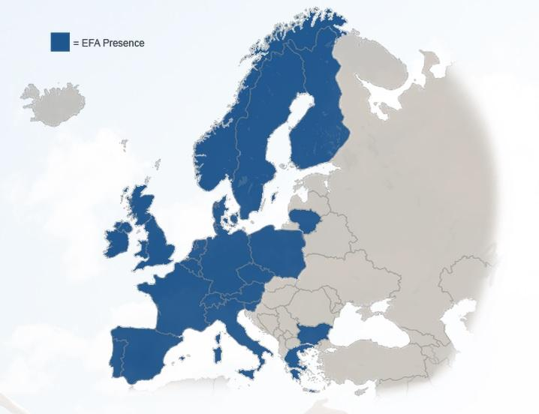
EFA’s Members
24 countries
38 member organisations representing over 500,000 patients & carers

Slide 4
Vision & Mission
EFA is dedicated to making Europe a place where
people with allergy, asthma and COPD:
Have the right to the best quality of care and safe environment
Live uncompromised lives
Are actively involved in all decisions influencing their health
EFA aims to be a powerful European network:
Advocates at EU level for the needs of people with allergies, asthma and COPD
Values all members equally
Implements best practices
Creates patient-driven projects
Cooperates with healthcare professionals, scientists, other NGOs

Slide 5
Advocacy: Role of Patient Organizations
Listen, collect & summarise patient voices, experience, needs and expertise.
Represent these to healthcare professionals & policy makers – anyone having impact in care/prevention
Facilitate patient participation
Facilitate communication, partnership, collaboration and greater understanding between them
Take advantage of unique position of patient organisations: neutral, non profit-seeking, patient at the core – ideally placed to influence
ENSURE PATIENT VOICE IS HEARD in
Research
Policy
Funding and Public Arena

Slide 6
Work Programme
ACCESS TO CARE – PARTICIPATION – SAFE ENVIRONMENT
EFA PROJECTS
- COPD Minimum Standards of Care
- Respiratory Allergy Awareness
- Asthma Health Literacy Youngsters
- Capacity building
EC PARTNERSHIP PROJECTS
- FP7 MEDALL, AirPROM, EARIP
- IMI U-BIOPRED
CORE PROGRAMME
PROJECT PROGRAMME
ALL CORE ACTIVITIES
Advocacy: EFA Manifesto,
EU chronic diseases agenda
Medical devices
Medicines: EMA PCWP
Pharmacovigilance
E-Health
Tobacco
Air pollution
Chemicals
Advocacy training
PATIENT
PERSPECTIVE
COLLABORATION - PARTNERSHIPS
PATIENT PARTICIPATION ↔ PATIENT PERSPECTIVE - EVIDENCE FOR POLICY

Slide 7
EFA’s Book
Minimum Standards of Care in Europe
“By addressing the existing care for COPD patients we hope to reveal the best practices which can help identify ways to lower costs and move healthcare systems towards greater sustainability”
Breda Flood EFA President - Foreword

Slide 8
Methodology
EFA’s Questionnaire was disseminated to its members representing COPD
Answers from 16 countries were collected and analysed comparing results across the European countries surveyed
The queries focused upon 5 main areas of care:
Prevention
Diagnosis
Management & Therapy
Rehabilitation
Alpha-1 Patient Care

Slide 9
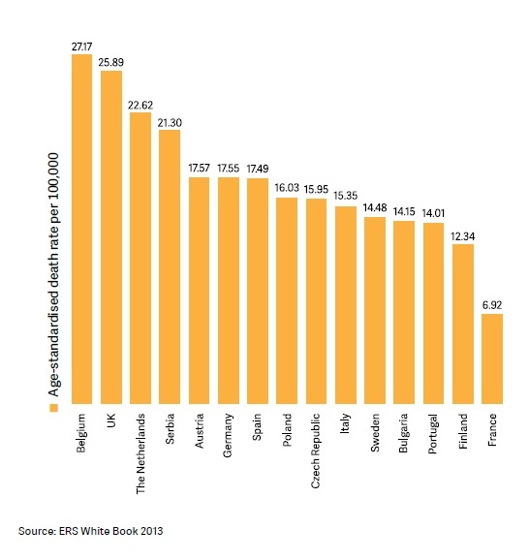
Yearly Mortality for COPD

Slide 10
Economic Burden and Prevalence
The Economic Burden of COPD is increasing
Direct costs to COPD Patients rang from € 1,200 to € 5,000 per year.
Confirmed national prevalence ranges from as low as 4,4 % (FR) to as high as 14,2 % (BE)
“COPD results in significant indirect costs in terms of impaired productivity and lost productivity due to early retirement in the working age population”
Baldwin M, Williams P, Fletcher M, et al.A novel method to estimate the economic impact of COPD in Patients of working age.COPD7,2010:Poster number 8

Slide 11
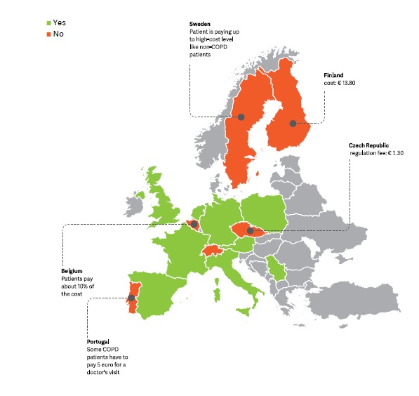
What is the cost for a doctor visit for COPD Patients?

Slide 12
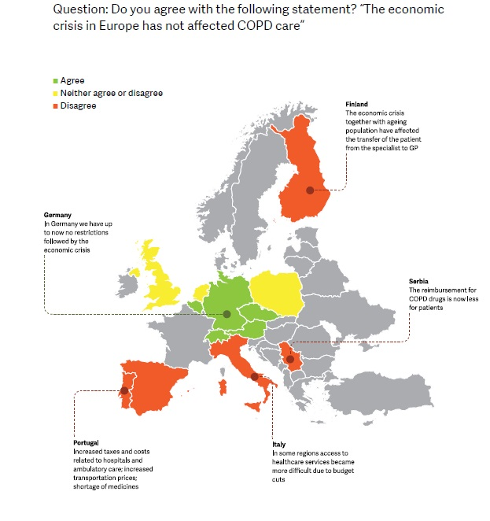
The effects of economic crisis on COPD care

Slide 13
Key Areas
PREVENTION
DIAGNOSIS
MANAGEMENT and THERAPY
REHABILITATION

Slide 14
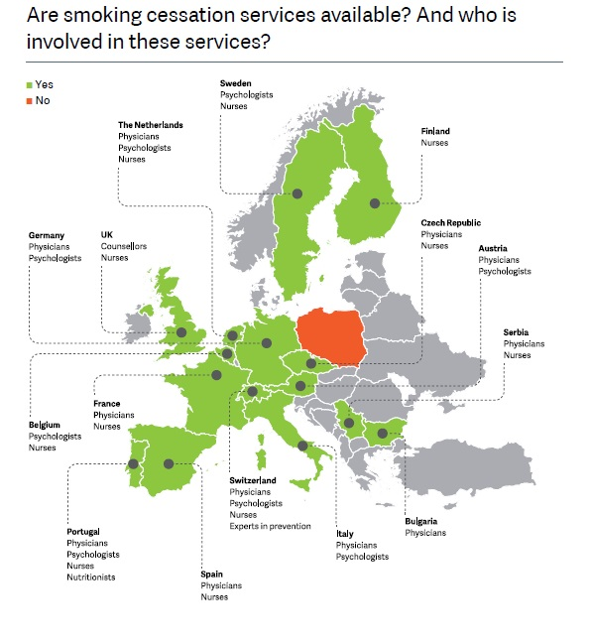
PREVENTION
Keep healthy people from becoming COPD Patients
Helping COPD Patients to reduce the disease progression

Slide 15
Prevention
Strict implementation of EU Tobacco Products Directive
Availability and reimbursement smoking cessation
Participation of Patient Organisations

Slide 16
Diagnosis
Spirometry tests
Role of GP’s
Coodination GP’s and specialists
“The importance of using spirometry as a tool for the prevention of COPD remains underappreciated across european countries”
Minimum Standards of Care

Slide 17
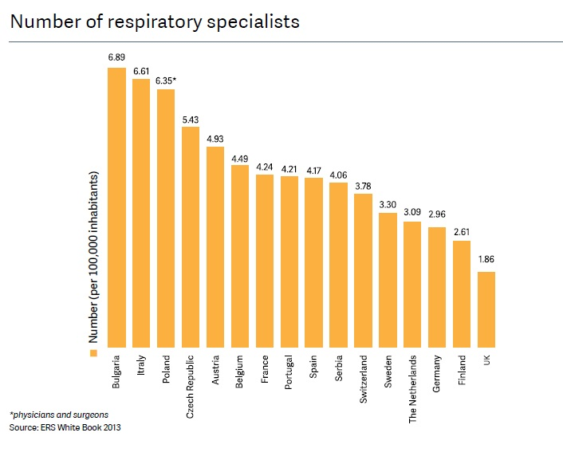
Management and Therapy

Slide 18
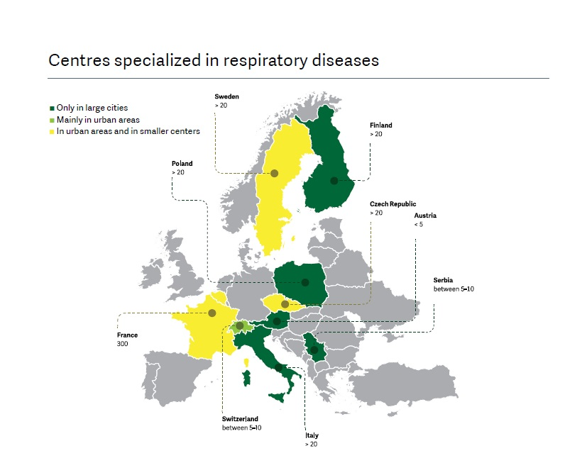
Management and Therapy

Slide 19
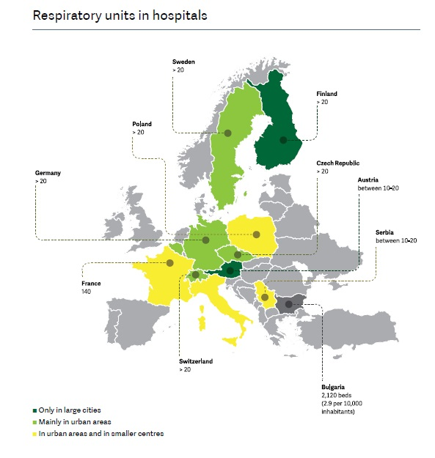
Management and Therapy

Slide 20
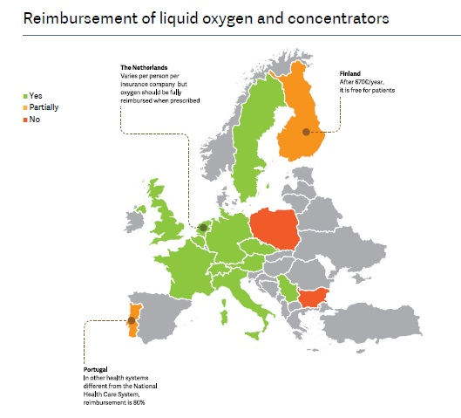
Management and Therapy

Slide 21
Management and Therapy
Cooperation between all healthcare profissional
Harmonisation of reimbursement and access to oxygen therapy
Creation of stronger links between pulmonar and resuscitation units

Slide 22
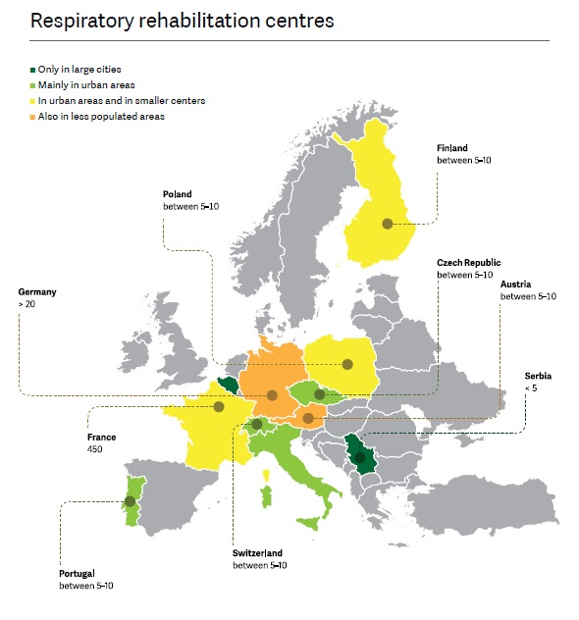
Rehabilitation

Slide 23
Rehabilitation
Pulmonary Rehabilitation should be available to all COPD patients who need such services
Centers of Pulmonary rehabilitation should be increased
Pulmonary Rehabilitation should be provided as soon as possible to COPD patients discharged from hospitals
Multidisciplinary approach
Encourage COPD patients to be actively engage in rehabilitation

Slide 24
The Special case of Alpha-1 Patients
“…genetic disorder which is defined by low levels of Alpha-1-antitrypsin protein in the blood steam”
There is low public awareness and knowledge on Alpha-1 and on such patients needs
Diagnosis of Alpha-1 deficiency in early life is important to prevent unnecessary quality of life loss
Notes:
*

Slide 25
Minimum Standards of Care for Alpha1 Patients
Alpha-1 Antitrypssin Deficiency testing should be available for infants and pregnant women at risk
Augmentation therapy should be available in all European countries with the possibility of reimbursement

Slide 26
Minimum Standards of Care
What We Want?

Slide 27
Minimum Standards of Care
Early Diagnosis Spirometry Testing
Training of GP’s
Coordination between primary care, specialists, hospitals
Smoking Cessation Services
Increase the number of centres for COPD care and rehabilitation

Slide 28
Minimum Standards of Care
Promotion of multidisciplinary approach for COPD rehabilitation
Participation of COPD patients
Testing for Alpha- 1 Antitrypsin deficiency

Slide 29
Minimum Standards of Care
What next?

Slide 30
Thank you for your attention!
European Federation of Allergy and Airways Diseases Patients' Associations (EFA)
EFA 35 Rue du Congrès
1000 Brussels, Belgium
www.efanet.org

