Slide 1



Benefits of a strong collaboration with patient groups at national and EU level
Susanna Palkonen, Director
susanna.palkonen@efanet.org
European Federation of Allergy and Airways Diseases Patients’ Associations (EFA)

Slide 2
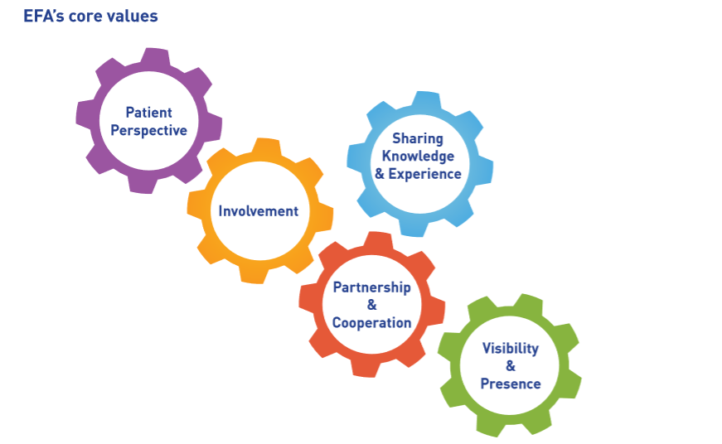
Who is EFA?
The European Federation of Allergy and Airways Diseases Patients’ Associations (EFA)
is an independent non-profit
European alliance of 38 allergy, asthma and
chronic obstructive pulmonary disease (COPD) patients’ associations representing 30% of European citizens currently
living with these diseases.

Slide 3
Background on pharmacovigilance
In the EU:
Adverse drug reactions (ADRs) cause around 197,000 deaths per year
5% of hospital admissions are caused by side effects
Side effects are the 5th cause of hospital deaths
→ BUT only 10–25% of ADRs are reported
THEREFORE
In 2005, the European Commission began a review of the European system of safety monitoring that resulted in the new pharmacovigilance legislation entering into force in July 2012
Aim is to reduce the number of ADRs in the EU through:
The collection of better data on medicines and their safety
Rapid and robust assessment of issues related to the safety of medicines
Effective regulatory action to deliver safe and effective use of medicines
Empowerment of patients through reporting and participation
Increased levels of transparency and better communication

Slide 4

Implementation of the pharmacovigilance legislation
EC report on the 1st year of implementation, May 2014:
Approximately 60% increase of spontaneous ADRs reports by patients in the EEA -> 25,000 compared to 15,000 year before
Product information changes as a consequence of assessment of signals of new or changing safety issues with certain medicines
Initiation of major public-health reviews
Training thousands of individuals in pharmacovigilance
Eudravigilance expansion and access

Slide 5
Patient’s Safety Balance
BENEFIT-RISK PERCEPTION
SEVERITY - HEALTH STATUS - CO-MORBIDITIES – PAST EXPERIENCES – VALUES – HEALTH LITERACY
OPTIONS - LIFE & WORK SITUATION - ENVIRONMENT – LIVING CONDITIONS - FAMILY/FRIENDS - SUPPORT
PREFERENCES - MOMEMENT IN TIME – FUTURE ASPIRE
BENEFIT
RISK/ADR
PHARMACOVIGILANCE FOR ALL

Slide 6
Patient’s Safety Balance
BENEFIT-RISK PERCEPTION
SEVERITY - HEALTH STATUS - CO-MORBIDITIES – PAST EXPERIENCES – VALUES – HEALTH LITERACY
OPTIONS - LIFE & WORK SITUATION - ENVIRONMENT – LIVING CONDITIONS - FAMILY/FRIENDS - SUPPORT
PREFERENCES - MOMEMENT IN TIME – FUTURE ASPIRE
BENEFIT
Quality of Life
RISK/ADR
PHARMACOVIGILANCE FOR ALL

Slide 7
Pharmacovigilance Patient/Public
Involvement EMA approach
Patient involvement throughout the benefit-risk process, before & after
  including scientific advice post marketing authorisation, parallel advice, risk management, communication…)
  CHMP, PRAC and their committees
Patient involvement in all roles: part of the decision making process, advice, review
Individuals / Organisations
Pharma approach? Variable & but evolving

Slide 8
GVP module XI on public
participation in pharmacovigilance
16 modules of good pharmacovigilance practices (GVP) to facilitate the performance of pharmacovigilance in the EU
Module XI on public participation is under development, expected for 8 week public consultation in June 2015 (planned Q4 2014)
Need to have the public involved to ensure full compliance of the legislation
Focus on public participation with public bodies
Two levels: individual patients & adrs & organisational stakeholder involvement in monitoring, evaluation..
Linked to the rules of procedure for public hearings (draft)

Slide 9
GVP module XI on public
participation in pharmacovigilance
In defining the way reports can be made by the public → for patients by patients, corresponding to users’ needs
In promoting the possibility of direct reporting system + explaining the “black triangle” symbol - patient organisations in particular
In identifying access policy to Eudravigilance → what should be known to the general public and what is too much/confusing?
In supervising the safety of medicines by participating in Pharmacovigilance Risk Assessment Committee (PRAC) → patients have their view on when benefits outweigh risks and vice-versa

Slide 10
GVP module XI on public participation in pharmacovigilance
Pharma’s patient
Involvement??

Slide 11

Public participation: benefits?
Transparency
Trust & confidence
Engagement
Patient- centeredness
Shared learning real world
Intelligence: medicines development, new indications
Avoid scandals & sad stories
Improve acceptance
Share responsibility

Slide 12
Value of patients’ feedback
Patients know best – unique perspective, expertise and diverse experiences of patients
Experiential knowledge complements scientific knowledge
Health professionals under-report
Patients may prefer not to report ADRs to their doctor
-> detected earlier
-> different ADRs reported by patients,
-> better understanding of impact of ADRs,
-> better knowledge on the medicines
Patients’ feedback paramount for industry and necessary to refine industry’s strategy development and risk management plans

Slide 13
Personnel to manage corporate-patients relations
Better and strong relationships between the company and the patients’ group that will foster mutual respect and improve the cooperation
Long term partnership/relationship – understanding and evolving value of patient perspective
Connect values & real patients
Better understanding of patients’ needs embedded in company culture
Having such personnel may result in increased training for patients’ group that will increase patients’ literacy and reduce side effects
Save money, time, effort
Mutual respect – appreciated dialogue

Slide 14
Mutual benefits of pharma-patient groups alliance in safety
Basic principles:
Taking patients into account when making decisions that impact their lives
Ensuring patients’ involvement is transparent and based on mutual trust and independence of both parties
May result in :
Increased patients’ literacy and ultimately safety as unmet needs are better identified, as well as development of better products
Patients taking an active role in all stages of the product development and reimbursement process
Good practise

Slide 15



Thank you!
European Federation of Allergy and Airways Diseases Patients' Associations (EFA)
https://www.facebook.com/EFAPatients
https://twitter.com/EFA_Patients
35 Rue du Congrès
1000 Brussels, Belgium
www.efanet.org

