Slide 1
EFA and Educator Activities from patients
Susanna Palkonen
Susanna.palkonen@efanet.org
New website! www.efanet.org

Slide 2
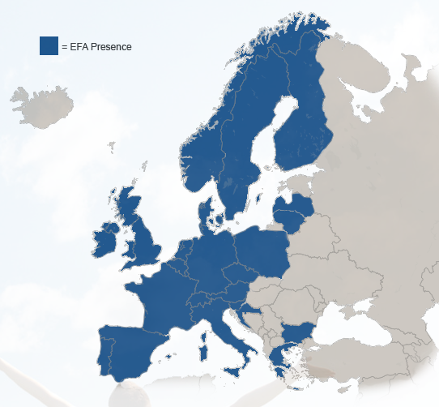
Members
40 allergy, asthma and COPD patient organisations
in 24 European countries
Representing 500,000 patients in Europe
EFA has its central office in Brussels, Belgium

Slide 3

Values
Advocates at EU level for the needs of people with allergies, asthma and COPD –
Values all members equally - Implements best practices - Creates patient-
driven projects - Cooperates with healthcare professionals, scientists, other NGOs

Slide 4

EFA 2015-2020
Healthier ENVIRONMENT
Quality of CARE
Patient
PARTICIPATION
INEQUALITIES
Europe where people with allergy, asthma and COPD:
Have the right to the best quality of care and safe environment
Live uncompromised lives
Are actively involved in all decisions influencing their health
HEALTH IN ALL POLICIES

Slide 5
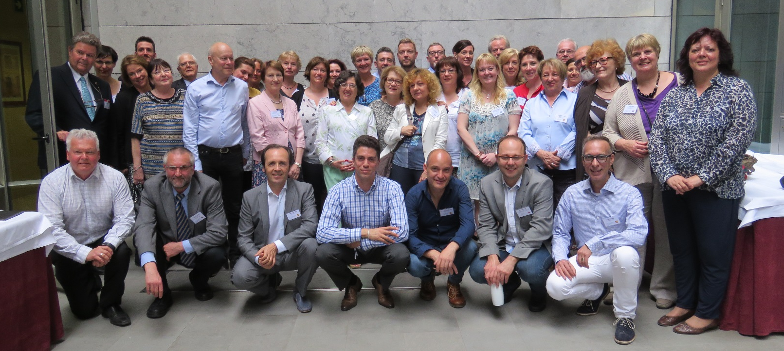


EFA and its Members
EFA Family, AGM 2015, Spain
  Uniting patient groups at the EU level
  Collaboration
  Sharing knowledge & best practices
  Capacity building
  Tools/Facilitation for policy change

Slide 6
EFA in Education
Develop our own projects to meet member organisations’ needs
Provide access to information, educational tools and opportunities for project involvement in patient-friendly language
Ensure active involvement of patients in all decisions regarding their health
Represent and act as liaison between people with allergy, asthma and COPD and EU policy-makers
Develop and promote long term partnerships with other NGOs and industry
Strengthen patient role in EU research by facilitating meaningful patient contribution and communicating EU projects results

Slide 7
EFA’s Educational Activities
Care: Multiannual Patient led Projects
1 | Allergy Awareness Project: support national level advocacy campaigns
2 | Asthma Health Literacy Project for Adolescents with Asthma: increase knowledge of adolescents with asthma to improve their treatment
3 | COPD Project: new approach to work with payers
4 | Oxygen Harmonization Project: Informative leaflet for patients and booklet
Equality: Capacity Building Programme
1 | Training on EMA functioning
2 | Meet and Greet the EU Institutions Training
3 | EFA Patient Education Working Group
4 | EFA Member Capacity Building Project: to strengthen capacity & skills

Slide 8

Access to care: Asthma Adolescents project
Objective: identify the REAL reasons for poor adherence of adolescents 12-17 years to asthma treatments – go young asthma
  Identify real reasons for poor adherence
  Validate an adolescent patient-centred survey in four European countries, with Maastricht University
  Recommendations for adherence education of youngsters with asthma
NO data from this group themselves!

Slide 9

Access to care: Allergy Awareness project
Objectives: raising awareness on respiratory allergies; increase the ability to identify early symptoms and to provide early diagnosis –based on the EFA Book on Respiratory Allergy
Advocacy tools for distribution among national decision makers
    Allergy Alert paper (lay version) – Education in Allergology is urgent! with ARIA, EAACI, UEMS, IPCRG
    Letter to national ministries & members
    Available Bulgarian, Dutch, French, German, Italian, Norwegian and Spanish

Slide 10

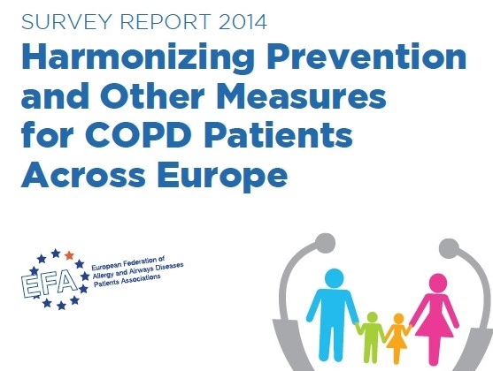
Access to care: COPD Project
Objective: promote increasing cooperation between primary and secondary care for COPD patients in Europe for early diagnosis and treatment
  EFA Minimum Standards of Care book & Survey report on the differences between 18 EU countries in:
  Involving national payers” to support
  EFA members for EU wide harmonisation of:
    Rehabilitation (incl. Smoking cessation)
    Coordinated multidisciplinary approach HCPs
    Spirometry in health checks (by GPs)

Slide 11
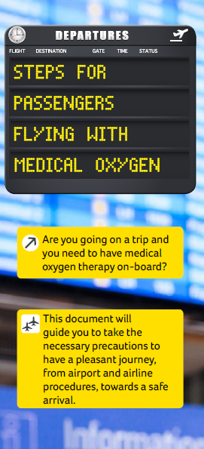
Access to care: Oxygen without Borders
Objective: delete the discriminatory barriers for passengers who require oxygen when traveling
  Guidance for patients for travel – coming soon people air
  Enabling Air Travel with Oxygen booklet
  (2013) on european airlines’ oxygen policies.
  e-publication of updated booklet on EFA Website (Fall of 2015) with ACI Europe
  Inclusion of Medical Oxygen and Oxygen equipment during Air Travel in training module for airline and airport staff.

Slide 12
Patient Capacity: Growing patient groups
Strengthen EFA Members’ capacity & skills at national level
3 Capacity Building Meetings (annually) on:
  Project management
    Run own projects (with national stakeholders)
    Contribute to EFA projects
  Cooperation with national stakeholders (HCPs, policymakers..)
  Identification of pathways for growth
  Participants selected in 2015 – 3 new countries
Follow-up with previous member participants
  Self-evaluate progress (what has been changed / optimised)
  Discuss area where further improvement is needed

Slide 13
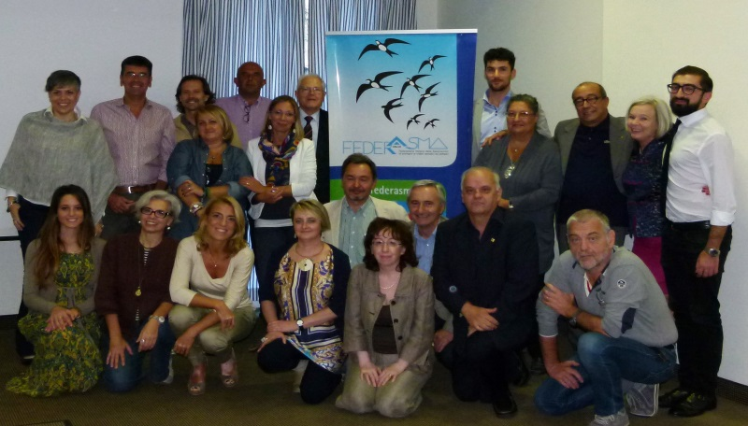


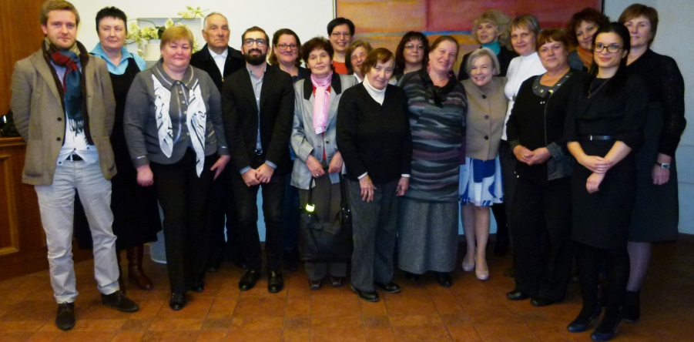
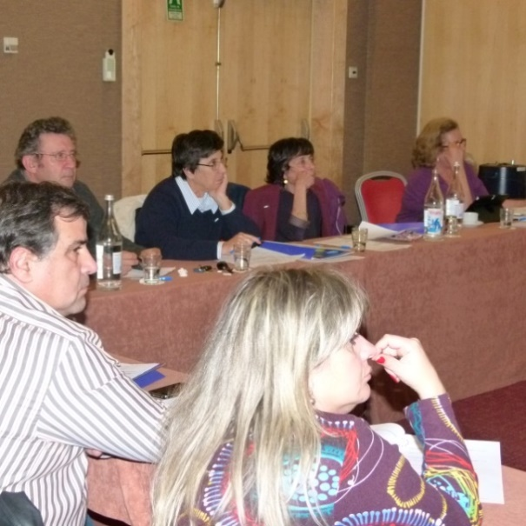

2014 Capacity Building Meetings
Florence, ITALY –
4th and 5th October
Vilnius,
LITHUANIA
– 18th October
Lisbon, PORTUGAL
– 15th November

Slide 14
Patient Capacity: Growing patient groups
46 patient leaders from 3 EFA member associations
Needs identified:
Limited funds
Limited availability
Knowledge in advocacy
Involvement in projects
Long-term strategy
Mission and vision
External collaborations
Communication strategy
Project Strengths:
Content relevant to the organization
Content useful to daily work
Feeling of empowerment
Logistics and organization
Overall satisfaction request for more training
Learnings for EFA: key role of moderator; approach to discussion; project work; questionnaire prior to meetings

Slide 15
Patient Capacity: Working with regulators/EU
First EFA “EMA Training” (2014) to support members’ involvement with European Medicines Agency
  EMA functioning
  Opportunities for patients to be involved throughout process of medicine development
  Sharing of best practices (EMA Patient experts & EMA secretariat)
Meet & Greet the EU Institutions Training (annually)
  Composition, power and functioning of EU institutions
  Main developments in EU Health Policy
  National level advocacy initiatives

Slide 16
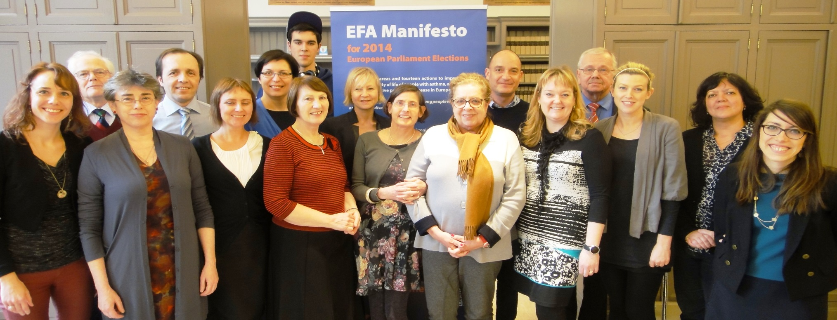
Patient Capacity: EMA Training 2014
1st training for EFA patients on getting involved with the European Medicines Agency (EMA)
Strengthen patient expertise at the EMA on allergy, asthma, COPD
  SAGs, CHMP, review PILs, EPARs & safety communication
Participants: 15 patient experts from 10 EFA member associations

Slide 17

Patient Capacity: EMA Training 2014
Evaluation:
High satisfaction with overall content, relevance and format of training
Need for more discussions, presentations, case studies, networking
Topics for future trainings:
Adherence
Health literacy
Pricing and reimbursement

Slide 18
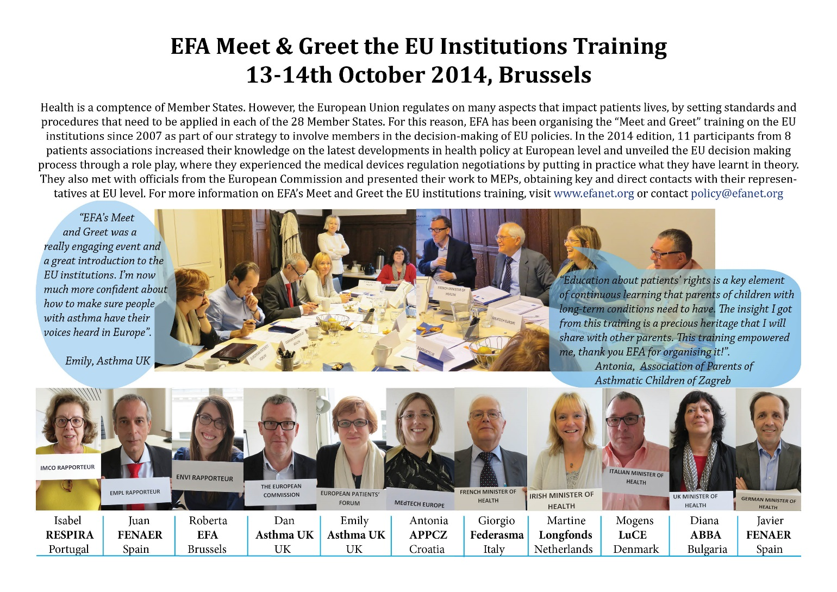

Slide 19

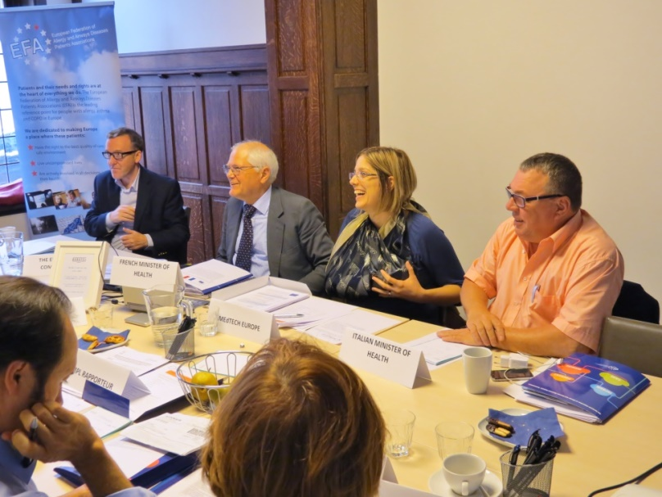
Patient Capacity: Meet & Greet the EU 2014
Evaluation:
Useful and relevant overall content, presentations, format of the meeting
Satisfaction with number of discussions, presentations, visits to institutions
Request for more meetings with MEPs and networking opportunities
Click for Report
Suggestions for the future meetings:
Tour to EU institutions
More information on the EU Council
Funding opportunities

Slide 20
Patient Capacity: Patient Education
First EFA Patient Education Working Group (2015)
Collection & repository of existing patient education resources and best practices of self-management
Development of a questionnaire for patients on patient education experiences
EFA Patient education/empowerment guidelines????

Slide 21

Patients at risk: Tobacco Advocacy
Stricter EU tobacco products directive + support Asthma Society of Ireland activities on plain packaging
Patients’ perspective at European and World Conferences on Tobacco or Health and in the World Tobacco Atlas http://www.tobaccoatlas.org/
EFA-ENSP guide on implementation of new EU rules on electronic cigarettes + support patients’ involvement in the implementation of the EU tobacco products directive
Contribute to the supervision of the implementation of the FCTC from patients’ perspective
Encourage EU legislative developments in tobacco control (smoke-free workplaces, increased taxation and stricter advertisement)
Press releases for World No Tobacco Day 2015

Slide 22


Patients at risk: Air quality Advocacy
EFA working group on environmental determinants
EU clean air package: patient needs + joint NGOs advocacy to keep air quality legislation high in the agenda of the new Commission
  Advocacy letters to Ministers & Members of the European Parliament + amendments on pollen monitoring
Patient-centred strategy on indoor air quality and stricter outdoor air quality limit values
  www.knowyourairforhealth.eu (EN, DE, IT, PL, S) and HEAL membership
  European Parliament Interest Group on Allergy and Asthma with EAACI
    First public event 2 July on the link between air pollution, asthma and allergy two weeks ahead of the ENVI vote on national emissions ceilings directive

Slide 23
Partnerships – maximise expertise & impact, inject patient perspective
HCPs: IPCRG, ERS & ELF, EAACI, PGEU, UEMS, ARIA, GOLD
Other patient groups: EPF, PHA Europe, Cystic Fibrosis Europe, LuCe, EURORDIS
Disability: EDF
Tobacco control: ENSP, EPHA, EHN, ECL
Air Quality: HEAL, EBB, EAS, IRS
GARD & EC
Other: ACI Europe
You are key partner

Slide 24
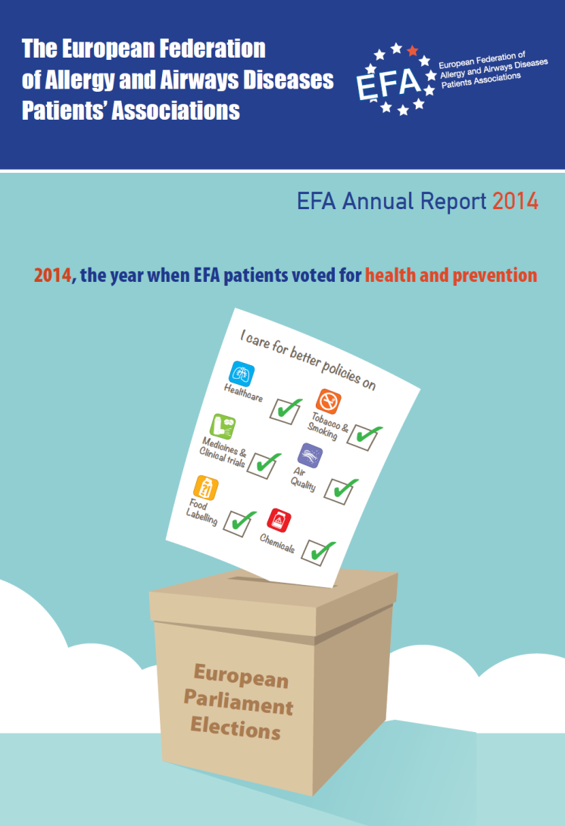
@EFA_Patients

Slide 25
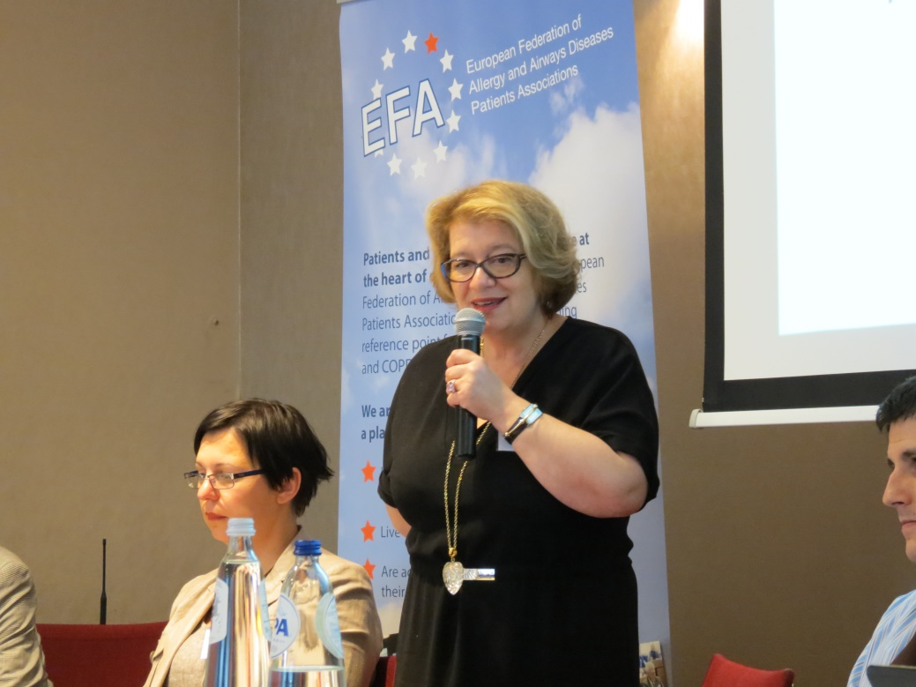
Thank you
to collaborate with Patient Groups on Equal level
We need YOU and you need US

Slide 26
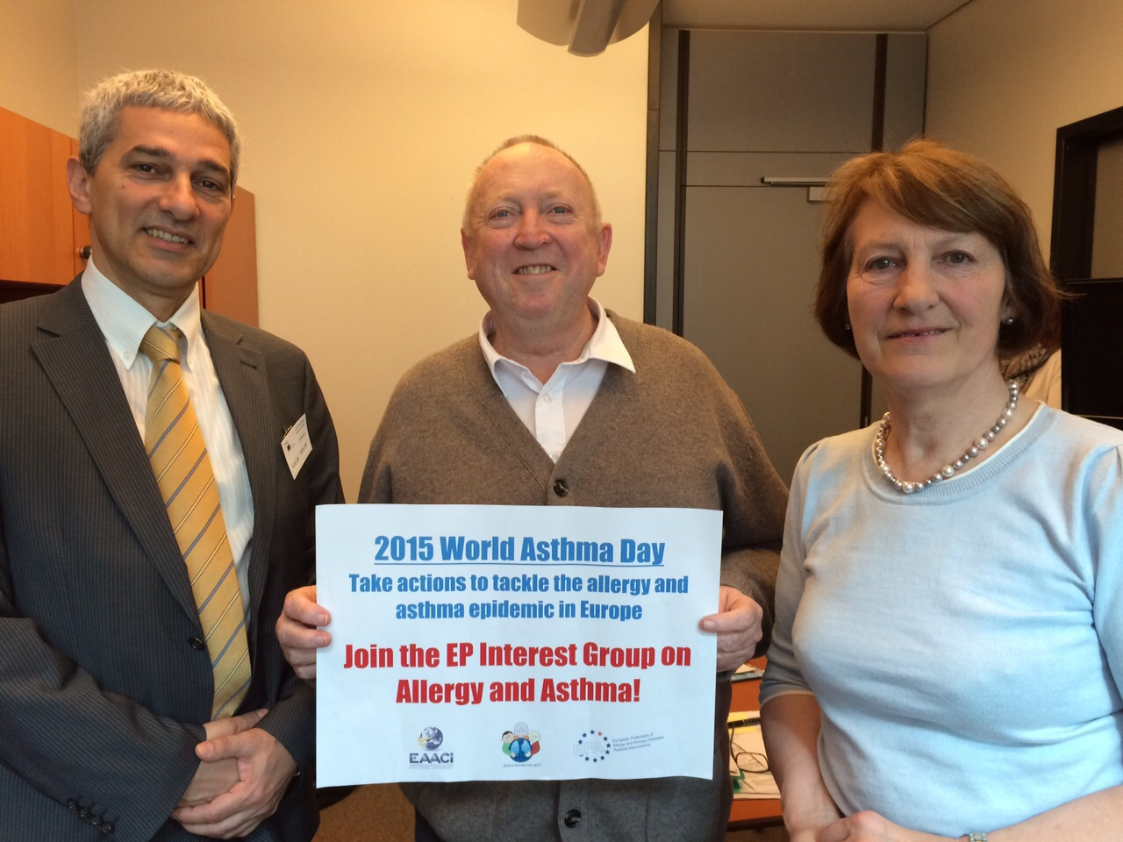
PATIENTS & SCIENTISTS IN ACTION!
with Keith Taylor, MEP at the EP

