Slide 2


Healthcare professional
EARIP Stakeholder meeting
15/09/2015
Professor Ildiko Horvath
National Koranyi Institute for Pulmonology, Budapest, Hungary

Slide 3
What’s needed to achieve change in the
European Union?
Strengthen primary, secondary, tertiary and emergency care

Slide 4
How to realise the vision of the European Innovation Partnership?
Reduce the annual level of deaths by 25% within 10 years and 50% within 20 years, and hospitalisations by 50%
European countries being 14 of the world's worst 20 for prevalence of asthma in adults

Slide 5
Current gaps
Appropriate surveillance system
Data integration between environmental factors and asthma attacks, treatment needs
Access to cost-effective medicines
Standards and accessibility of care at different levels of the health care system.

Slide 6
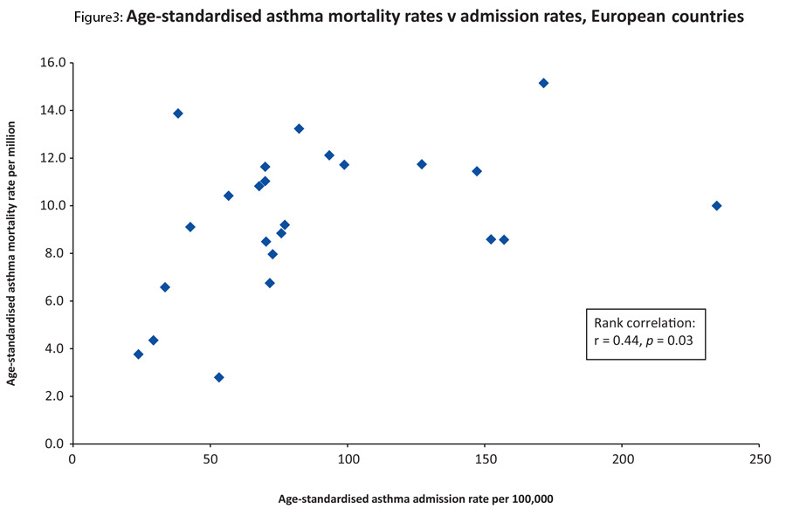
Agree on Key Performance Indicators
Global Asthma Burden Report, WHO 2014

Slide 7
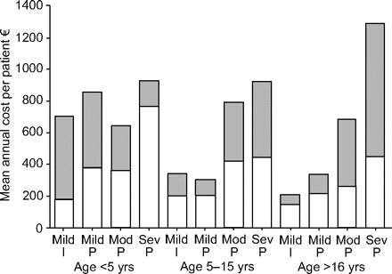

Cost of scheduled vs unscheduled visits

Slide 8
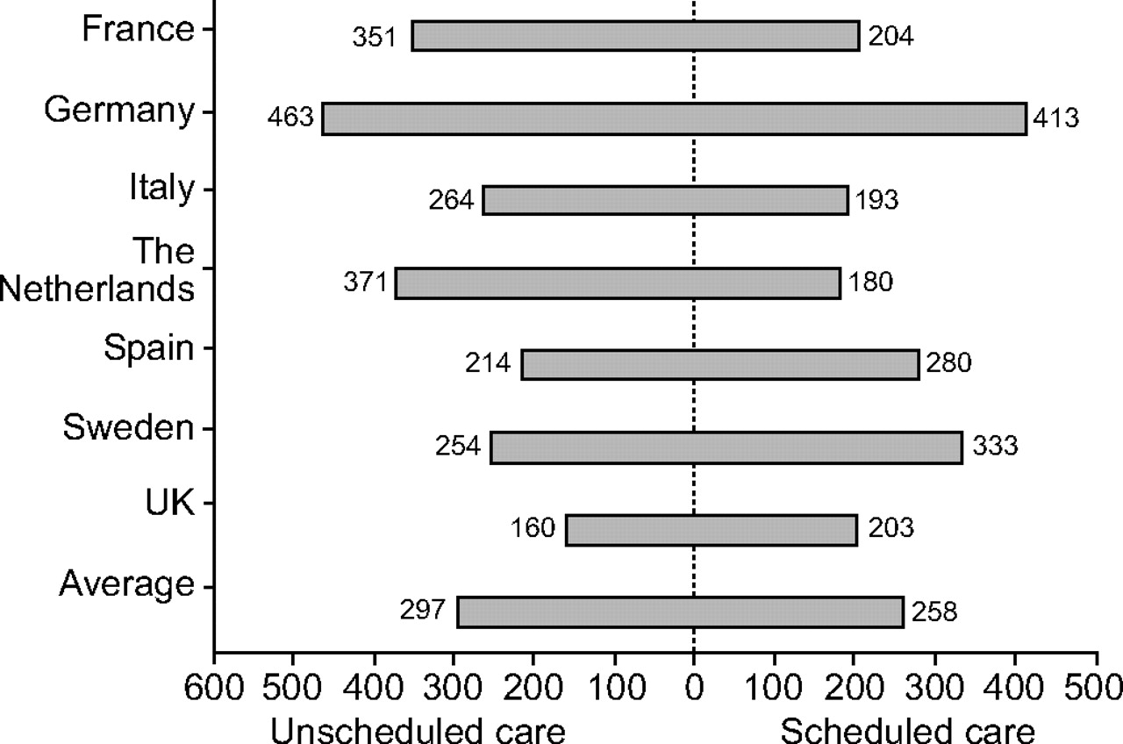
Cost of scheduled vs unscheduled visits

Slide 9
Health professionals patient centred personalised
Scale up public health efforts
Support with education, tele-support for patient management, adherence
Early participation in clinical research, feed-back for basic research
Adaptive health care system
Continuity of care across Europe
Speed up the innovation cycle for new drugs and devices

Slide 10
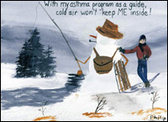
Thank you for your attention!
AAAAI/Philip B.
ildiko.horvath@koranyi.hu

