Slide 1
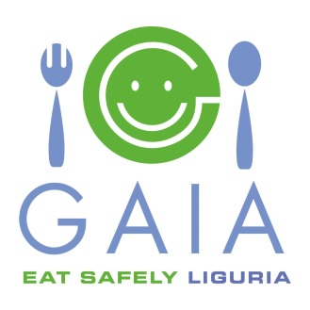
Food Labelling from Patients’ Perspective in Europe: the Good, the Bad and the Ugly
Roberta Savli
Senior EU Policy Advisor – European Federation of Allergy and Airways Diseases’ Patients Associations (EFA)
roberta.savli@efanet.org
@robertasavli

Slide 2
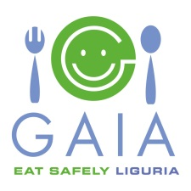
WHO IS EFA?
European alliance of 39 allergy, asthma and chronic obstructive pulmonary disease (COPD) national patients’ associations representing more than 30% of European citizens living with these diseases
Patients’ participation in every decisions influencing their health, partnership & sharing knowledge
Notes:
The European Federation of Allergy and Airways Diseases Patients’ Associations (EFA) is the European alliance of 39 allergy, asthma and chronic obstructive pulmonary disease (COPD) national patients’ associations representing 30% of European citizens living with these diseases.
We work for European patients with allergy, asthma and COPD to live uncompromised lives, have the right and access to the best quality care, and live in a safe environment.

Slide 3
FOOD ALLERGY ACROSS EUROPE
Up to 25% of European population reacts to food
About 17 million Europeans suffer from food allergies, 3.5 million aged less than 25
8% of allergic patients produce acute anaphylaxis considered potentially fatal
Over the past ten years, number of allergic children younger than 5 years has redoubled + emergency room visits for anaphylactic reactions have increased seven-fold *
* Source: European Academy of Allergy and Clinical Immunology (EAACI)
Notes:
Although it is difficult to get aggregated data (both at the European level and taking into account all the 14 main allergens), the European Academy of Allergy and Clinical Immunology (EAACI) has identified that there are about 17 million Europeans affected by food allergy.

Slide 4
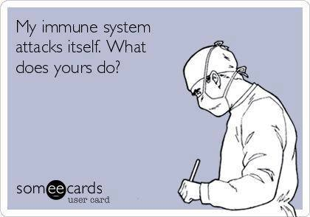
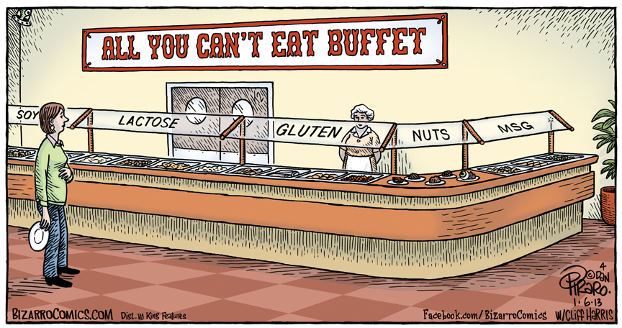
BURDEN OF DISEASE
Allergy is a “crazy” disease as the immune system of an allergic person fails to distinguish between dangerous substances and harmless ones
BUT
Allergies can make you crazy too! as they might result in poor nutrition and quality of life, fear, restrictions, social isolation, and sometimes even death (anaphylaxis)
Notes:
Allergies may have several symptoms, ranging from gastro-intestinal problems, eczemas and urticarias to airway obstructions and cardiovascular shocks. Food allergy has also a significant impact in terms of social, dietary and psychological factors: in Italy, 20% of young children with food allergy have never attended a birthday party.

Slide 5
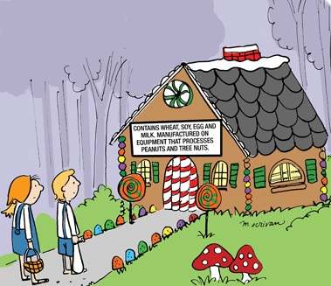
IMPORTANCE OF ALLERGENS’ INFORMATION
No cure for food allergy
Protection = abstention
Consumers suffering from allergy or intolerance must be able to identify the ingredients they are sensitive to
“When food is your enemy, knowledge is your best weapon of defense.” (Marjan van Ravenhorst from EFA member Dutch Food Allergies Foundation)

Slide 6
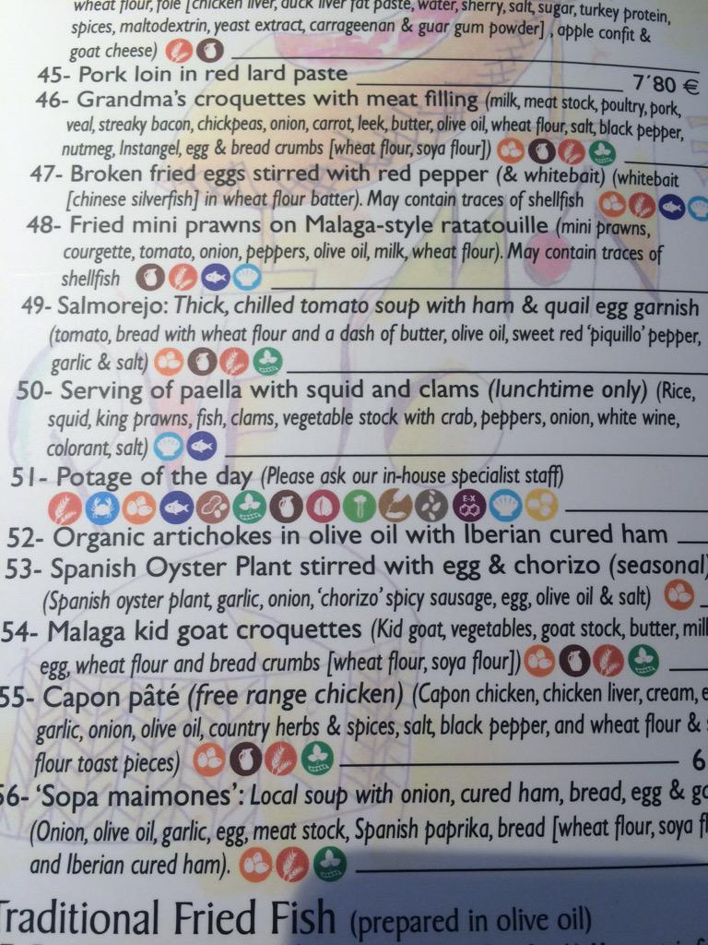
MAIN ISSUES WITH FOOD LABELLING
Information not available or inaccurate
Readability → too small font, poor contrast
Cross-contamination, precautionary labelling → not trustworthy, no common practice
Changes in recipe and introduction of novel ingredients (e.g.: lupine) → new allergies
Complicated and processed food containing unnecessary ingredients
Not in national language → complicating travelling

Slide 7
EU FOOD INFORMATION TO CONSUMERS REGULATION
Regulation 1169/2011 of the European Parliament and the Council on the provision of food information to consumers, positive step to improve health and quality of life of people with food allergy
“May contain” labels
Allergens labelling in pre-packed & non-pre-packed food
List of allergens, pictograms, readability & recipe changes
Notes:
For the previously mentioned reasons, in 2011, the European Parliament and the Council of the European Union have adopted a new regulation, which entered into force December last year. This new regulation being a clear step forward, let us now concentrate on the current situation of allergen labelling in Europe and identify good and bad practices.

Slide 8
THE GOOD I: ALLERGENS IN PRE-PACKED FOOD
Emphasising 14 listed allergens within the ingredients’ list through a typeset that clearly distinguishes them (novelty as of December 2014)
EFA position:
Bolding allergens, the best way to highlight them and attract allergic consumers’ attention
Need to label also consumption units
Where no list of ingredients is required, label on the package with the wording “it contains” followed by the name of the allergen
EFA position:
Ingredients’ list always compulsory (irrespective of the size of the pack) as people may be allergic to other substances than those listed in the regulation
Information on allergens should be given also in case of food distance selling before the purchase is concluded
Notes:
Annex II of the new regulation identifies 14 allergens that should be always labelled in pre-packed food. The new regulation requests that the complete list of ingredients should be indicated, but there is an exception for packaging or containers whose surface is inferior to 10 cm2. In such cases, this list shall be provided through other means or made available at the request of the consumer.
The names of the substances listed in annex II of the regulation should always be mentioned. Specific names can be a useful addition (for instance, in brackets). Indeed, we cannot expect all consumers, especially foreigners, to know the specific names of the food. Moreover, if such an exception is allowed, mandatory labelling would be more difficult as annex II does not mention any specific names for fish, molluscs, etc. as opposed to specific names for nuts and gluten. In these last two cases, on the other hand, identifying the specific gluten-containing grain or nut used in the product would not unnecessarily limit the range of products available to people with allergies, as most people are not allergic to all nuts or all different gluten-containing grains.
In the Netherlands, in the JUMBO website (grocery shop food chain), people can find all the products they sell and have a look at the allergens present online, before doing shopping.

Slide 9
THE GOOD II: ALLERGENS IN NON-PRE-PACKED FOOD
7 out of 10 severe reactions happen when people eat out *
Compulsory information on allergens, Member States can decide how it should be made available to consumers and its form of expression and presentation (novelty as of December 2014)
EFA position:
Written information is the most reliable means of ensuring the provision of detailed information to the allergic consumer, unless it is possible to talk directly to the person that prepared the food
Need to share best practices on EU Member States’ legislations
Necessity to draft and implement EU-wide guidelines
In the long-term, compulsory list of all ingredients
* Source: European Commission
Notes:
By setting mandatory requirements on allergens for non pre-packed food, article 44 of the regulation represents a crucial step forward. Indeed, evidence suggests that most food allergy incidents can be traced back to non pre-packed food.

Slide 10
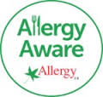
BEST PRACTICE: PATIENTS TRAINING RESTAURANTS
Allergy Aware Scheme by EFA member Allergy UK
Hooray an allergic guest! by EFA member Swedish Asthma and Allergy Association
Endorsement training for allergen management for restaurants
Accreditation with allergy-friendly label
Notes:
EFA member Allergy UK launched the “Allergy Aware Scheme” for restaurants in summer. Allergy UK will provide an endorsement training for allergen management for restaurants, after which restaurants will be accredited with an allergy-friendly label. In order to gain accreditation as part of the Allergy Aware Scheme, all staff need some form of training initially. At least 40% of staff working at each outlet need face-to-face training: this applies to senior staff, front of house and chefs with the remainder needing online training. In order to maintain the accreditation, the level of trained staff on the premise should never drop below 80% of the total workforce. A follow-up control is foreseen between 6 and 12 weeks after the end of the training. Allergy UK is also working in partnership with the restaurant directory Can I Eat There?, which helps allergic people to find out allergy-friendly restaurants.
The same idea was developed by EFA member Swedish Asthma and Allergy Association. In the framework of the project Hooray an allergic guest!, after a training provided to restaurants, the certification Safer Food will be released. This shows that the restaurants are working systematically to minimise the risks for guests with food allergies. The certification does not guarantee that allergic people will not have a reaction in the establishment.

Slide 11
THE BAD I: ALLERGENS & PICTOGRAMS
List of allergens
No change in the list of 14 main allergens: it can be updated by Commission’s delegated acts (novelty as of December 2014)
EFA position:
Need to review prevalence of food allergy in Europe with the possibility of identifying “emerging” allergens
Avoid precautionary approaches for novel foods
Pictograms
No harmonised set of pictograms: symbols can be used in addition to words via Commission’s implementing acts
EFA position:
Consistent pictograms across Europe are crucial for travellers
“Whilst we are in our home country, food labelling is a daily activity to keep our son alive; but when we go overseas, things become a lot more difficult.”
(David Supple, father of a severe allergic child, from EFA member Asthma UK)
Notes:
List of allergens
The new regulation maintains the same list of allergens. However, the Commission can now update this list via delegated acts. The regulation also foresees the possibility for urgency procedure in cases of emerging risks to consumers’ health. We believe that a review of the list of the 14 existing allergens should be carried on on the basis of the most recent scientific knowledge.
Pictograms
Recital 59 and article 9.3 of the new regulation may apply to allergens too, although it is made clear that these pictograms might only be added to the name of the allergen and not replace it. It is easier to find common and easily understandable pictograms for some allergens, but not for all.

Slide 12
THE BAD II: READABILITY & RECIPE CHANGE
Readability
Information on allergens should be provided in 1,2 mm font size; possibility to reduce the minimum font size to 0,9 mm
EFA position:
Minimum 3 mm font size to guarantee clear legibility and safe choices
Need to develop a comprehensive approach to take into account all aspects related to legibility, including font, colour and contrast
Changes of recipe
Nothing is mentioned regarding labelling allergen changes/additions in products
EFA position:
Clearly mention the change in the package as consumers may feel safe due to previous consumption of the product and not check properly the list of ingredients
Notes:
Readability
In case of small packaging or containers (surface area less than 80 cm²), the minimum font size is reduced to 0,9 mm. We encourage the Commission to develop a comprehensive approach (as suggested by recital 26 of the regulation) with the final objective of increasing the minimum font size to help allergic consumers make safe choices.

Slide 13
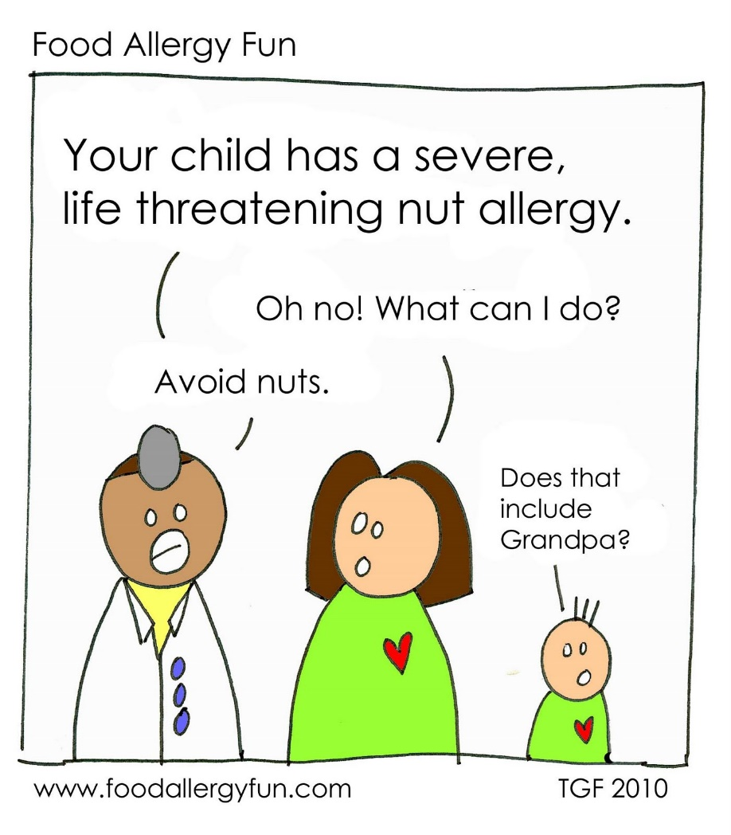
BAD EXAMPLE: LABELLING POSSIBLE CROSS-REACTION
Early 2014: European Commission’s authorisation of rapeseed protein as a novel food + special labelling provision regarding cross-reactivity & possible allergenicity for people allergic to mustard
Unnecessarily limit to the choices of mustard allergic patients:
Either a substance is an allergen (and therefore listed in the regulation, with the provisions this implies) or is not
Cross-reactivity happens with other foods too, such as almonds and peaches seeds: we do not label green peas, beans or lentils, even if peanut allergic people might react
Information about possible cross-reaction is best handled by patients’ organisations or healthcare professionals
Notes:
The European Commission has decided that rapeseed protein containing products are allowed on the market for human use. Although no specific risk of allergic reactions has been identified by EFSA, it was suggested that these products carry a special label saying that people allergic to mustard may have an allergic reaction to the rapeseed protein too. For us, this is limiting the choices of citizens as we can have cross-reactivity with several products and this can create a precedent. Either a substance is an allergen (and therefore listed in annex II of the new regulation, with the provisions this implies) or is not.

Slide 14
THE UGLY: PRECAUTIONARY LABELLING
Voluntary Member States’ information on the unintentional presence of allergens, harmonised rules to be set by the Commission through implementing acts (no deadline)
EFA position:
Long-term: abolishment (complete and accurate information, establishment of “safe thresholds”)
Short-term: ultimate solution after implementation of best-practices to avoid cross-contamination
Allergen management as part of hygiene/safety manual
Awareness and practical training on food allergy for workers
Responsibility of food business operators at each step of the distribution chain
European guidelines on food allergen management
Notes:
Recital 24 of the regulation, although not legally binding, emphasises the importance for allergic people to receive all the information on the presence of food additives, processing aids and other substances or products with a scientifically proven allergenic or intolerance effect, and therefore recognises the need to regulate precautionary labelling. The Commission is required to set harmonised rule on the use of this voluntary information, although this implementing act has no deadline.
We understand that it is not easy to determine the allergen present in the product as the analytical methods (i.e. “ELISA tests”) are not reliable, and the quantitative methods (based on the presence of the DNA of an allergen in a product) is difficult to use and to determine the link between the presence and the quantity. In addition, we also know that processed food changes the allergenic potential of proteins. However, following a system (e.g.: VITAL) and being audited on the basis of this could be a useful option for people with food allergies.

Slide 15
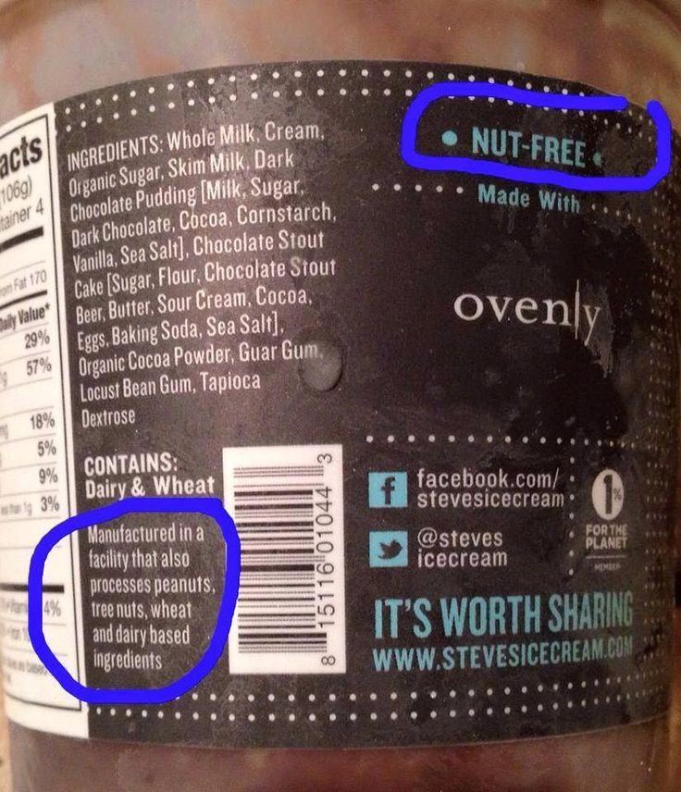
8% of people with accidental reactions may attribute it to having ignored a precautionary labelling *
* Source: Barnett J et al, BMC Public Health 2011

Slide 16
(AVOIDANCE OF) WORST PRACTICE – EFA’S SUCCESS
Early 2014: company’s decision to end outsourcing production of nuts-based products & start producing them in own production lines together with soya products + introduction of nuts precautionary labelling for soya products
Severely impacting health and quality of life of allergic people:
Hugh number of people with milk allergy, often children, have accompanying nut allergy
“Default” soya products in most supermarkets and highly recommended by dieticians, negligible alternatives especially in many non-urban areas
Raising awareness & social media campaigns
Summer 2014: company announces the arrangement of current production lines to exclude risk of cross-contamination & remove “may contain” claims
Notes:
Precautionary labelling reduces the choices available to allergic consumers.
Regardless of the label: in a study from 10 European countries of over 500 types of biscuits and chocolate, “may contain” labelling for nuts is included on the packaging of 26% of biscuits and 80% of chocolate;
Unnecessary restrictive diet: 90% of products with “precautionary labelling” do not contain residues of peanuts’ proteins or very small quantities unlikely to cause a clinical reaction.
This results in frustration and risk-taking behaviours, not depending on age, gender or the severity of the allergy
Variety of the wording: 80% of parents with nuts allergic children would not let them eat products with “not suitable for” or “may contain” labelling, only 50% would do so with “cannot guarantee nut free” or “may contain traces of” labelling;
Distrustfulness of the message sources: “may contain” labels are not taken into consideration by allergic consumers sometimes as food business operators are deemed to use them to discharge any possible liability in case of adverse reactions following the ingestion of their products;
Implausibility of the labelling: sometimes these labels are located on products that legitimately contain the allergen (e.g.: nuts in a packet of peanuts) or on others where it is considered impossible that they actually contain it (e.g.: nuts in a bottle of lemonade);
Previous experience and personal preferences: people may also think that if they did not react to a product with “may contain” label, then they might tolerate traces of the allergen that could be present in the product. However, sometimes there are no traces of the allergen and therefore this causes a risk-taking behavior in food allergic people.
All this is complicated by the fact that even healthcare professionals do not recommend stringent avoidance of products with “may contain” label: in the UK, only one-third of them would advise patients with tree nut allergy to avoid all foods with precautionary labelling related to tree nuts.

Slide 17
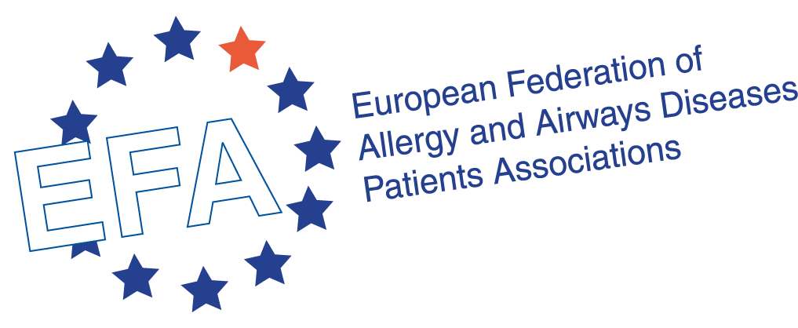
Thank you for your attention!
35, rue du Congrès B-1000, Brussels www.efanet.org @EFA_Patients www.facebook.com/EFAPatients

