Slide 1
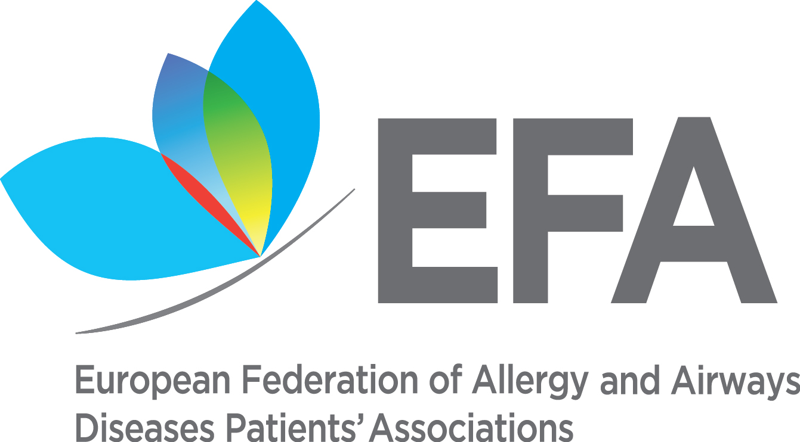
Food Labelling from Patients’ Perspective: the Good, the Bad and the Ugly
Roberta Savli, European Federation of Allergy and Airways Diseases Patients’ Associations
roberta.savli@efanet.org @robertasavli

Slide 2
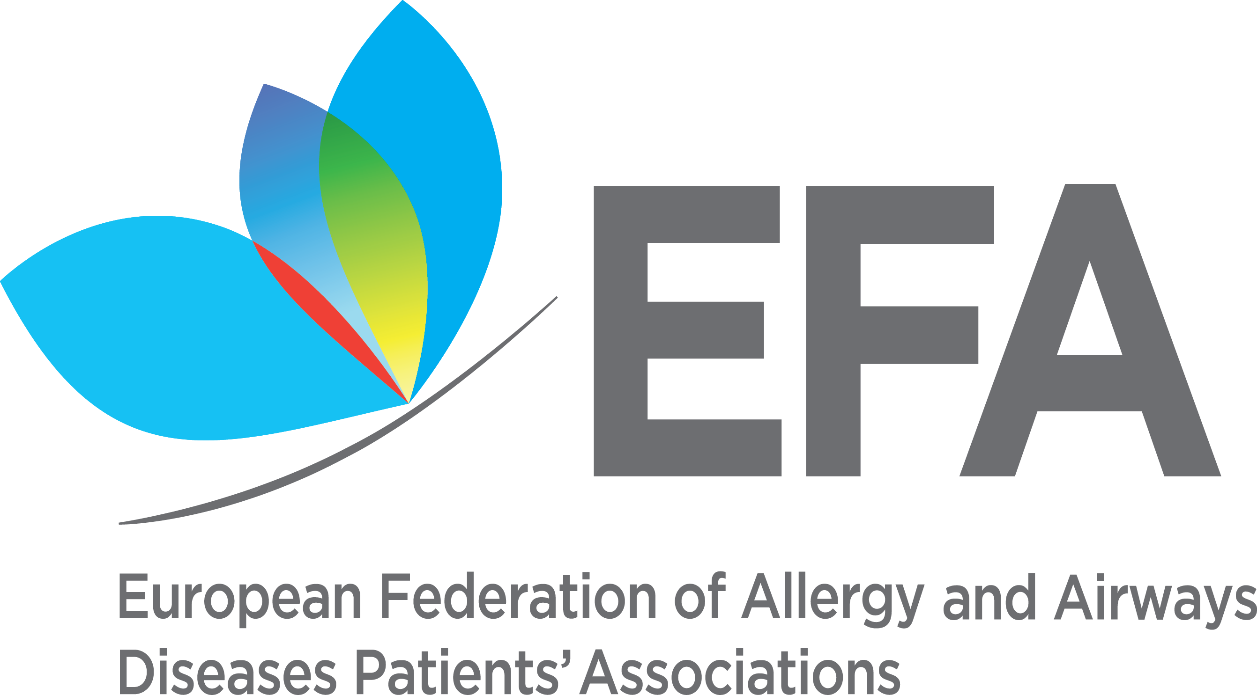
Who are we?
A European alliance of more than 40 allergy, asthma and chronic obstructive pulmonary disease (COPD) national patients’ associations
We represent more than 30% of European citizens living with these diseases
We aim for patients to live uncompromised lives, have the right and access to best quality of care and safe environment

Slide 3
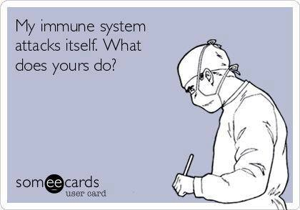
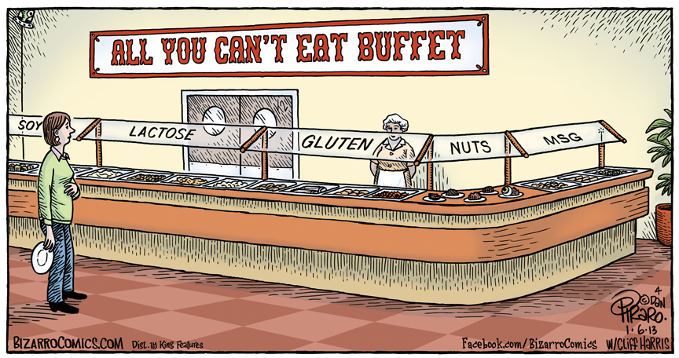
One man’s meat is another man’s poison
Allergy is a “crazy” disease as the immune system of an allergic person fails to distinguish between dangerous substances and harmless ones
BUT
Allergies can make you crazy too! as they might result in poor nutrition and quality of life, fear, restrictions, social isolation, and sometimes even death (anaphylaxis)

Slide 4
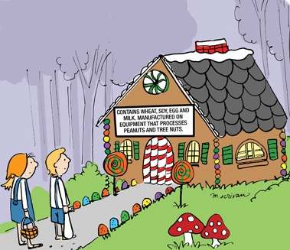
Importance of allergen information
No cure for food allergy
Protection = abstention
Consumers suffering from allergy or intolerance must be able to identify the ingredients they are sensitive to
“When food is your enemy, knowledge is your best weapon of defense.” (Marjan van Ravenhorst from EFA member Dutch Food Allergies Foundation)

Slide 5
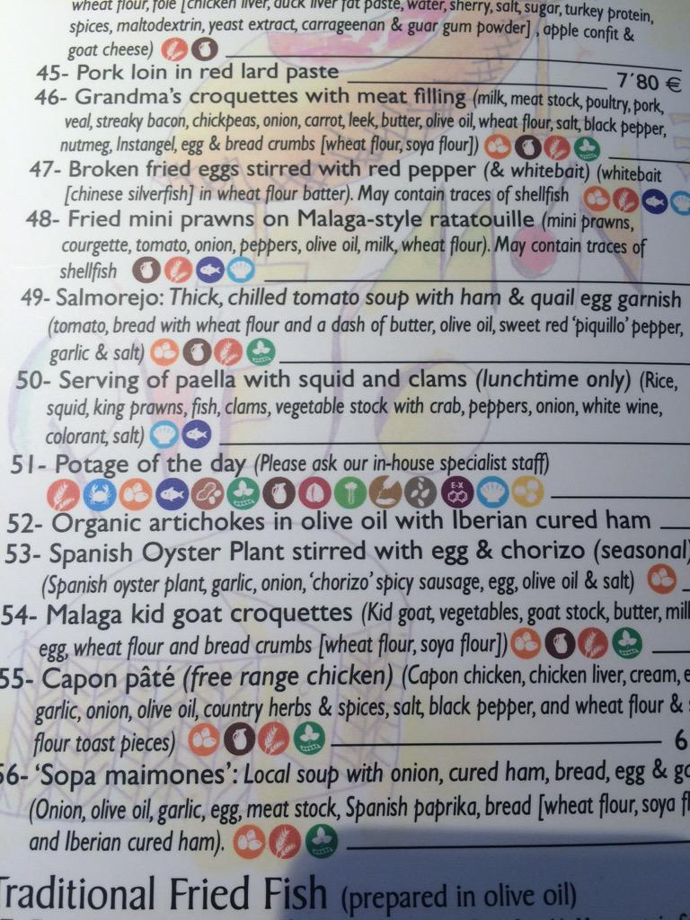
Main issues with food labelling
Information not available or inaccurate
Readability → too small font, poor contrast
Cross-contamination, precautionary labelling → not trustworthy, no common practice
Changes in recipe and introduction of novel ingredients → new allergies
Not in national language → complicating travelling
Regulation 1169/2011 on the provision of food information to consumers, a positive step to improve health and quality of life of people with food allergy

Slide 6
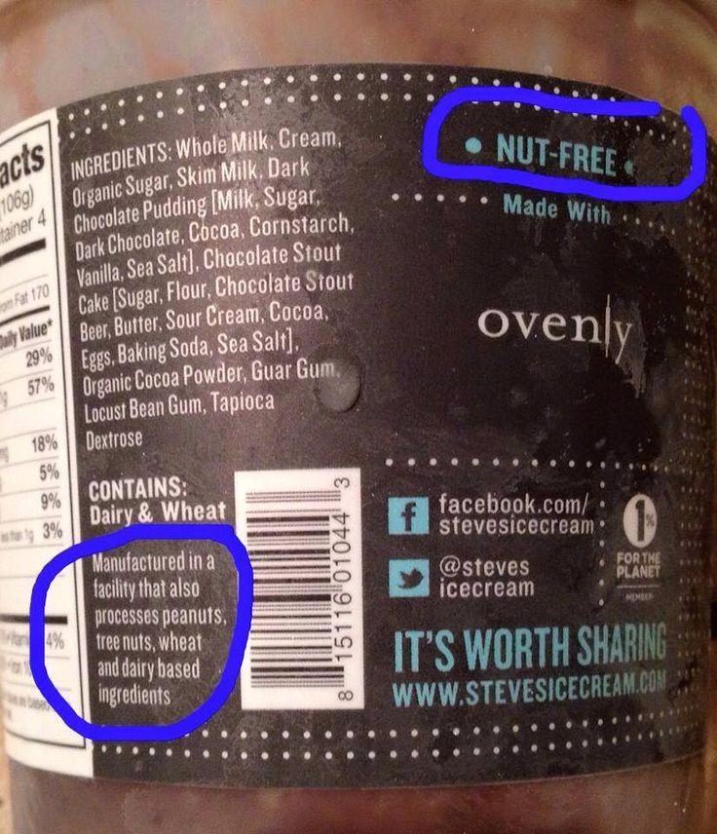
Precautionary labelling
Voluntary Member States’ information on the unintentional presence of allergens is possible if it does not mislead the consumer, is not ambiguous or confusing and is based on scientific data
Need to harmonise this information
8% of people with accidental reactions may attribute it to having ignored a precautionary labelling
Reference: Barnett J et al, Using “may contain” labelling to inform food choice: a qualitative study of nut allergic consumers, BMC Public Health, 2011
Notes:
Recital 24 of the regulation, although not legally binding, emphasises the importance for allergic people to receive all the information on the presence of food additives, processing aids and other substances or products with a scientifically proven allergenic or intolerance effect, and therefore recognises the need to regulate precautionary labelling. The Commission is required to set harmonised rule on the use of this voluntary information, although this implementing act has no deadline.

Slide 7
Patients’ questions
Is there a real risk by eating this food?
Distrustfulness of the message sources: is it just there for liability reasons?
How much is a “trace”?
Variety of the wording: what do different phrases of precautionary labels mean?
Regardless of the label: how trustworthy is this precautionary label?
Is this food safe for me to eat or should I avoid it?
Notes:
“May contain” labels are not taken into consideration by allergic consumers sometimes as food business operators are deemed to use them to discharge any possible liability in case of adverse reactions following the ingestion of their products.

Slide 8
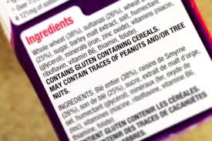
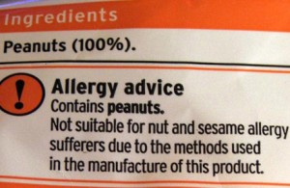
Variety of the wording
May contain (allergen)
May contain traces of (allergen)
Produced in a factory that also uses (allergen)
Manufactured in a facility that also processes (allergen)
Packaged in a facility that also packages products containing (allergen)
Manufactured on shared equipment with products containing (allergen)
Not suitable for (allergen) allergy sufferers
May contain occasional nut
Carefully baked in a nutty environment
? ?

Slide 9
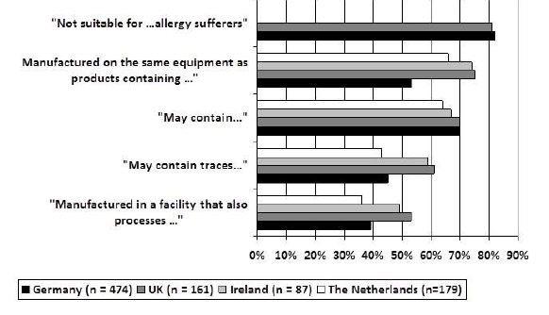
Patients’ interpretation vs scientific check
Consumers with food allergies make their personal risk assessment and food choice according to the wording used
BUT
The wording of precautionary labels does not reflect the level of allergen present in the food
Different phrases that do not link to different risks are not meaningful and helpful to consumers with food allergies
Percentage of food-allergic consumers that would never buy a product with precautionary label according to the wording used
Sources: Dunn Galvin A et al, PAL: Perspectives from key-stakeholder groups, Allergy, 2015; Crotty M, Taylor S, Risks associated with foods having advisory milk labelling, JACI, 2010

Slide 10
Regardless of the label
No precautionary labels, but allergen presence: up to 5% of pre-packed foods contain relevant amounts of allergens (= which can elicit allergic reactions) without being mentioned on the label
Prepacked foods with no precautionary labels cannot be assumed to be “safe”
Source: Jahresbericht 2014 Überwachung Lebensmittel Bedarfsgegenstände Baden-Württemberg Ministerium für ländlichen Raum und Verbraucherschutz; FSA – Survey of allergen advisory labelling and allergen content of UK retail pre-packed processed foods
Precautionary labels, but no allergen: 55-95% of pre-packed foods with precautionary labels do not contain relevant amounts of allergens (= unlikely to cause a clinical reaction) when they are mentioned on the label
Pre-packed foods with precautionary labels often do not pose a real risk
Source: Hefle SL et al, Consumer attitudes and risks associated with packaged foods having advisory labelling regarding the presence of peanuts, J Allergy Clin Immunol, 2007

Slide 11
Impact of precautionary labels on patients’ daily lives
Abundance of food with precautionary labelling leaving allergic consumers with a restricted food choice, resulting in either
Frustration and risk-taking behaviours, when opposing precautionary labelling – not depending on age, gender or the severity of the allergy
Loss of quality of life and unnecessary restricted diets, when adhering to precautionary labelling
Experiencing allergic reactions to food either due to
Unknown consumption of a not labelled allergen in a food (missing precautionary labelling)
Ignoring precautionary labelling because it is not seen as trustworthy or reliable (distrustfulness of the message sources or implausibility of the labelling)
Previous experience and personal preferences
Overall uncertainty, not knowing how to assess the real safety of a food, social isolation (not participating in family meetings, business dinners, parties, etc.)
Notes:
In a study from 10 European countries of over 500 types of biscuits and chocolate, “may contain” labelling for nuts is included on the packaging of 26% of biscuits and 80% of chocolate.
Implausibility of the labelling: sometimes precautionary labels are located on products that legitimately contain the allergen (e.g.: nuts in a pack of peanuts) or on others where it is considered impossible that they actually contain it (e.g.: nuts in a bottle of lemonade).
All this is complicated by the fact that even healthcare professionals do not recommend stringent avoidance of products with “may contain” label: in the UK, only one-third of them would advise patients with tree nut allergy to avoid all foods with precautionary labelling related to tree nuts.

Slide 12
Impact of precautionary labels on patients’ daily lives – CONT’D
Overall uncertainty, not knowing how to assess the real safety of a food, social isolation (not participating in family meetings, business dinners, parties, etc.)
Notes:
In a study from 10 European countries of over 500 types of biscuits and chocolate, “may contain” labelling for nuts is included on the packaging of 26% of biscuits and 80% of chocolate.
Implausibility of the labelling: sometimes precautionary labels are located on products that legitimately contain the allergen (e.g.: nuts in a pack of peanuts) or on others where it is considered impossible that they actually contain it (e.g.: nuts in a bottle of lemonade).
All this is complicated by the fact that even healthcare professionals do not recommend stringent avoidance of products with “may contain” label: in the UK, only one-third of them would advise patients with tree nut allergy to avoid all foods with precautionary labelling related to tree nuts.

Slide 13
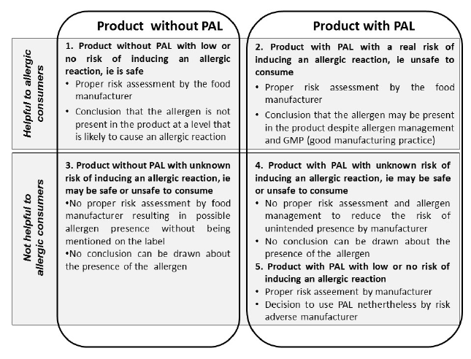
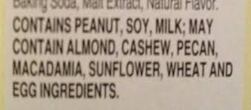
What do patients need?

Slide 14
EFA position
Long-term: abolishment
Risk assessment should be quantitative and the use of precautionary labels should be based on agreed reference doses derived from scientific data on medical thresholds
Reduce reactions to mild or acceptable levels for almost all allergic people
Short-term: ultimate solution
Precautionary labelling must reflect an actual health risk
Implementation of best-practices to avoid cross-contamination (allergen management as part of hygiene/safety manual, awareness and practical training on food allergy for workers, responsibility of food business operators at each step of the distribution chain)
Wording must be easy to understand, uniform and agreed on a limited number of statements with a consented meaning
European guidelines on food allergen management
Notes:
We understand that it is not easy to determine the allergen present in the product as the analytical methods (i.e. “ELISA tests”) are not reliable, and the quantitative methods (based on the presence of the DNA of an allergen in a product) are difficult to use and to determine the link between the presence and the quantity. In addition, we also know that processed food changes the allergenic potential of proteins. However, following a system (e.g.: VITAL) and being audited on the basis of this could be a useful option for people with food allergies.
Having very low thresholds (under discussion in the Netherlands) would mean that the allergen will have to be labelled in the ingredients’ list even if it is present in an indiscernible concentration. This might lead to risk-taking behaviours, as most of the allergic people will have had previous positive experience with the product and they will continue to eat it, and it could be dangerous in some very extreme cases.

Slide 15
Questions?
THANKS to EFA Food Allergy Working Group members and in particular to Sabine Schnadt from Deutscher Allergie- und Asthmabund (DAAB)

Slide 16
European Federation of Allergy and Airways Diseases Patients’ Associations
35 Rue du Congrès
1000 Brussels
Belgium
Tel.: +32 (0)2 227 2712
Email: info@efanet.org
Twitter: @EFA_Patients

