Slide 1
Participation OF PATIENTS INTO DECISIONMAKING IN EUROPE:
PERSPECTIVE OF EPF
Susanna Palkonen
Board Member of the European Patients’ Forum; Member of the EMA Patients and Consumers’ Working Party (PCWP), Director of the European Federation of Allergy and Airways Diseases Patients’ Associations
Thanks to Kaisa Immonen & Kostas Aligiannis, EPF, Nathalie Bere, EMA
12 December 2017

Slide 2
Outline
Introduction to EPF
Our priorities: Empowerment
Our priorities: Access
Our membership, our compass
The added value of patient groups & making it visible i.e. EMA
Closing – food for thought
Notes:
We work on : cross-cutting issues of relevance to all patients with chronic diseases
Our Vision: all patients with chronic and/or lifelong conditions in the EU have access to high quality, patient-centred equitable health and social care.
Our Mission: to ensure that the patient community drives policies and programmes that affect patients’ lives to bring changes empowering them to be equal citizens in the EU.

Slide 3
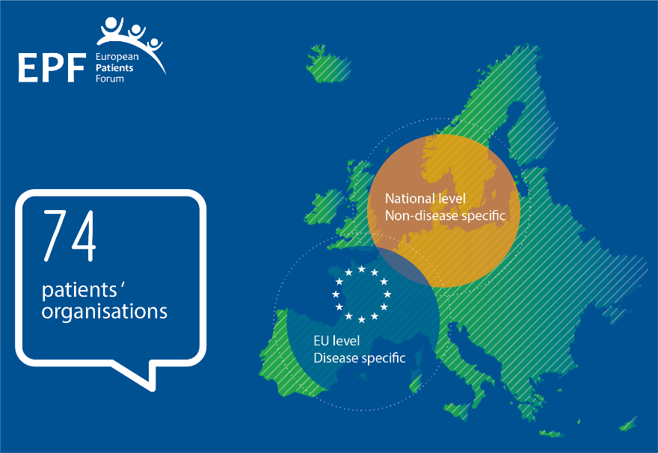
About EPF
European Patients’ Forum
  Independent & non-governmental
  Umbrella organisation
  Active since 2003
  EU patients’ voice
Our members
  74 patients’ groups
  EU disease specific organisations & National patient coalitions
Notes:
The European Patients’ Forum (EPF) is an umbrella organisation that works with patients’ groups in public health and health advocacy across Europe. Our members represent specific chronic disease groups at EU level or are national coalitions of patients.
Our role is to ensure the patients’ community drives policies and programmes that affect patients’ lives
We work on cross-cutting issues of relevance to all patients with chronic diseases

Slide 4


Mission and vision
Our Vision!
“All patients with chronic conditions in Europe have equal access to high quality, patient-centred health and related care.”
Our Mission!
“To be the collective, influential patient voice in European health and related policies and a driving force to advance patient empowerment and patient access in Europe.”

Slide 5



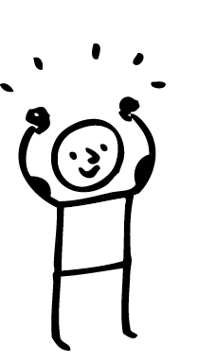


Our Strategic Goals
Healthcare Access and Quality
Health Literacy
Patient involvement
Patient Empowerment
Sustainable Patients’ Organisations
Non-discrimination
Notes:
Goal 1: HEALTH LITERACY
To promote access for patients and their informal carers to information and education that enables them to make informed choices about their health.
Goal 2: HEALTHCARE ACCESS AND QUALITY
To contribute to improvements in health systems that enable equitable access to sustainable and high-quality healthcare designed and delivered to meet patients’ and informal carers’ needs at all levels of care, embracing innovation in all its forms.
Goal 3: PATIENT’S INVOLVEMENT
To advance meaningful patient involvement in the development and implementation of health-related policies, programmes and projects in the EU.
Goal 4: PATIENTS' EMPOWERMENT
To promote the development and implementation of policies, strategies and healthcare services that empower patients to be involved in the decision-making and management of their condition according to their preference, whilst raising awareness about their rights and responsibilities.
Goal 5: SUSTAINABLE PATIENT ORGANISATIONS
To support the development, growth and capacity building of inclusive, effective, sustainable and representative patients’ organisations, and to foster cooperation and synergies between them.
Goal 6: NON DISCRIMINATION
To promote the development of EU and national policies that tackle discrimination faced by patients in health and social care as well as in domains like education and employment.

Slide 6



Evolution of EPF activities 2003-2017
Strengthening Patients’ voice in the EU
2003-2007
Influencing policy developments at EU-level
From 2008
EPF partnering in EU projects to gather evidence-based knowledge
2012 – present
Capacity Building and targeted activities for patient leaders, e.g. EUPATI
Evolution from 1 to 3 “pillars”
Strengthening policy impact
Notes:
Who is EPF? – 2003-2013
The slide shows the development of EPF throughout the years.
2003-2007: in the early years , EPF focus was on policy developments (e.g. Pharma Forum)
As from 2008: EPF started to gather evidence and good practice projects. Our first EU funded project was Value+ which basic premise is that patients’ meaningful involvement enhances health project results, which can contribute more effectively to policy towards patient-centred, equitable healthcare throughout the EU.
2012 – present: On the request of our members , we have developed a Capacity Building Programme and targeted activities for patient leaders (Regional Advocacy Seminars, EUPATI project)
This evolution from 1 to 3 pillar is strengthening our policy impact and strengthening the patients’ voice at EU level and at national level – a full circle approach

Slide 7
Our priority:
Equitable ACCESS for all patients

Slide 8
EPF: a patient’s perspective on access
2015
2016
2017
Definition of access &
advice on indicators
Survey for patients on access to healthcare
Campaign on access to health and social services
Notes:
EPF’s working group on access has been instrumental in the development of EPF’s work on access and this campaign.
The working group aims to:
Focus EPF’s work on priorities set by members
In 2015 – worked on defining access and recommendations on access indicators
In 2016 – we worked on a survey for patients on access to healthcare to provide strong evidence of patients’ current situation across the EU
And 2017 will see a patient led campaign on access

Slide 9

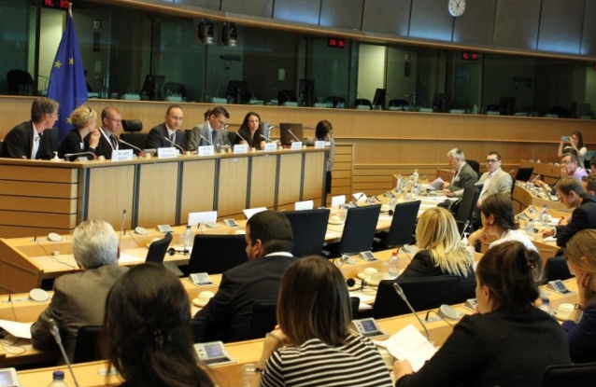
PACT – a multistakeholder initiative
Launched in 2015, joint initiative of EPF & its BG member org
Multi-stakeholder partnership:
  Patients, healthcare professionals, healthcare industries, and health experts, and key decision makers
Three focus areas
  Ensuring access is high on political agenda in close cooperation with MEPs
  Mapping access to healthcare in EU 28 (“5As of access”
  Development of tool to measure access and identify barriers
http://www.eupatientaccess.eu

Slide 10



EPF thematic campaign 2017: Access
Linked to the UN SDGs, the EPF Access campaign will contribute to making universal access a reality by 2030 through asking for specific actions from political decision-makers
UND SDG 3: Ensure healthy lives and promote well-being for all at all ages
Key target : achieve universal health coverage by 2030
We are still far from it… whether it is: the population covered, the type of services, or the proportion of costs that patients’ pay…
We will define concrete steps that need to be taken by 2030 to be on the right track
We ask politicians to change focus from short sighted cuts to a real commitment to a long term vision where equity of access is a reality
Notes:
The UN SDG for health: is a means to universal access in the EU by 2030
According to the UN sustainable development goals, EU member states need to achieve universal health coverage and to improve access to healthcare by 2030
However we still have some way to go…
The campaign will aim to:
define concrete steps that need to be taken by 2030 to be on the right track
change the focus of politicians from short sighted cuts to a real commitment to a long term vision where equity of access is a reality
EPF wishes to build on current political momentum of the UN SDGs, to foster more EU cooperation on access to healthcare.

Slide 11





Content of the Campaign – 5 Areas for action
Providing access to quality of care
Committing to sustainable investment in health
Encouraging affordability of healthcare products and services
Implementing access to an holistic range of health and social services
Ending discrimination and stigma patients are facing in healthcare
Notes:
Additionally the access campaign encompasses 5 key dimensions and areas for action
Providing quality of care across the EU
Committing to sustainable investment in health
Encouraging affordability of healthcare products and services
Implementing access to a holistic range of health and social services
Ending discrimination and stigma that patients are facing in healthcare

Slide 12
Our priority:
Patient empowerment and involvement

Slide 13
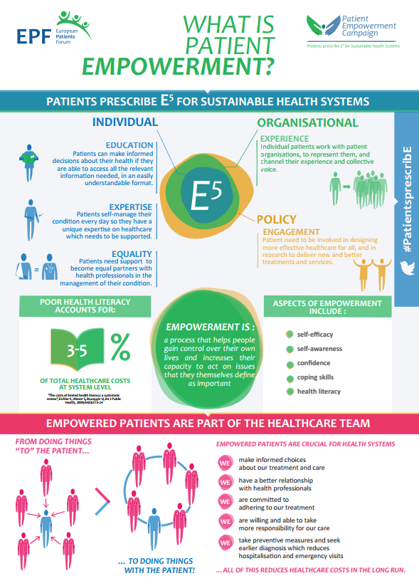
2015-16 Patient Empowerment Campaign
May 2015 – June 2016
EPF membership survey & Strategic Plan 2014-2020: Patient empowerment as key “thematic priority”, internal Working Group set up
Campaign:
  Promote awareness of patient empowerment to policy-makers
  What it means for patients
  Critical role of patients – the “untapped resource” for health systems
  Patients’ individual & collective participation in healthcare & policy-making
Supported by:
and by unrestricted grants from GSK, Amgen and MSD.

Slide 14
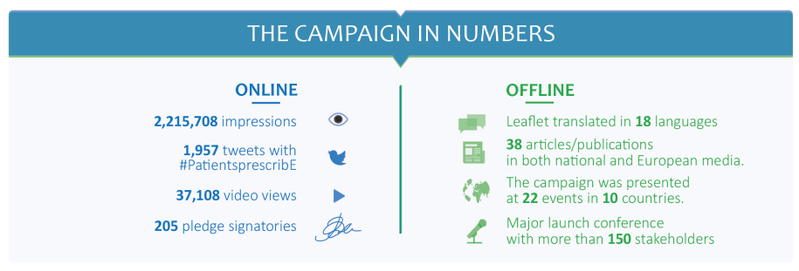
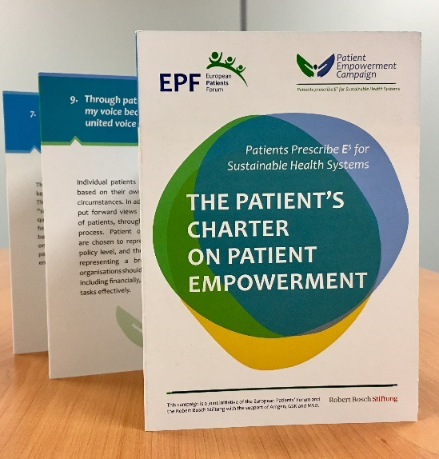
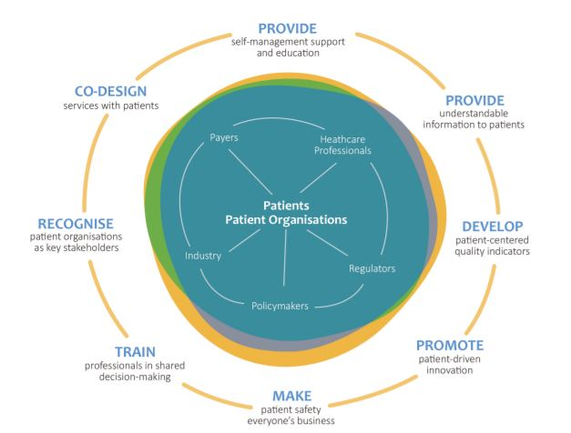
Outcomes & outputs
The Charter
&
The Roadmap

Slide 15
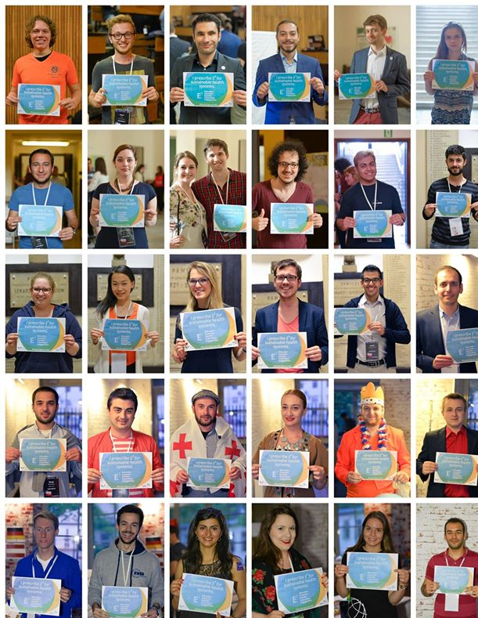

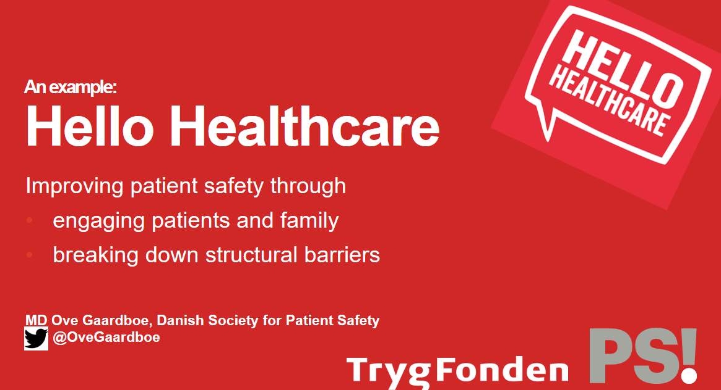
Follow-up: broad engagement
Continued engagement at EU level in all policy areas
Work with HCP/international organisations, EU Institutions, other interested partners ➔ influence policy AND practice
Initiative from 2018: develop patient-led framework for defining and implementing “good practice” in meaningful Patient involvement !
Photos of EMSA campaign supporters

Slide 16
EPF members – our compass

Slide 17


National coalitions & EU umbrellas
Complementary roles – dialogue in both directions and with EPF
Closer to European decision-makers
(better access to te European Commission, European Parliament’s Committees)
In a better place to monitor the legislation at EU level
Have a better “overview”, able to compare situations and transfer best practices whenever possible
Closer to national decision-makers
(including Council of the EU)
Have a greater influence on MEPs from their country (they are voters!)
Know about national-specific situations, realities
Know about national legislation
Closer to patients
Influence
Knowledge

Slide 18



Growing a stronger patient movement
EPF’s Membership Strategy – now in third year of implementation
Transparency guidelines
For members & stakeholders – helps in ensuring highest possible standards of transparency in our network!
Report on added value of patient organisations
For health stakeholders & policymakers – helps recognition of the contribution of patient organisations in public health debates and as key policy partners
Policy
Breakfast Briefings
For members – regular updates on EU health policy development

Slide 19
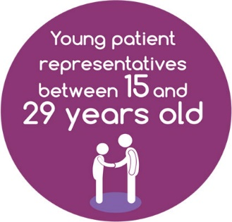
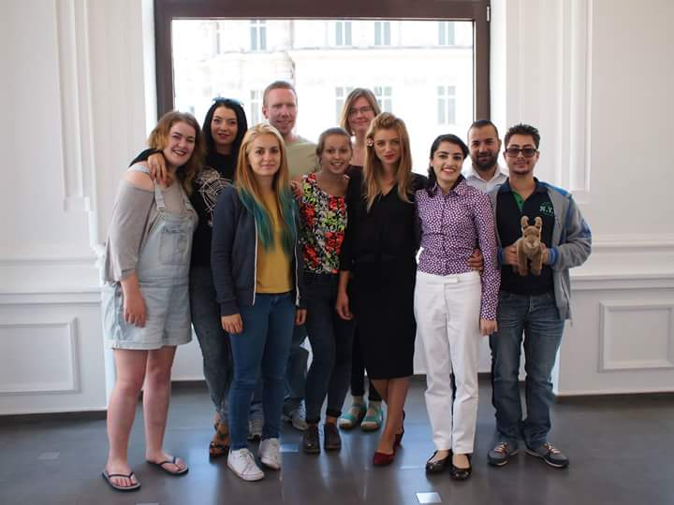



EPF Youth Group
GOALS
  Strengthening the involvement and representation of young patients in patient organisations
  Promoting young patients’ rights and recognition of their needs and expectations within and beyond health policy area
  Promoting better cooperation between young patient and adult patient advocates
  Strengthening young patient representatives’ skills and self-confidence

Slide 20
Added value of patient organisations: example of the European medicines agency
With thanks to the PCWP Secretariat for their kind permission to use EMA materials

Slide 21
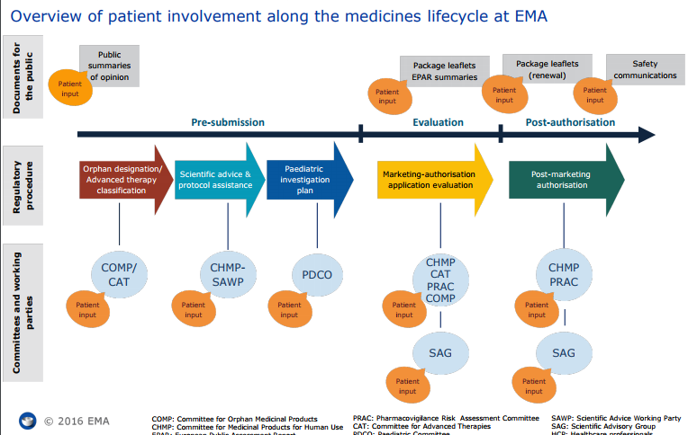
Patient involvement in the lifecycle at EMA
Patients involved in every aspect of regulatory lifecycle of medicines, from pre-submission and evaluation through to post-authorisation

Slide 22
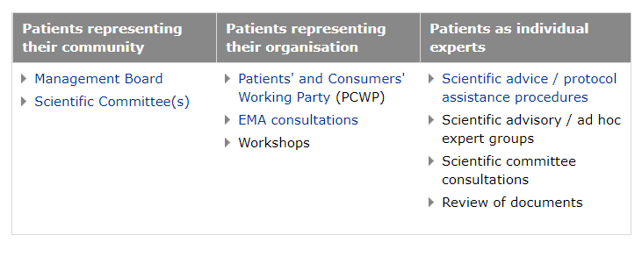
Roles of patient representatives
Patients as representatives of EU organisations, of their own organisation, or as individual experts (depending on nature of the activity)

Slide 23
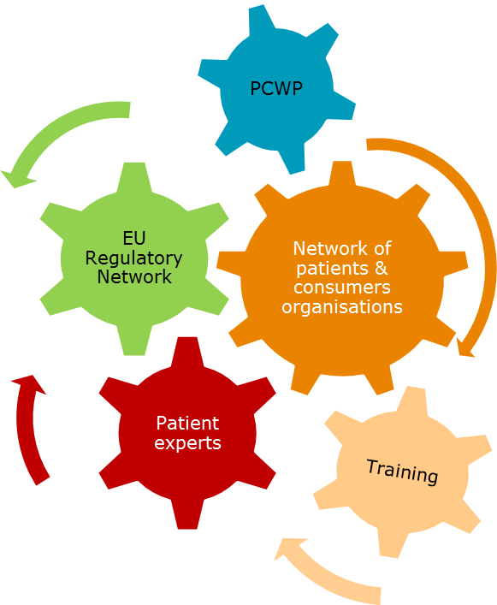
Comprised of five critical elements
A Framework of interaction
A network of European patients and consumers organisations
A forum of exchange: EMA Working Party with Patients and Consumers’ organisations
A pool of patients acting as experts in their disease and its management
Interaction with the EU Regulatory Network
Capacity-building focusing on training and raising awareness about EU regulatory system

Slide 24
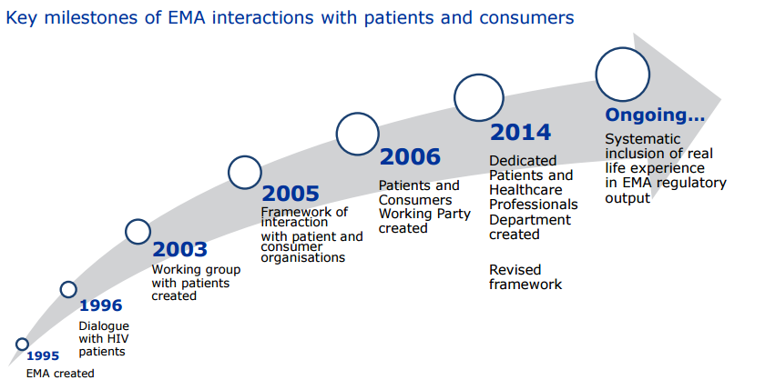
Patient involvement is increasing…
… at all levels and stages of regulatory process – this demonstrates its added-value & recognition of patients as legitimate partners
http://www.ema.europa.eu/ema/index.jsp?curl=pages/partners_and_networks/general/general_content_000317.jsp&mid=WC0b01ac058003500c

Slide 25
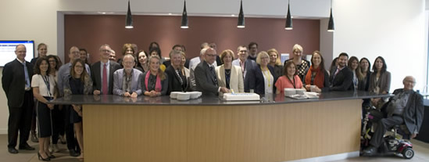

The Patients and Consumers Working Party (PCWP)
The PCWP: vital platform for dialogue
  Platform for dialogue and exchange between the EMA and patient organisations
  Representation from 20 organisations, EMA committees & Management Board
  Four plenary meetings per year, and consulted as and when needed
  2016:
  10th Anniversary!

Slide 26
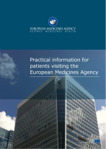
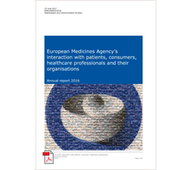
EMA Training and Tools for Patients
'EMA Basics' videos
The European Medicines Agency
The centralised procedure
Involvement of patients
The Patients’ and Consumers’ Working Party
EMA video for patient representatives
Pharmacovigilance
How EMA works with healthcare professionals
Scientific advice: what to expect and how to prepare
Declarations of interests: a practical guide
How patients are involved in the review of documents
What is a European safety referral

Slide 28
The Added value of patient organisations: making it visible

Slide 29
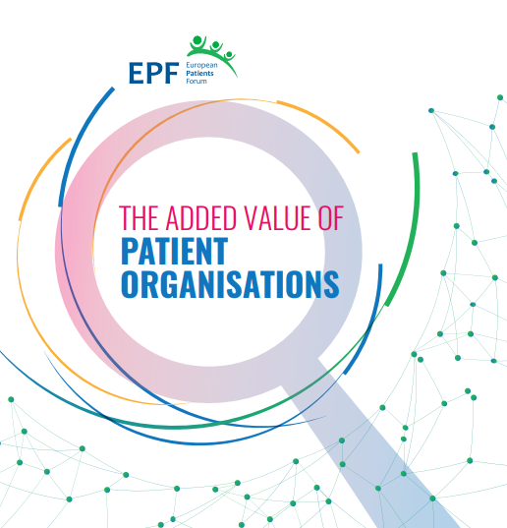
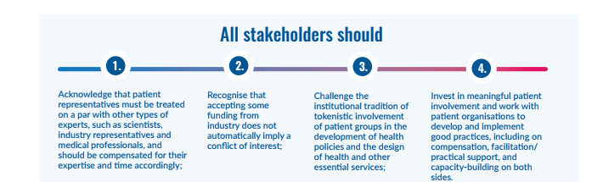
Patient organisations: the untapped potential of healthcare systems
EPF-commissioned report (2017) makes visible the invisible added value, clarifies role and activities of patient organisations
PO are invaluable partners both at European and national level
In therapeutic R&D, (public) health research, service co-design and evaluation, capacity-building, peer support, policy formulation..
Notes:
PO have long ago overstepped their initial role as self-help organisations, where individual patients share experiences of a specific disease. If peer support remains one of the core missions of patient organisations, the report identifies three further areas where patient organisations undertake activities: policy and advocacy, capacity-building and education, and research and development.
“Patient organisations are invaluable partners in the policy process, providing input through stakeholder advisory groups, expert panels, European and/or national government public consultations or institutional meetings”, the report finds.

Slide 30
Key recommendations of EPF report
Political decision-makers should:
Adopt patient involvement as a value in itself
Recognise that usual (quantitative) impact assessment methods may not capture added value of patient input
Work together with Pos to develop meaningful methods of evaluation
Find ways of providing unrestricted funding to help PO do their daily work
Work with PO to identify appropriate, sustainable funding base
Enable PO to provide input into all stages of policy development and evaluation
Introduce quotas in expert groups for patient and/or public NGOs
Invite PO to become involved in development of non-health sector policies (e.g. environment, urban, housing, transport, food..)
Notes:
PO have long ago overstepped their initial role as self-help organisations, where individual patients share experiences of a specific disease. If peer support remains one of the core missions of patient organisations, the report identifies three further areas where patient organisations undertake activities: policy and advocacy, capacity-building and education, and research and development.
“Patient organisations are invaluable partners in the policy process, providing input through stakeholder advisory groups, expert panels, European and/or national government public consultations or institutional meetings”, the report finds.

Slide 31
Conclusion & food for thought

Slide 32


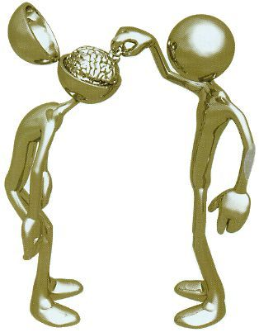

Why do strong patient organisations matter?
EPF’ experience shows:
EU legislation is demonstrably more patient-centred, thanks in part to our advocacy work over years (e.g. pharmacovigilance, cross-border healthcare directive)
Soft law and policy: a clearer, more nuanced patient perspective (e.g. patient safety recommendations)
Real evidence for change thanks to our investment in solid project work
Notes:
Legislation is more demonstrably patient-centred , thanks in part to our advocacy work
(e.g Clinical Trials – provisions on informed consent, transparency and patient involvement, MDD – patient safety, transparency, patient involvement, Cross Border Healthcare – commitment to quality information, ‘ patient centred ‘Pharmacovigivilance- Direct Patient Reporting of adverse events)
Our work does not stop in Brussels or Strasbourg – appropriate and effective implementation of the legislation is equally important to us e.g; CBHC
Soft law and policy – a clearer , more nuanced patient perspective in advances on patient safety, quality of care, patient empowerment, health literacy that has helped to take discussions forward and create a groundswell of support and ambition to do things differently.
Our investment in solid project work – to provide real evidence for change, from the patient’s perspective, that is recognised and respected by other healthcare players
Capacity building – apart from the obvious skill and know-how building, confidence and identity among patient groups at being part of a ‘ patients movement’

Slide 33




A challenge for decision-makers
Individual patient experts should be treated like other experts
1
Patient empowerment and involvement: a “sine qua non” quality criterion for healthcare
There are now “seats at the table” – is the patient voice really heard?
How can you encourage “meaningful” patient involvement as opposed to tokenism?
Is the need for capacity-building for those involving patients sufficiently recognised ?
2
3
4

