Slide 1



AirQ+ for the assessment of the health risks of air pollution: utilization, communication of results and potential improvements:
patients’ perspective
Daniela Morghenti
Policy Adviser
World Health Organisation
Bonn, 13/15 February 2017

Slide 2


Content
Who we are
Our vision
Our mission
How AirQ+ can improve patients’ quality of life?
1. Preventive health approach is met
° Policy design: measure air quality
° Communication
2. Readiness of the Health Care System
3. Effective Self Management
4. Involvement of patients’ associations
° Case study: EFA
° Case study: EFA members
AirQ+ evaluation at the status quo

Slide 3
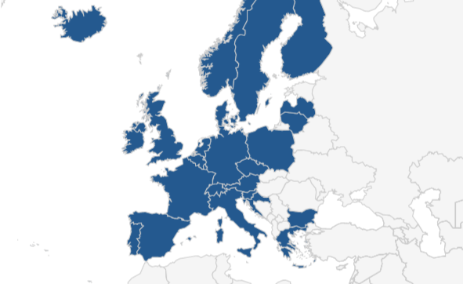
Who we are
The European Federation of Allergy and Airways Diseases Patients Associations (EFA) is a European network of:
42 allergy, asthma and chronic obstructive pulmonary (COPD) patients national organisations
in 25 European countries
representing 500,000 patients in Europe
30 million people in Europe have allergy, asthma, and COPD

Slide 4
Our vision
EFA is dedicated to making Europe a place where people with allergy, asthma, and COPD patients’:
Live in safe environment and health in all policies approach is met
Live uncompromised lives
Patients are actively involved in all decision influencing their health
87% of Europeans think respiratory diseases
asthma and allergy
are a serious problem caused by air pollution
[Eurobarometer 2012, Attitudes of Europeans towards air quality]

Slide 5
Our mission
EFA is dedicated to making Europe a place where people with allergy, asthma, and COPD patients’ are represented:
We are actively involved in the dialogue with policy makers and we closely collaborate with EU agencies
We foster dialogue, exchange and collaboration among our network of national patients’ associations
We participate in European projects
“If we do not link health costs and air quality and communicate this to the politicians, we are going to lose the battle”
MEP Sirpa Pietikäinen (EPP),
Co-leader of the IG Asthma and Allergy at the European Parliament
“Clean air is of supreme importance to our health”
MEP Nessa Childers (S&D),
Co-leader of the IG Asthma and Allergy at the European Parliament

Slide 6
How AirQ+ can improve patients’ quality of life?
4 main pillars
Preventative health approach in all policies is met, both in long and short term air term pollution exposure
° Policy design
° Communication
2. Readiness of health care infrastructures to tackle emergency respiratory symptoms
3. Accurate and timely information and tools for effective self management of respiratory symptoms
4. Involvement of patients associations in the decision making process on air quality

Slide 7
1. Preventive health approach is met
The total exposure approach is essential to evaluate the health effects from the air pollution to
improve the quality of life of patients & vulnerable people
Policy design (long term):
Health risk assessment has to be quantitative and qualitative:
a) It should evaluate both indoor and outdoor air quality effects to improve patients’ quality of life and prevent the onset of chronic respiratory diseases
b) Health hazard evaluation should be extended to additional hazards and their effects on patients with allergy, asthma, and COPD
Communication (long and short terms):
Authorities and media should communicate timely with accurate information on how to prevent harmful exposure to bad air quality

Slide 8
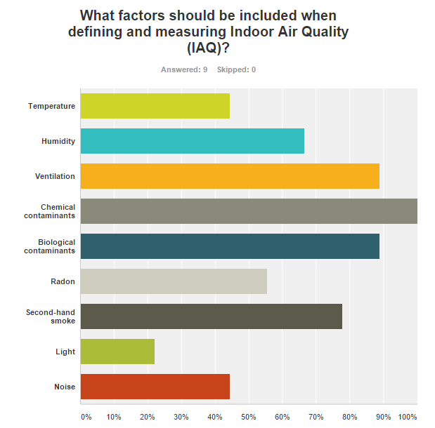
1.2. Policy design: measure air quality
Quantifying the effects of exposure to outdoor air pollution is not enough, EFA patients definition of air quality pledges for a quantification based on a broader health hazard evaluation approach
“EFA Working Group on Environmental Determinants proposed to develop a definition of IAQ, with the goal to have a set of comprehensive factors, values and measurements”

Slide 9
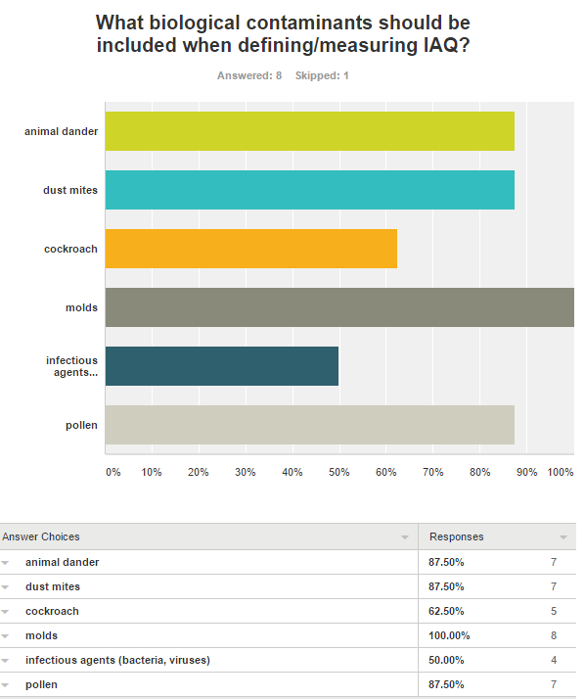
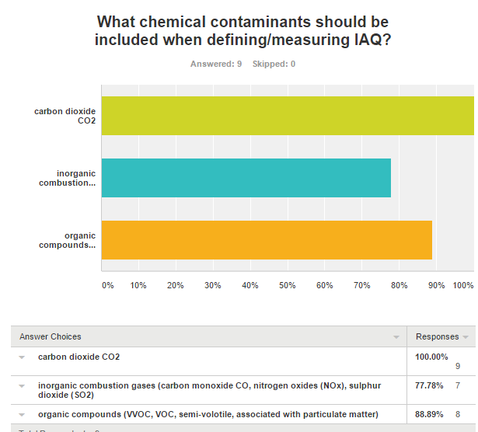
1.2. Policy design: measure air quality
Health hazard evaluation should include also biological and chemical contaminants

Slide 10
1.3. Communication
Lack of knowledge on air pollution risks increases vulnerability, communications should be disseminated in compliance with legislative acts & guidelines
Ambient Air Quality Directive 2008/50/EC states:
It is compulsory to inform the public of the level of ground air pollution, free of charge
Competent authorities need to ensure that information is made available to the public, even in the case of trans-boundary air pollution
Annex XVI, point 4 c), Public information on alerts and forecast should include
  type of population concerned, possible health effects and recommended behaviours
  information on population groups at risk
  description of likely symptoms
  recommended precautions to be taken by the population concerned
  - where to find further information
3 out of 5 Europeans
do not feel informed about air quality and policies in the EU
[Eurobarometer 2012]

Slide 11
1.3. Communication
According to legislative acts & guidelines, public authorities should communicate following 3 principles:
Data available:
Information should be channeled
The results should be disseminated at regional and urban level
Communication about peak of air quality pollution (short and timely terme analysis)
Messages tailored:
In terms of quality of life
Premature deaths and number of deaths metrics
Information should respond to the specificities of the audience (different information adopted to scope: regional, local, urban level / population categories / risks)
Information accessible (vs. « only » available):
Clear information and simple/understable messages
Easy to find

Slide 12
2. Readiness of the Health Care System
In the event of massive wheezing, coughing, breathlessness symptoms due to poor air quality, health infrastructure should be ready to embrace patients’ urgent needs :
National/regional/local real time air quality monitoring by public institutions to protect vulnerable people (i.e. allergy and asthma patients), immediately cascaded to healthcare infrastructures
Harmonised agreement about quality criteria and data
Education for air quality local desk officers to interpret air pollutant impact on human health – monitoring should be coupled with healthcare protocols
Health protocols should be defined and resourced to ensure readiness in health infrastructures in the event of air pollution peaks
Systematic dialogue with respiratory professionals and patients associations to cascade emergency measures and monitor unreported exacerbations among the population

Slide 13
3. Effective Self Management
Information available, accessible, and public information on alerts and forecast about air pollution effects on health to vulnerable people
Disseminate specific advice on how to limit exposure and recognize symptoms, in particular in high pollen season (and preferably at local level)
Develop mobile technologies (mHealth) to inform about real-time air pollution and its effects on health
Constantly report at national and urban level (single and/or multiple cities)

Slide 14
4. Involvement of patients associations
European and national patients’ association involvement is crucial to reach chronic respiratory diseases patients:
Patients’ associations play a key role in the interinstitutional dialogue at national, regional, and local levels
Patients’ association organize public campaign to increase awareness amongst citizens about the disease, symptoms, and self-management
Patients’ association have an active role in research projects and tools
National patients’ associations are trusted interlocutors to other patients, through their daily informative activities

Slide 15
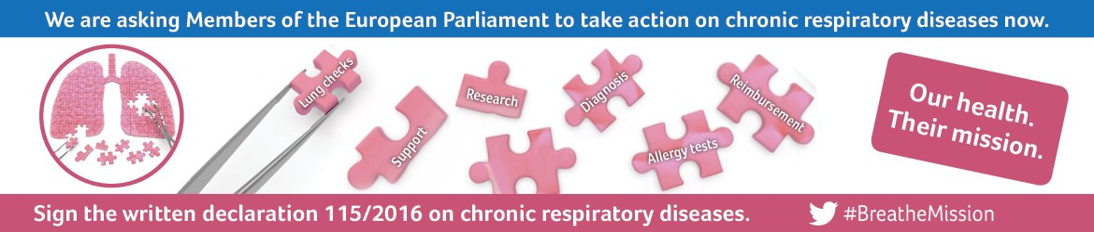


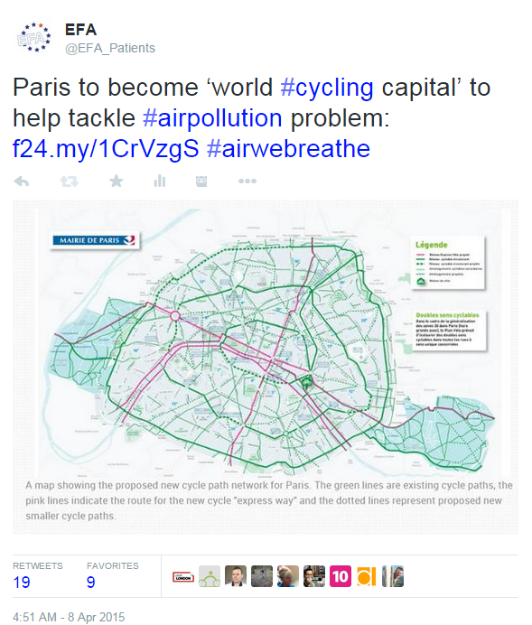

4.1 Case study: EFA
Policy expertise:
Decision making participation (CALL TO ACTION soon!)
Advocacy campaigns (Written Declaration n 115)
Environment determinants working group (IAQ)
Thematic trainings (NEW!)
European projects:
Hackair
myAirCoach
  External communications:
Social media
Dedicated website to specific projects
Monthly newsletter

Slide 16


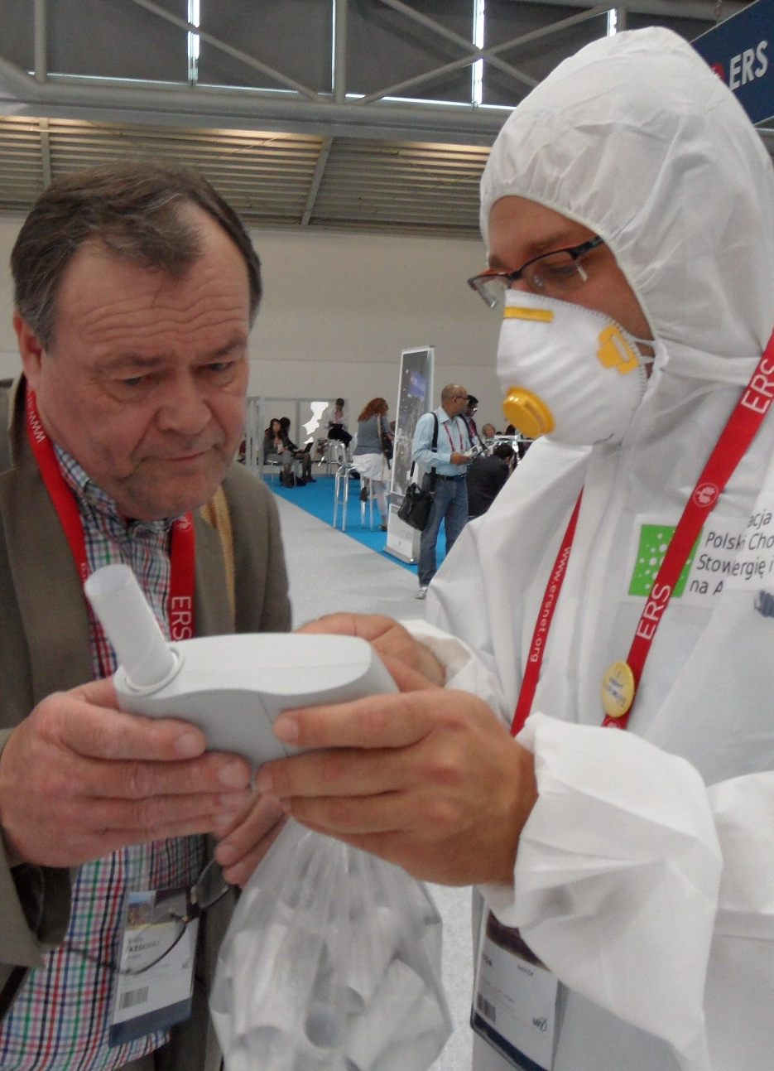

4.2 Case studies: EFA Members

Slide 17
AirQ+ evaluation at the status quo
Yes: policy making and communication of results …
Extensive data analysis and trusted information
Policy implementation and design (4 pillars)
Involvement of local administrations
Ambient Air Quality Directive 2008/50/EC application
Participation of patients’ associations
But: difficulties …
Advocacy evaluation in terms of quality of life : minimum 1 year term analysis of data available to have a real picture of the amount of air pollution breathed in by humans
Possible difficulties to compare datasets
Inflexibility to timely analyze and react to ongoing changes
Technical problem to use/download the software
Something is still missing according to the patients’ perspective in the general approach
Estimation of the population exposure to air pollutants living in cities >500.000 inhabitants by regular questionnaires and clinical reports
Regular respiratory health risk estimation of the population living near pollutant factories (2 years)
Law enforcement programme to evaluate data and to carry out adequate vigilance of pollutants factories
International alert system and exchange of information

Slide 18
Thank you!
Daniela Morghenti
EU policy adviser
daniela.morghenti@efanet.org

Slide 19

European Federation of Allergy and Airways Diseases Patients’ Associations
35 Rue du Congrès
1000 Brussels
Belgium
Tel.: +32 (0)2 227 2712
Email: info@efanet.org
Twitter: @EFA_Patients

