Slide 1
German Patient Liga, Airway Diseases DPLA e.V.
Antje-H. Fink-Wagner, PhD.
Lisboa, April 16, 2018
www.pat-liga.de
info@pat-liga.de

Slide 2
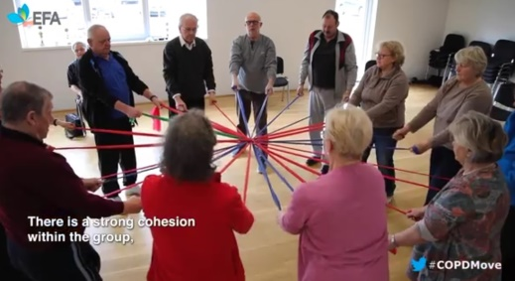
Airmail = Luftpost - 1 Issue/Quarter since 26 years/€10,00/Year - Asthma, COPD, Lungtransplantation, Cough - Comorbidities - Up-to-date Guidelines - Lungsport - Lung Hospitals - Other lung self-help groups (e.g. including Allergies) - Education appointments - Rehabilitation - New development in diagnosis and therapy - Social policy - Quality of Life for patients including psychological aspects - News from the regional offices

Slide 3
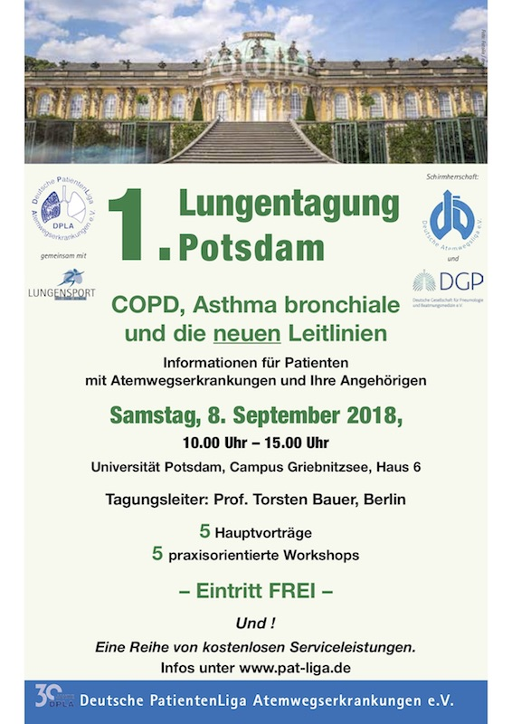

Slide 5
Thank you!
www.pat-liga.de
info@pat-liga.de

