Slide 1


The Asthma Society of Ireland
Ashling Jennings
Health Promotion Officer
EFA AGM, Lisbon
16th April 2018

Slide 2
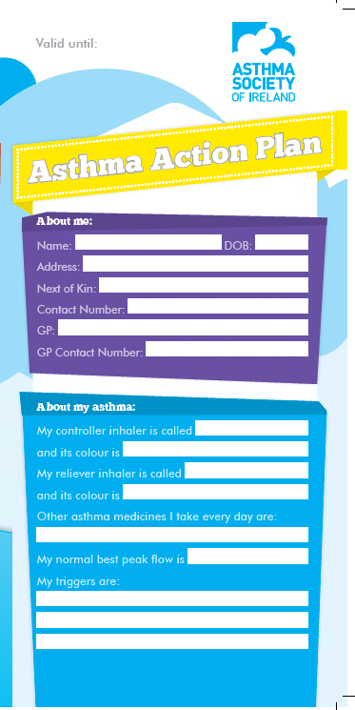
Self-management Support (SMS)
“The systematic provision of education and supportive interventions by health care staff to increase patients’ skills and confidence in managing their health problems”
Asthma SMS interventions:
Patient education
Written action plans
Why SMS?
Improved quality of life
Reduced hospital admissions
Reduced use of urgent and unscheduled health care
Notes:
Health Information and Quality Authority (2015). Health technology assessment of chronic disease self-management support interventions.

Slide 3



Joint Asthma and COPD Adviceline
Patient education and empowerment service
Accredited by the Helplines Partnership in the UK
12 month pilot – Asthma Adviceline expanded to also provide support to those with COPD
Evaluation conducted in 2017 – comprehensive and robust evidence the service was effectively delivering agreed objectives
Notes:
The Helplines Standard is a nationally recognised quality standard which defines and accredits best practice in helpline work.

Slide 4

Joint Asthma and COPD Adviceline
Learning from the evaluation:
  Use of information packs and self-management plans
  Focus on increasing the reach of service
  Ongoing monitoring and evaluation
  Channels of communication
  Use of technology

Slide 5

Asthma in the Pharmacy Programme
Private face-to-face consultation with an Asthma Specialist Nurse
  Up to 10 patients can be seen over a 6 hour period
Benefits to patient:
  Complete an Asthma Control Test
  Personalised asthma education
  Inhaler technique review and education
In 2017:
  112 clinics held nationwide
  830 people availed of a free consultation

Slide 6


Asthma and Sport
2017:
Partnership with the Gaelic Athletic Association (GAA)
2018:
Development and launch of ‘Active with Asthma’ resources including:
  A comprehensive booklet, factsheets, interactive quizzes and videos
Notes:
Supporting all people with asthma to be active
Team – individual sports

Slide 7


Thank You
Asthma Society of Ireland
42-43 Amiens Street,
Dublin 1
Email: ashling.jennings@asthma.ie
Phone: +353 (0)1 5549208

