Slide 1
Objectives
Promote and organize activities and meetings to ensure the living conditions to asthmatics and allergic patients Disclose and publish information about asthma / allergies Represent patients to health authorities and other institutions, interests & rights of asthmatics:
- Promote a database registries to severe asthma and severe allergies
- Medicare / anti-allergy vaccines / medical devices ...
- guarantee access to innovation
To implement a network of Educators in Asthma ...

Slide 2
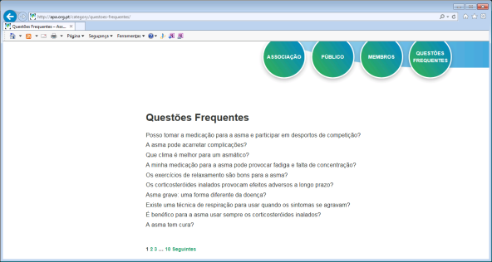
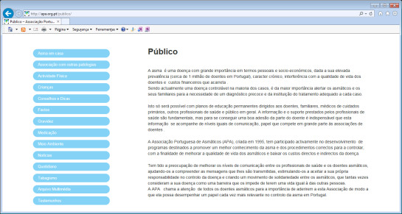
apa.org.pt
Fighting to have a better quality of LIFE

Slide 3
Educators in Asthma
Schools
Health Primary care
Nursing
Cardio pneumology technicians
Pharmacies
Social media professionals
Sportsmen

Slide 4
National Annual Forum
Involving
Asthmatics
Allergic patients
Health professionals
MD, nurses, CP technicians, etc.
Social welfare institutions
Educational Technicians (basic and intermediate schools)

Slide 5
Training courses to Asthma educators
Definition of asthma Information about health problem of asthma - prevalence - costs - family, social factors - occupational factors - quality of life Predisposing and triggering factors Co-morbidities (rhinitis, eczema, CV, COPD, GER, etc.) Asthma in the various stages of life - childhood - pregnancy - Elderly Treatment - use of regular medication and types of medication - how to use inhalers and expander chambers Social supports

Slide 6
Organize a meeting every 2 years for asthmatic patients Dissemination of informative contents for asthmatics, participating in campaigns / initiatives that contribute to increase health literacy in asthma
Videos, pamphlets, posters, books, etc. "Antenna Times": Radio, Television, Social Networks, ... The asthmatic at school / work / recreational activity Organization "Vacation courses"

Slide 7
Implemented
To enable asthmatic partners to join APA in a free way through partnerships, allowing access to a collaboration / participation / dynamization network ...
Organize database by age groups, gender, professional activity, region, ... and characteristics / severity of the disease ...

