Slide 1
Selected activities carried out by the Polish Federation of Asthma, Allergy and COPD Patients’ Associations
Artur BADYDA

Slide 2
www.astma-alergia-pochp.pl astma.federacja@gmail.com
The aim of the Polish Federation of Asthma, Allergy and COPD Patients’ Associations is to represent the interests of people with asthma, allergies and chronic obstructive pulmonary disease, defending their rights and freedoms, coordination of activities in this area and creating conditions for full and active participation of people with asthma, allergies and COPD in social life.
Participation in the organization of the World Asthma Day
Participation in the organization of the World Allergy Week
Participation in the organization of the World COPD Day
Participation in the organization of Spirometry Days (World and Polish)
Participation in the Dialogue for Health at the Ministry of Health, Poland
Participation in the project „Every breath counts" at the National Health Fund
Consultations on new drugs for the Agency of Medical Technologies Evaluation and Tarification

Slide 3
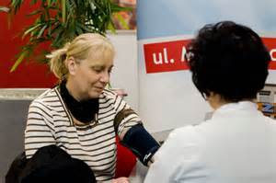
www.astma-alergia-pochp.pl astma.federacja@gmail.com
Participation in the World Asthma Day
Since 2005 we organise the World Asthma Day in Poland
In the 1st Tuesday of May specialists invited by the Federation conduct cost-free examination (including allergy tests, pulmonary function tests)

Slide 4
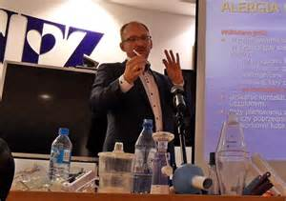
www.astma-alergia-pochp.pl astma.federacja@gmail.com
Participation in the World Allergy Week
Since 2010 we organise the World Allergy Week in Poland
In the 2nd week of April we conduct an education campaigns dedicated to allergy, living in polluted atmosphere and generally to pulmonary health

Slide 5
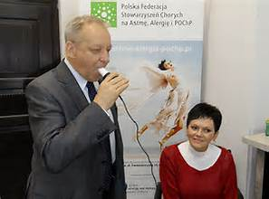
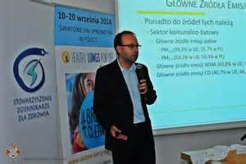
www.astma-alergia-pochp.pl astma.federacja@gmail.com
Participation in the World COPD Days
Since 2010 we organise the World COPD Days in Poland
In the 3rd week of November we conduct education campaigns dedicated to COPD; we also perform pulmonary function tests and medical consultations

Slide 6
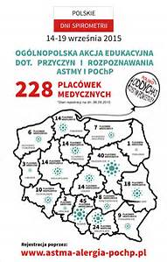
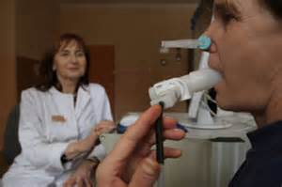
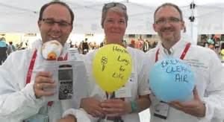
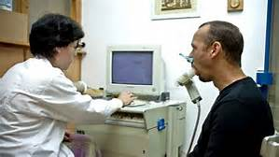
www.astma-alergia-pochp.pl astma.federacja@gmail.com
Participation in the World Spirometry Days and organisation of Polish Spirometry Days
Within last 8 years the Federation together with the Polish Society of Lung Diseases and Polish Society of Allergy examined over 60,000 people
In more than 10,000 of them bronchi obstruction was diagnosed and they received a letter to the doctor with a request to further diagnosis of asthma and/or COPD

Slide 7
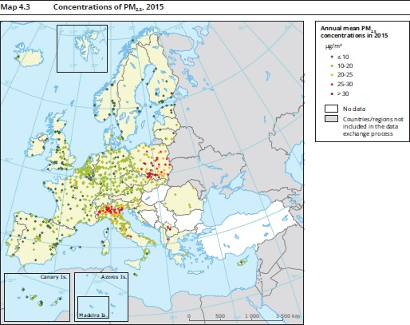
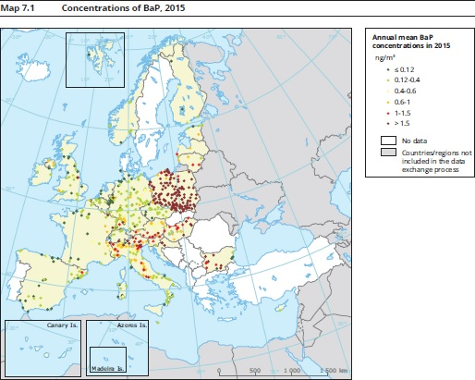
www.astma-alergia-pochp.pl astma.federacja@gmail.com
In Spirometry Days conducted in Poland we try to focus not only on tobacco addiction but also on environmental issues that could influence pulmonary health
Poland has one of the worst air quality in EU, especially in the context of PM_{2.5} and BaP

Slide 8
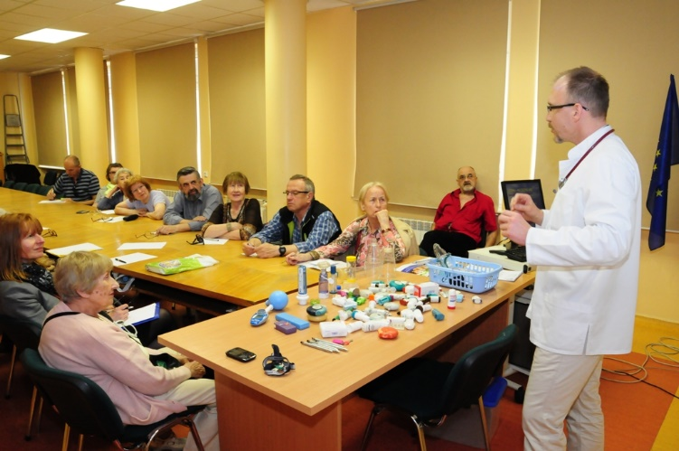
www.astma-alergia-pochp.pl astma.federacja@gmail.com
Participation in the Dialogue for Health in the Ministry of Health of the Republic of Poland
Consultation of the main legal acts regarding ailing people
Participation in the project Every breath counts in the National Health Fund
Education campaigns for patients in the National Health Fund and the School for ailing people

Slide 9
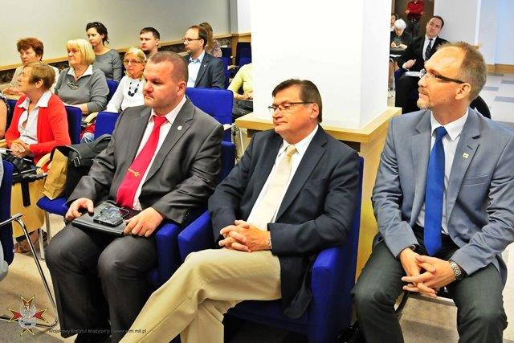
www.astma-alergia-pochp.pl astma.federacja@gmail.com
Anti-nicotine education campaign End with cigarette, initiated together with the Federation and the Institute of Patient's rights and Health Education
The organisers created a 12-week motivation program for people who want to stop their addiction and prepare to fight with their disease (www.koniecpapierosa.pl)
There was a possibility to contact the special call-centre for smokers where they could talk with a specialist in addiction therapy

Slide 10
Selected activities carried out by the Polish Federation of Asthma, Allergy and COPD Patients’ Associations
Artur BADYDA, Prof. of WUT, PhD, DSc, Eng.
Expert on environmental determinants of health
artur.badyda@pw.edu.pl

