Slide 1
How to overcome the barriers to research in chronic NCDs in Europe?
The case of allergy and asthma
European Parliament, October 9th, 2018
Karin Sipido, MD PhD
Chair, Scientific Panel for Health

Slide 2
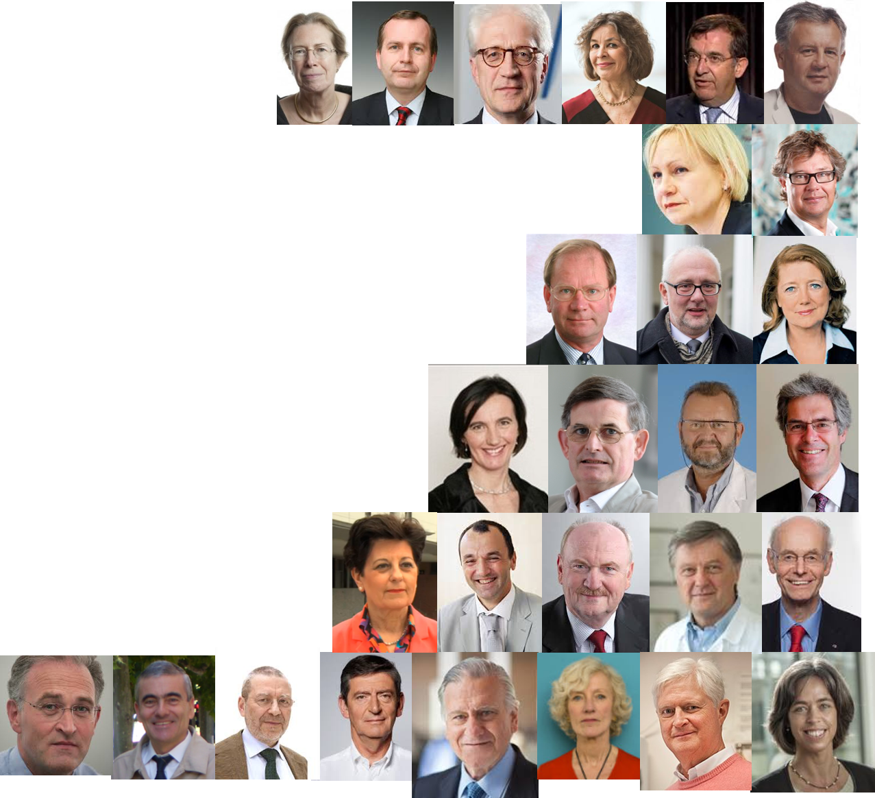
The Scientific Panel for Health
25 experts across disciplines and activities
advisors and liaisons to the community
Our mandate
to provide foresight, overall vision, strategy
to identify bottlenecks to innovation and propose solutions
to consult and connect
recommendations
Notes:
Updated and improved images

Slide 3
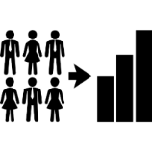
Health research in a connected and participative society
June 9th, 2017 – EC, Brussels
environment
population
interventions
societal participation
& benefit
research & discovery
innovation
public health
systems medicine
big data
novel technologies
multi-stakeholder collaboration
market
mechanisms
devices
health & economic value
Notes:
Note Horizon2020 interim evaluation- summary.. “The involvement of non - governmental organisations and civil society organisations still appears to be low. 48.5% of respondents agree that an increased involvement of citizen in priority setting is needed to further maximize the socio - economic impact of the EU framework programme for research and innovation whereas 37.9% disagree (13.6% don’t know)” (https://ec.europa.eu/research/evaluations/pdf/archive/h2020_evaluations/swd(2017)221-interim_evaluation-h2020.pdf#view=fit&pagemode=none )
3 points from Moedas video: 1. patient and people at the center (updated icons); 2. Open access…not a key item today..more about technology- open science/collaboration….; 3. Comprehensive policy- Focus in earlier slides today…need to focus on policymakers and member states..

Slide 4
Citizens and patients at the center of health research
.. patient and public involvement in health research and health care are still underachieving
Patients have different roles: as co-researchers to generate ideas and facilitate data collection, capture and review; as advisers; and as participants in policy. Educating patients leads to patient experts.
Novel trial design can optimize patient access and participation in novel treatments.
To achieve authentic patient empowerment, patients need to have a say in how value is measured in health care.
The lack of access of patients to their own data is a waste of co-creation opportunity: it disengages and disempowers patients, and wastes positive use of those data.
Participation is not about involvement of patients, but about engaging patients
https://ec.europa.eu/programmes/horizon2020/en/h2020-section/scientific-panel-health-sph

Slide 5
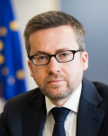
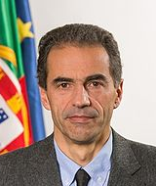
“There are many competing political priorities, so we must all shout about the importance of health research and innovation systems.”
Carlos Moedas, EU Commissioner
Research, Science & Innovation
“Specific needs for health research need further investment and require a collective effort in the years to come.”
Manuel Heitor, Minister of Science, Technology & Education, Portugal

Slide 6
*https://ec.europa.eu/programmes/horizon2020/en/h2020-section/scientific-panel-health-sph

Slide 7
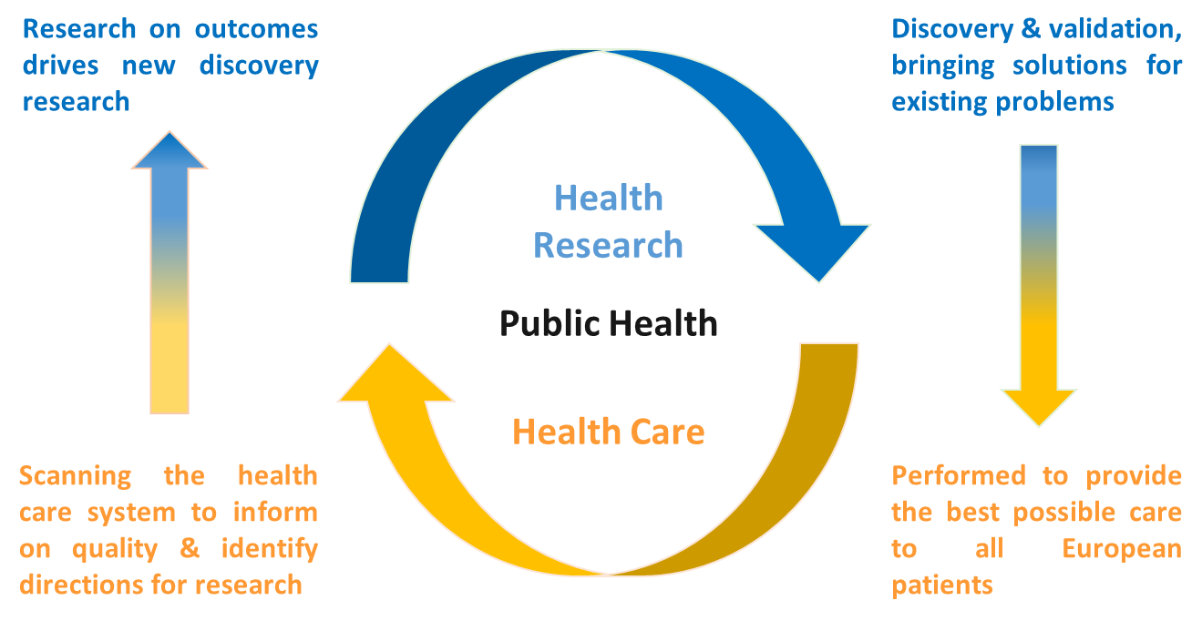
Specific needs and opportunities for health research
Health, health care and health research form a unique and interdependent ecosystem

Slide 8
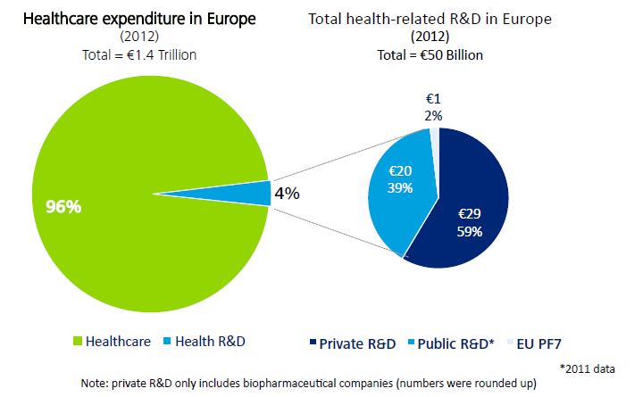
Europe as a whole spends about 10% of its gross domestic product on health care .. but only 0.4% on health-related R&D
Bouillon et al. Lancet. 2015; Deloitte Deloitte Health Economics Group 2013

Slide 9
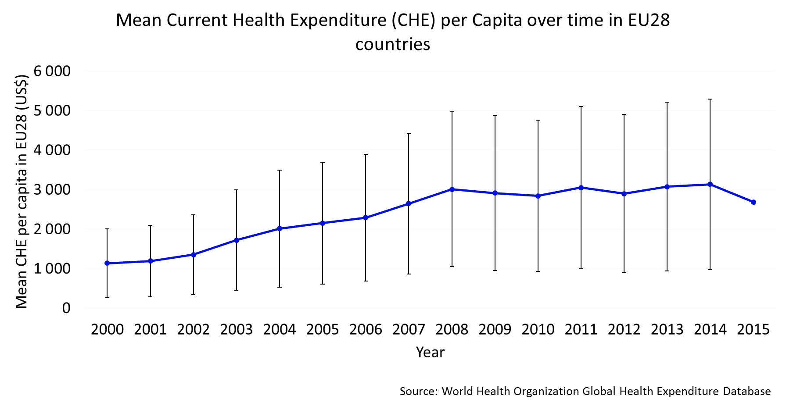
The rising costs in health care can only be managed through research underpinning decisions for implementation
Health care is a national competence but cannot be separated from research. Health research at the EU-level can identify and address mechanisms that reduce health inequality

Slide 10
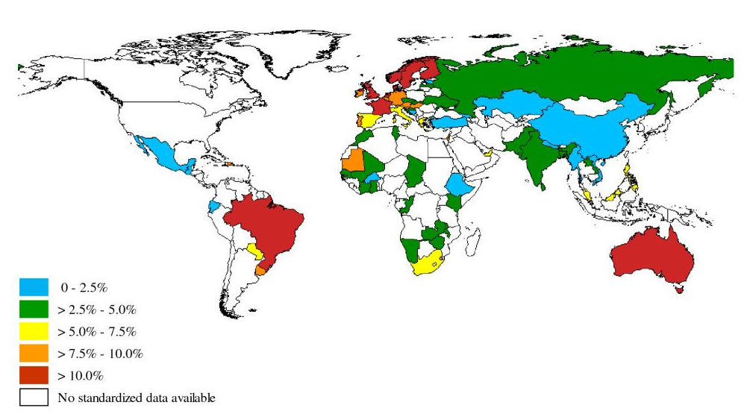
Health has no borders
Worldwide prevalence of clinical asthma.
To et al. BMC Public Health 2012; 12:204

Slide 11
Impact of collaboration - a study of cardiovascular disease research
Countries with high shares of collaborative research papers have highest impact
Gal et al. European Heart Journal 2016 Source: Thomson Reuters Web of Science Core Collection
Notes:
Assessing impact of collaborations
Aim: To assess the visibility/impact/citations received by collaborative research over time.
Methods: Unit of analysis can also vary (Country, Institution, authors, etc). Example given: countries chosen. Several indicators can be used for impact- here use
Outcomes: Countries with high shares of collaborative research papers also tend to have highest impact. Large countries tend to have lower share of internationally collaborative research. Visualization choices complex- here used ggplot in R to visualize. China has a relatively low share of internationally collaborative publications and overall the internationally collaborative publications from China have a higher impact/visibility/use by the international research community than do domestic publications from China.

Slide 12
Increasing collaborations between countries
Strongest collaborations (>0.09) observed between close country neighbors and smaller countries. USA, UK, Germany and France central to strong collaboration in CVR.
Gal et al. European Heart Journal 2016 Source: Thomson Reuters Web of Science Core Collection
Notes:
Assessing research collaboration
Aim: To cross-fertilization of cardiovascular research by identifying who is working together – doing research together and publishing together.
Methods: Unit of analysis can also vary (Country, Institution, authors, etc). Example given: countries chosen. Strength of collaboration is calculated using similarity scores of country-co-author-pairs.
Outcomes: Strongest collaborations observed between close country neighbors and smaller countries. Visualization choices complex- here used ggplot in R to visualize. Only strongest collaborations shown. Note: China and Hong Kong collaboration disappears after 1992-1998 because after this all publications from Hong Kong included in China data by WoS. China has many collaborations with other countries (not shown) but only one strong collaboration with the USA.

Slide 13
When it comes to collaborative research across borders
the EU is the prime source of public funding
Public funding
R&D - all
*Public funding
multinational collaborative research
.. but needs a common policy with national funding
*Scientific Panel for Health, K. Sipido - estimate based on MS funding schemes and EC reporting

Slide 14
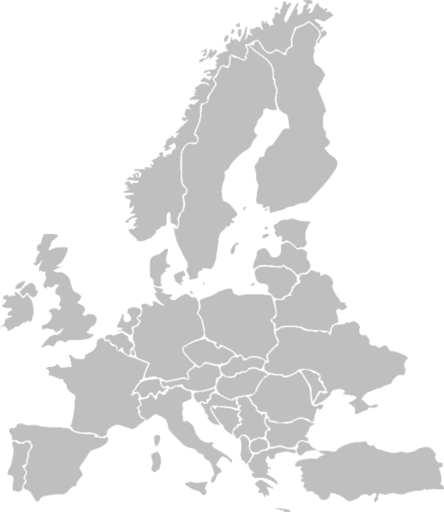
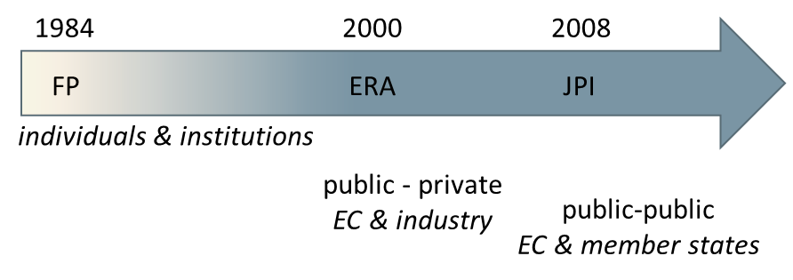
To increase impact, European health research would benefit from
EU-wide vision and strategy for health research across sectors and borders
Synergy with more cohesive and better aligned funding, programs and initiatives
Continuity in a long-term vision to increase efficiency and facilitate sustainable results
Visibility & leadership
More equality between European countries
Comprehensive policy
Synergy of programs

Slide 15
Health is a domain where Europe has the potential to lead in the global competition yet it still is an underdeveloped domain of common policy in Europe.
The Scientific Panel for Health therefore proposes to develop a comprehensive vision and strategy for health and health research, with a strong, visible leadership under the form of a European Council for Health Research, including all stakeholders.
.. to secure the future of health research, to improve the life of citizens
Building the Future of Health Research. A consensus document of the Scientific Panel for Health.
https://ec.europa.eu/programmes/horizon2020/en/h2020-section/scientific-panel-health-sph

