Slide 1
The asthma and COPD patient digital journey:
Preliminary findings of the EFA DIGIT Project
#EFAPatientsDigital
Valeria Ramiconi,
EFA Programme Manager
ELF Patient Networking Day
September 2, 2021

Slide 2
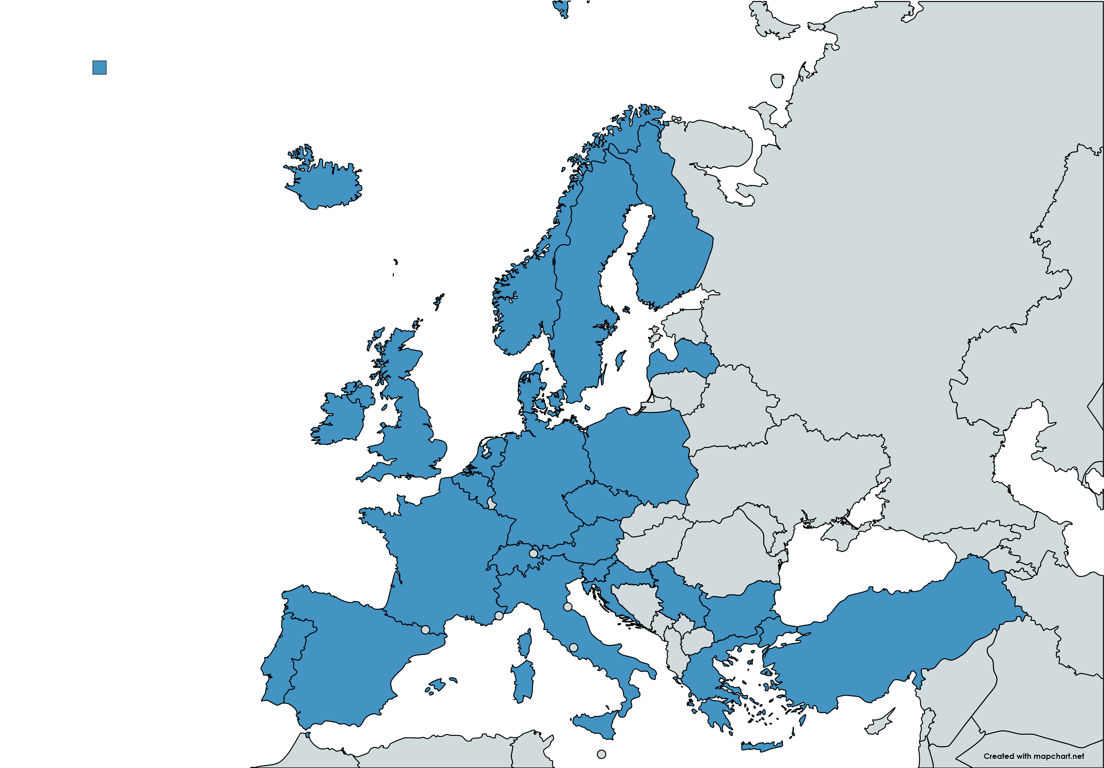
Who are we?
A European federation of 42 allergy, asthma and chronic obstructive pulmonary disease (COPD) national patients’ associations
Present in 25 European countries
We are the voice for over 200 million people living with allergy and airways diseases in Europe
We are dedicated to making Europe a place where patients can live uncompromised lives, have the right and access to high quality care, participate in their care, and to have a safe environment.

Slide 3
Digitalisation in health and care
Digital Health
eHealth and tele-Health
mHealth and wearables
Broad umbrella term encompassing e-Health and m-Health, as well as emerging areas, such as the use of advanced computing sciences in ‘big data’, genomics and artificial intelligence
The use of information and communications technologies in support of health and health-related fields (e-prescription). When the digital means are addressed to the delivery of healthcare for the patient, it is described as “tele-Health”
Subcategory of eHealth, is the use of mobile wireless technologies for health. When they are carried by the patient they are called “wearables”
Notes:
The world is undergoing a digital transition and the pandemic has accelerated its implementation in healthcare. Last year showed the importance of implementing and providing digital services and digital solutions that work for patients, including eHealth, telemedicine, contact-tracing apps.
Digital health refers to healthcare practices supported by electronic processes and communication. It includes a wide range of services and information technology such as electronic medical records, telemedicine, evidence-based medicine, consumer health informatics, etc.
Digitalisation has the enormous potential to improve the health services and patients’ self-management. It can shift from a disease-centred to patient-centred healthcare
The appropriate use of digital health takes the following dimensions into consideration: health promotion and disease prevention, patient safety, ethics, interoperability, intellectual property, data security (confidentiality, integrity, and availability), privacy, cost-effectiveness, patient engagement, and affordability. It should be people-centred, trust-based, evidence-based, effective, efficient, sustainable, inclusive, equitable and contextualized.
Patients benefit undoubtedly by the digital revolution in the area of health. E-Health and m-Health offer a great potential for patient empowerment and the modernization of health systems respectively, which can facilitate patient-centricity in health and personalised medicine in care.
Besides, a digital health system that monitors the disease over time and collects data (home monitoring), assist patients and assess their disease progress, leads to patients empowerment, enabling them to take with their healthcare professionals optimal care decisions. Furthermore, digital health can increase adherence, improving treatment outcomes
New digital tools, together with a greater access to information and knowledge, to new self-management solutions, are shifting the patient position in healthcare, enabling patients to become partners of their healthcare provider, rather than care receiver.
Digital tools rely on trust. Digitalisation must consider the privacy and security of patients and their data. Health data are the most sensitive facts of an individual, and therefore require strong regulatory framework that protect how data is created, owned, stored, and exploited, especially if these data will them inform healthcare decision-taking. As nowadays the flow of big data is vast, issues on privacy and data protection are a big concern for the patient community.
Nevertheless, the benefits of digitalisation, data gathering and analysis outweigh its drawbacks. This is why patients and their representatives are mostly willing to share their data for research purposes, the advancement of cutting-edge technology, and boosting digitally-enabled, person-centered care models.
WHO Global Strategy on Digital Health 2020-2025 https://cdn.who.int/media/docs/default-source/documents/gs4dhdaa2a9f352b0445bafbc79ca799dce4d_02adc66d-800b-4eb5-82d4-f0bc778a5a2c.pdf?sfvrsn=f112ede5_68
A journey towards smart health The impact of digitalization on patient experience, Deloitte 2018 https://www2.deloitte.com/content/dam/Deloitte/lu/Documents/life-sciences-health-care/lu_journey-smart-health-digitalisation.pdf

Slide 4
Digitalisation of care for patients
Self-management: Digital tools can help monitoring risk factors that lead to exacerbations, helping patients managing their condition. They can bring new approaches to communicate with healthcare providers too, enabling patients to become partners of their healthcare provider, rather than care receivers
Diagnosis - Digital data can support researchers better identify phenotypes and underlying disease mechanisms, leading to more specific treatments and quality of life, achieving precision and personalised medicine
Treatment: Digital solutions, such as apps or wearable can help increasing adherence, crucial to improve the quality of life. Digital tools can enable behavioural changes in patients, driving the shift from a disease-centred to patient-centred healthcare
Notes:
One of the major clinical concern for patients with asthma and COPD is misdiagnosis. That could be improved thanks to digitalized data that can support researchers better identify phenotypes and underlying disease mechanisms, leading to more specific treatments and quality of life, making medicine more personalised.
On the treatment level, digital solution, such as apps or wearable devices can help increasing adherence, which is particularly challenging in long-duration treatment for chronic diseases, but that is also crucial to improve the quality of life and avoid deterioration in patient’s condition. Digital tools can enable behavioural changes in patients, leading to more efficient ways of following the prescribed treatment.
Moreover, for chronic respiratory conditions with strong interlinkages with the external environment, such as asthma and COPD, digital tools can help monitoring the external factors that could led to exacerbations, helping patients in managing their conditions. Furthermore, self-management can strongly improve thanks to new ways of communicating with healthcare providers and to new programs and tools that help chronic patients in their daily lives.
WHO Guidelines on Hand Hygiene in Health Care: First Global Patient Safety Challenge Clean Care Is Safer Care.

Slide 5
Future EU Regulation on the European Health Data Space (EHDS)
GOALS
TOPICS
healthcare delivery (primary use of data)
health research
health policy making (secondary use of data)
Data quality and interoperability
Strong infrastructure and interoperability
stimulate innovation in health and care for better treatment and outcomes,
innovative solutions and foster use of digital technologies, including Artificial Intelligence
Facilitating better access to and exchange of health data is crucial to ensure:
A strong system of data governance and rules for data exchange
Promotion of better exchange and access to different types of health data to support:
Balance benefits from data sharing and protecting users sensitive personal data.
PILLARS
Tackling challenges from the collection, access, use and re-use of health data in healthcare
increased accessibility, availability and affordability of healthcare,
Notes:
The creation of a European Data Space is one of the priorities of the Commission 2019-2025, including the health sector. A common European Health Data Space will promote better exchange and access to different types of health data (electronic health records, genomics data, data from patient registries etc.), not only to support healthcare delivery (so-called primary use of data) but also for health research and health policy making purposes (so-called secondary use of data).

Slide 6
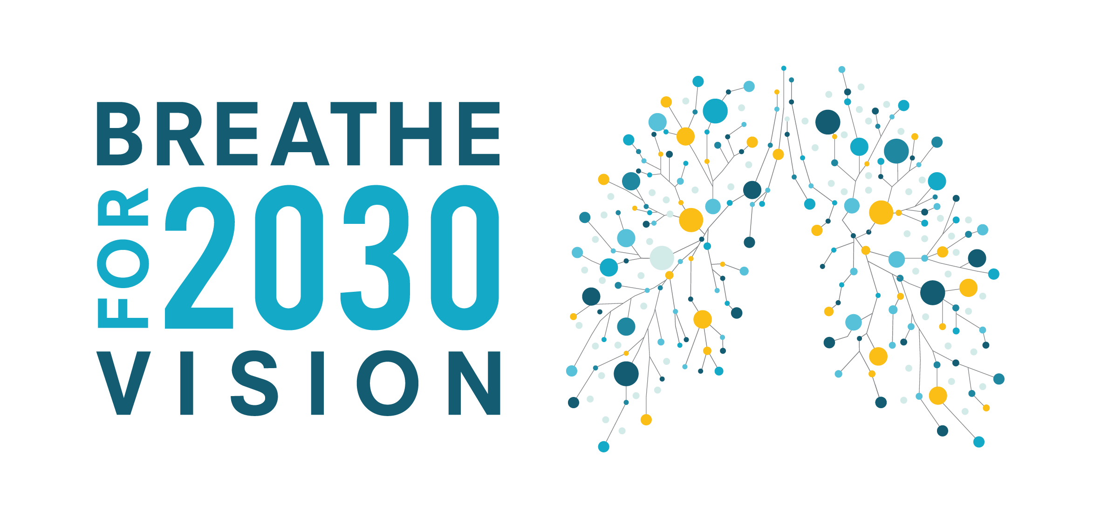
European Lung Health Group
Formed in 2020 as a collective initiative driven by European level patient groups and healthcare professionals: Alpha-1 Plus Belgium, CFE, EFA, ERS, ELF, LuCE, PHA-E, EU-IPFF, TBEC
With the ambition to draw more attention to lung health at the European level
5 main priority areas 2021-2030:
Raise awareness on respiratory diseases
Promote prevention across the board
Enable access to care
Advance research in respiratory health
Draw the lessons of the COVID-19 pandemic
4 thematic workstreams 2021-2022:
Air quality
Tobacco cessation
Medicines development and safety
Digital health
Notes:
The creation of a European Data Space is one of the priorities of the Commission 2019-2025, including the health sector. A common European Health Data Space will promote better exchange and access to different types of health data (electronic health records, genomics data, data from patient registries etc.), not only to support healthcare delivery (so-called primary use of data) but also for health research and health policy making purposes (so-called secondary use of data).

Slide 7
EFA and digitalisation
Develop an EU framework of trust and ethical standards around how data collection, sharing, usage and process, with patients as central actors.
Lowering technical barriers in the individual exercise of health data rights.
Improve patients and citizens access to data and enabling citizen science
Boosting digital health in Europe: for diagnosis, optimal care decisions, and improving treatment adherence, conceived as a part of the healthcare system with digital health equity, removing barriers to access digital services.
Ensuring informed, involved and empowered patients based on the principle of inclusiveness, and design and implement the space fully taking patients’ considerations into account.
EFA Responses to EU Health Data Space consultations:
Roadmap (March 2021) and Questionnaire (July 2021)
Notes:
The WHO defines patient empowerment as “a process in which patients understand their role, are given the knowledge and skills by their healthcare provider to perform a task in an environment that recognizes community and cultural differences and encourage patient participation.”. Digitalisation can enable this process. Especially patients with chronic disease, such as asthma and COPD, can benefit on different levels from access to digital tool.
One of the major clinical concern for patients with asthma and COPD is misdiagnosis. That could be improved thanks to digitalized data that can support researchers better identify phenotypes and underlying disease mechanisms, leading to more specific treatments and quality of life, making medicine more personalised.
On the treatment level, digital solution, such as apps or wearable devices can help increasing adherence, which is particularly challenging in long-duration treatment for chronic diseases, but that is also crucial to improve the quality of life and avoid deterioration in patient’s condition. Digital tools can enable behavioural changes in patients, leading to more efficient ways of following the prescribed treatment.
Moreover, for chronic respiratory conditions with strong interlinkages with the external environment, such as asthma and COPD, digital tools can help monitoring the external factors that could led to exacerbations, helping patients in managing their conditions. Furthermore, self-management can strongly improve thanks to new ways of communicating with healthcare providers and to new programs and tools that help chronic patients in their daily lives.
WHO Guidelines on Hand Hygiene in Health Care: First Global Patient Safety Challenge Clean Care Is Safer Care.

Slide 8
EFA’s 2021 DIGIT Project
970 asthma and COPD patients interviewed in Q2 2021
Questionnaire on access and use of digital health services, digitalization of diagnosis, digitalization of treatment, digitalization of care, digital use and sharing of health data, and digital empowerment
Aim
Objectives
to identify the existing gaps in accessing digital solutions
to identify potential biases (age, socio-economic status, level of education, level of digital literacy)
to understand the impact of the COVID crisis on the use and perception of digital solutions in healthcare
Who?
What?
Improving the understanding and confidence pathway for people with asthma and COPD in the digital health space, to become aware of theirs rights and possibilities.
to understand the digital needs, perceptions and use by asthma and COPD patients, with the aim to gather more insights on the asthma and COPD patient digital journey
5 countries: Belgium, Czech Republic, Ireland, Norway, and Spain
Notes:
The WHO defines patient empowerment as “a process in which patients understand their role, are given the knowledge and skills by their healthcare provider to perform a task in an environment that recognizes community and cultural differences and encourage patient participation.”. Digitalisation can enable this process. Especially patients with chronic disease, such as asthma and COPD, can benefit on different levels from access to digital tool.
One of the major clinical concern for patients with asthma and COPD is misdiagnosis. That could be improved thanks to digitalized data that can support researchers better identify phenotypes and underlying disease mechanisms, leading to more specific treatments and quality of life, making medicine more personalised.
On the treatment level, digital solution, such as apps or wearable devices can help increasing adherence, which is particularly challenging in long-duration treatment for chronic diseases, but that is also crucial to improve the quality of life and avoid deterioration in patient’s condition. Digital tools can enable behavioural changes in patients, leading to more efficient ways of following the prescribed treatment.
Moreover, for chronic respiratory conditions with strong interlinkages with the external environment, such as asthma and COPD, digital tools can help monitoring the external factors that could led to exacerbations, helping patients in managing their conditions. Furthermore, self-management can strongly improve thanks to new ways of communicating with healthcare providers and to new programs and tools that help chronic patients in their daily lives.
WHO Guidelines on Hand Hygiene in Health Care: First Global Patient Safety Challenge Clean Care Is Safer Care.

Slide 9
EFA’s 2021 DIGIT Project - Highlights
Use of general digital tools (e.g. internet, social media, etc.) is high among participants, especially among asthma patients
Compared with general digital tools, the specific use of e-health and m-health is overall comparatively low and often limited to simple, general and non-disease-related services and tools.
COVID pandemic increased the use of digital services and there are signs of more positive attitudes towards digitalisation. The pandemic has also boosted the use of e/m-Health, especially for video consultations, booking appointments and e-prescriptions
The results show that the general openness towards digital health services is quite high and that the low use must have other reasons
Notes:
The WHO defines patient empowerment as “a process in which patients understand their role, are given the knowledge and skills by their healthcare provider to perform a task in an environment that recognizes community and cultural differences and encourage patient participation.”. Digitalisation can enable this process. Especially patients with chronic disease, such as asthma and COPD, can benefit on different levels from access to digital tool.
One of the major clinical concern for patients with asthma and COPD is misdiagnosis. That could be improved thanks to digitalized data that can support researchers better identify phenotypes and underlying disease mechanisms, leading to more specific treatments and quality of life, making medicine more personalised.
On the treatment level, digital solution, such as apps or wearable devices can help increasing adherence, which is particularly challenging in long-duration treatment for chronic diseases, but that is also crucial to improve the quality of life and avoid deterioration in patient’s condition. Digital tools can enable behavioural changes in patients, leading to more efficient ways of following the prescribed treatment.
Moreover, for chronic respiratory conditions with strong interlinkages with the external environment, such as asthma and COPD, digital tools can help monitoring the external factors that could led to exacerbations, helping patients in managing their conditions. Furthermore, self-management can strongly improve thanks to new ways of communicating with healthcare providers and to new programs and tools that help chronic patients in their daily lives.
WHO Guidelines on Hand Hygiene in Health Care: First Global Patient Safety Challenge Clean Care Is Safer Care.

Slide 10
Use of digital health and data
EFA’s 2021 DIGIT Project - Highlights
Lack of awareness and availability of digital solutions
Main barriers
Main drivers
Better disease management
Sharing data to improve the conditions, treatments and research outcomes
Fear of losing the human contact with HCPs
Concerns about misuse of data (privacy and data security)
Notes:
The WHO defines patient empowerment as “a process in which patients understand their role, are given the knowledge and skills by their healthcare provider to perform a task in an environment that recognizes community and cultural differences and encourage patient participation.”. Digitalisation can enable this process. Especially patients with chronic disease, such as asthma and COPD, can benefit on different levels from access to digital tool.
One of the major clinical concern for patients with asthma and COPD is misdiagnosis. That could be improved thanks to digitalized data that can support researchers better identify phenotypes and underlying disease mechanisms, leading to more specific treatments and quality of life, making medicine more personalised.
On the treatment level, digital solution, such as apps or wearable devices can help increasing adherence, which is particularly challenging in long-duration treatment for chronic diseases, but that is also crucial to improve the quality of life and avoid deterioration in patient’s condition. Digital tools can enable behavioural changes in patients, leading to more efficient ways of following the prescribed treatment.
Moreover, for chronic respiratory conditions with strong interlinkages with the external environment, such as asthma and COPD, digital tools can help monitoring the external factors that could led to exacerbations, helping patients in managing their conditions. Furthermore, self-management can strongly improve thanks to new ways of communicating with healthcare providers and to new programs and tools that help chronic patients in their daily lives.
WHO Guidelines on Hand Hygiene in Health Care: First Global Patient Safety Challenge Clean Care Is Safer Care.

Slide 11
The DIGIT Project – Next Steps
Q4 2021
Q4 2021
Q4 2021
Q1-Q4 2022
Publication of EFA DIGIT Survey report
Publication of DIGIT Survey Countries Factsheets
Charter for asthma and COPD digital care
Dissemination Activities
Notes:
Charter of Rights for Digital Asthma and COPD Patients for the sharing, fair collection, use and protection of data and patient centred digital services.

Slide 12
THANK YOU
www.efanet.org

