Slide 1

Thresholds in allergen mandatory labelling: How much is too much?
TITLE OF YOUR PRESENTATION
Marcia Podestà
President of EFA and Food Allergy Italia

Slide 2

DISCLOSURE FORM:
In accordance with the National-Regional Regulation of 2 February 2017, art. 76, page 34
The undersigned, MARCIA PODESTA, as Speaker in this activity
I HERE DECLARE
NO, I have no relevant personal financial relationship in the medical/health field. The organisations which I am involved with, EFA and Food Allergy Italia received unrestricted educational grants from companies in the medical/health field.

Slide 3
Thresholds in allergen mandatory labelling: How much is too much?
Marcia Podestà, President of EFA and Food Allergy Italia
GA2LEN Anaphylaxis and Food Allergy Forum | 5 September 2024 | Padua, Italy

Slide 4

Thresholds in allergen mandatory labelling: how much is too much?
Marcia Podestà
President of EFA
European Federation of Allergy and Airways Diseases Patients’ Associations
President of Food Allergy Italia
marcia.podesta@efanet.org
GA2LEN Anaphylaxis and Food Allergy Forum Presentation Thresholds in allergen mandatory labelling

Slide 5
Thresholds in allergen mandatory labelling: How much is too much?
The current situation in Europe
Nordics (2)
the Netherlands (4)
Switzerland (1)
Swedish guide on undeclared allergens in food (2022) – yet no advice on safety choice
United Kingdom (3)
New policy in force since January 2024
(guidelines)
2-year transition
period
RfDs based on ED05
E.g. 5mg gluten, 2mg egg, 2mg milk, 5mg fish
Single threshold for all allergens above 1000ppm and for gluten above 100ppm [mg/kg]
Legally required
Law in force since 2017
Committee of Toxicity assessment of Codex report (2024)
Key outcome: ED01 more protective than ED05
Swiss Food Law, 2017 https://www.fedlex.admin.ch/eli/cc/2017/62/en#art_5
Swedish Food Agency, Undeclared allergens in food – guide on how to assess the risk of allergic reactions in the population (Version 2) 2022 https://bit.ly/3XsGY9z
UK Food Standards Agency, Committee on Toxicity (COT) assessment of the Codex report on food allergen thresholds, 2024 https://bit.ly/4g70xLV
Dutch Ministry of Health, Welfare and Sport (VWS), Guidelines on cross-contact of allergens, 2024 https://bit.ly/3XtgNiW
GA2LEN Anaphylaxis and Food Allergy Forum Presentation Thresholds in allergen mandatory labelling

Slide 6


EFA work with the
Observer since 2019, focusing on food labelling committee (CCFL)
Participation in CCFL meetings and Electronic Working Groups
Contribution to consultations on allergen labelling, e-commerce, use of technology for food information, exemptions in emergencies etc
Letter to Italian Codex contact point with proposals for future work:
A solid framework for ‘free-from’ labelling
Definition and labelling of vegan/vegetarian/plant-based products
GA2LEN Anaphylaxis and Food Allergy Forum Presentation Thresholds in allergen mandatory labelling

Slide 7
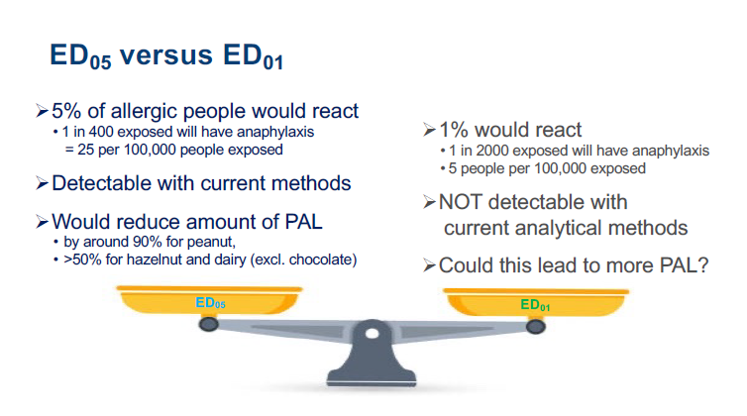
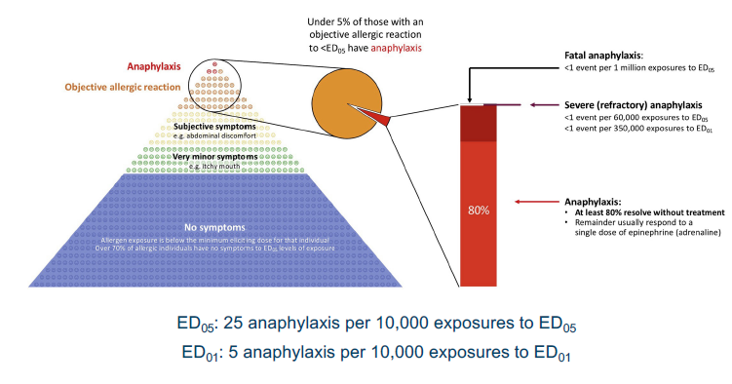
EFA work with the
Development of PAL Guidelines
Mandatory PAL to be included in an ‘Allergen Statement’ together with other allergy-related information
Strong support of RfDs based on ED05 as opposed to ED01
Detectable with existing methods
Leading to reduced and more trustworthy PAL
Negligible public health impact
In line with the FAO/WHO expert recommendation
Protect people still uncovered through identification and solid ‘free-from’ schemes
Two-tiered PAL is still premature as long as a legal definition of ‘traces’ is lacking
Specific advice needed on vulnerable groups e.g. infants, elderly etc.
Invest to inform the community of actual risks
*For more information on EFA’s positions on PAL, see here: https://bit.ly/3TdJNbS
Turner et al. JACI Pract. 2022;10:59-70
GA2LEN Anaphylaxis and Food Allergy Forum Presentation Thresholds in allergen mandatory labelling

Slide 8

Risk of allergic reactions depending on the patient's individual Eliciting Dose (ED)
Individual Risk-Assessment
Percentage of eating occasions that would result in a predicted allergic reaction (risk for a peanut allergic individual)¹
Peanut –allergic individual´s threshold value (mg) |  | Snack Chip Mixes (%) |  | Cookies (%) |  | Donuts, Snack Cakes (%) |  | Ice Cream (%)
1 |  | 45.8 |  | 44.5 |  | 56.0 |  | 60.7
3 |  | 32.3 |  | 31.2 |  | 42.4 |  | 46.9
10 |  | 17.6 |  | 16.2 |  | 27.5 |  | 32.3
30 |  | 5.6 |  | 5.5 |  | 14.0 |  | 19.0
100 |  | 0.5 |  | 0.4 |  | 2.2 |  | 5.8
300 |  | 0.009 |  | 0.012 |  | 0.027 |  | 0.295
1000 |  | NR |  | NR |  | NR |  | 0.0040
Based on modelling the risk of an allergic reaction to pre-packaged foods is inversely proportional to the patients ED
>> the lower the patient´s ED, the higher risk of an allergic reaction to UAP.
NR: No reaction predicted UAP: unintended allergen presence
1) J Baumert et al. J Allergy Clin Immunol Pract 2018;6:457-65.

Slide 9




Thresholds in allergen mandatory labelling: moving forward
EFA food allergy patient community aim at Codex Alimentarius harmonised approach and implementation
EFA food allergy community needs:
New diagnostic tools to better identify the amount that fits your patient
Inform the patients how strict should be their diet
Better diagnosis
Better labellings
GA2LEN Anaphylaxis and Food Allergy Forum Presentation Thresholds in allergen mandatory labelling

Slide 10

Thresholds in allergen mandatory labelling: moving forward
EFA food allergy patient community active at both the EU and international level
EFA is always ready to work with the medical community. Key areas:
Communicating science-based messages on risk perception to the public, including the most vulnerable
Further development and application of precision medicine in food allergy
Educational programmes on
the use and interpretation of PAL
GA2LEN Anaphylaxis and Food Allergy Forum Presentation Thresholds in allergen mandatory labelling

Slide 11





THANK YOU!
Marcia Podestà
marcia.podesta@efanet.org
efanet.org
@EFAPatients
@European Federation of Allergy and Airways Diseases Patients Associations
@efapatients
@EFAPatients
GA2LEN Anaphylaxis and Food Allergy Forum Presentation Thresholds in allergen mandatory labelling

