Slide 1
Are we neglecting the role of patients in the prevention of respiratory disease
Hubert Nettel
EFA Treasurer
Helsinki 30/08/2018

Slide 2
@EFA_Patients
Democratic patient organisation governed by AGM who elects the board of 5 members representatives
Founded 1991, registered as charity 1996
Represents members at the European level
EU advocacy, links patients into EU institutions
and agencies: EMA, EFSA, ECHA, WHO
European awareness
Sharing best practices
Capacity building
Patient driven evidence through projects/surveys
Partnership with European level organisations:
ERS, EAACI, EADV
Participation in EU research
Notes:
The European Federation of Allergy and Airways Diseases Patients’ Association is representing people with Allergy, Asthma and COPD.
EFA represents members at the European level:
EU advocacy, links patients into EU institutions and agencies: EMA (European Medicines Agency), EFSA (European Food Safety Authority), ECHA (European Chemicals Agency) and WHO (World Health Organisation)
EFA is involved in raising awareness of patients’ with asthma, allergy and COPD needs on a European level
EFA is also very involved in sharing best practices
As well as capacity building for its members
EFA contributes to patient driven evidence through various projects and surveys
And it partners with European organisations such as ERS (European Respiratory Society), EAACI (European Academy of Allergy and Clinical Immunology ) and EADV (European Academy of Dermatology and Venereology)
EFA is also actively involved in participating in EU research for its topics of interest

Slide 3
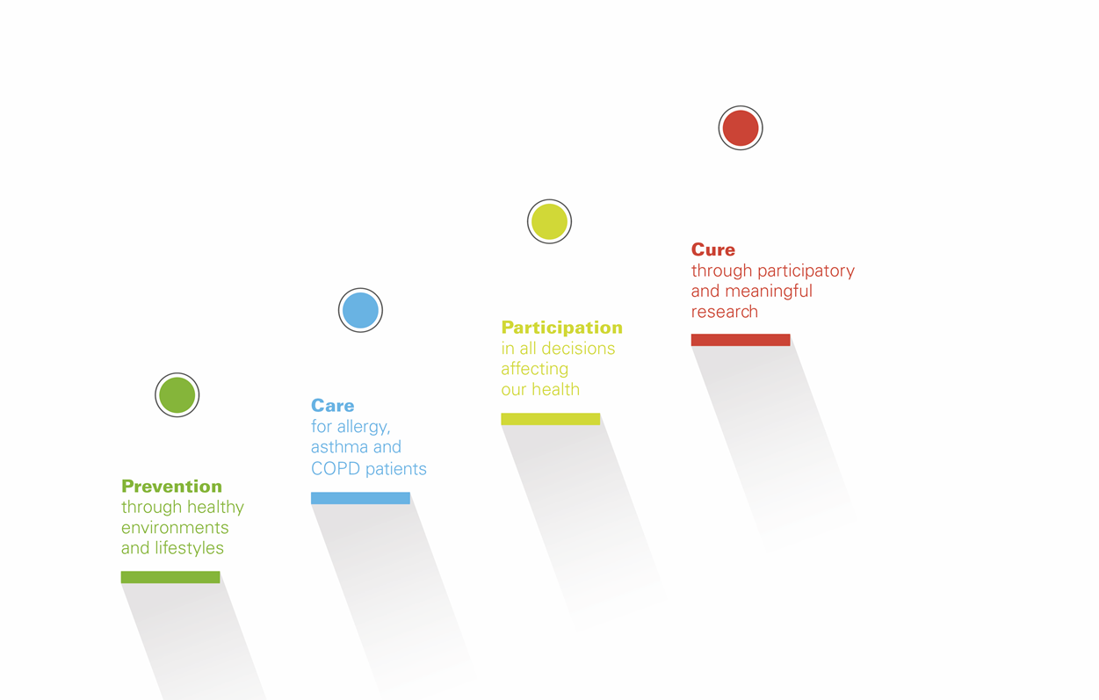
www.efanet.org/annual-report-2017
EQUALITY
Notes:
As you can see from this slide, “prevention through healthy environments and lifestyles” makes part of EFA’s absolute core objectives.
We are absolutely transparent, you can check our beautiful annual report online

Slide 4
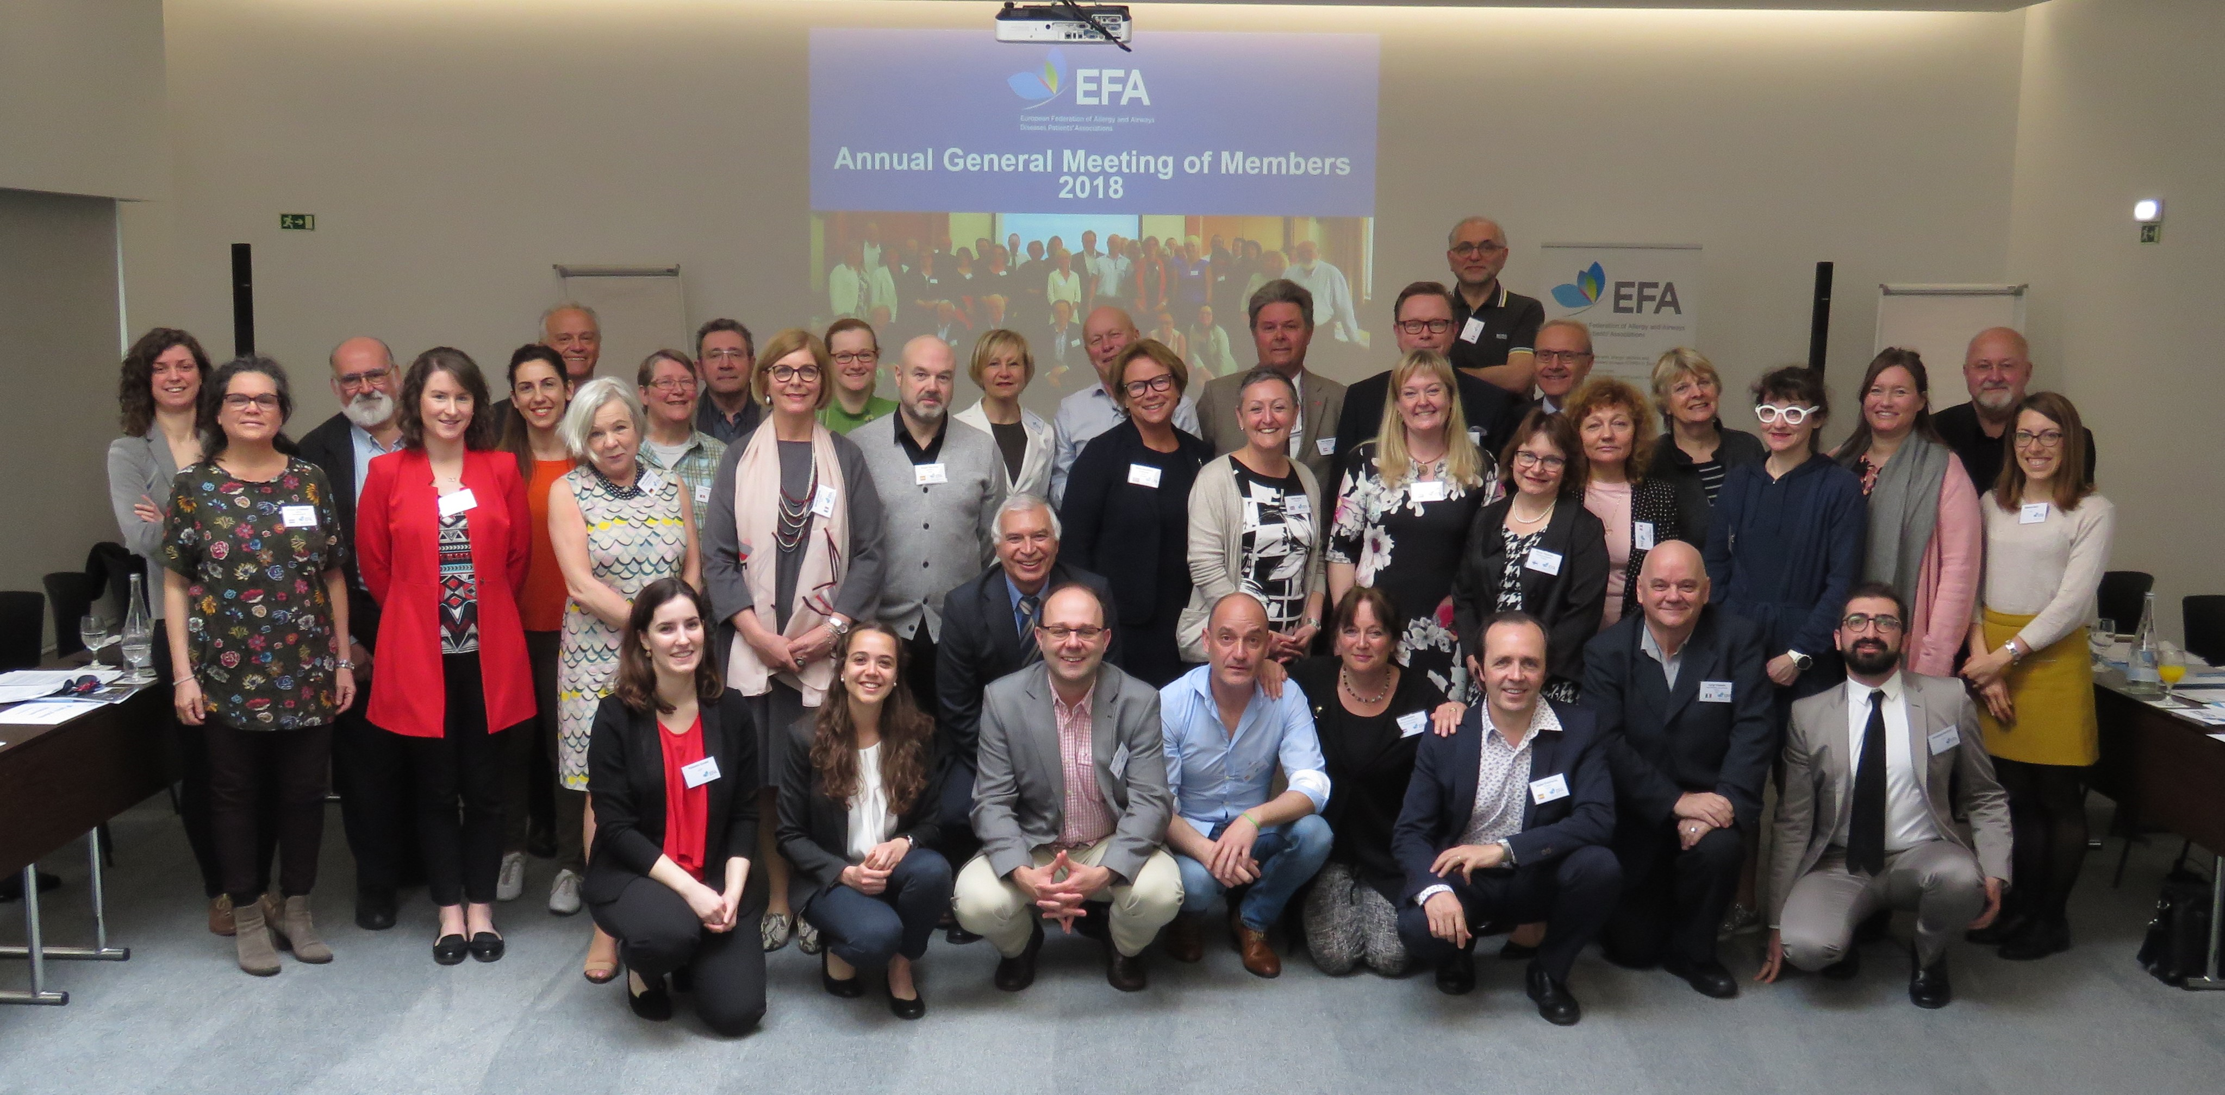
“Nothing about us without us”
EFA Members: 43 associations in 25 countries in Europe
http://www.efanet.org/who-we-are/members

Slide 5
Invest in patients,
increase prevention
Enable patients to self-manage
To reduce the asymmetric dialogue patients-health carers
To recalibrate the patient’s role managing their conditions
To help manage their healthcare risk
To increase participation in clinical trials
Promote the empowerment of patients
By including patient representatives in all decisions for prevention, as this is not the case in many countries
By investing in patient literacy/education,
at school or by health professionals
Notes:
At EFA we believe that there needs to be more investment in patients, and increase in prevention
Patients need to be enabled to self-manage
This would improve the current situation, as it will reduce the asymmetric dialogue between patients and health carers
It would help to recalibrate the role that patient has in managing their own conditions.
Self-management of patients will also help manage their healthcare risk (for instance the risk on the quality of life, the risk of non-adherence to medication, risk of side effects to medication)
It will also help increase clinical trial participation. Understanding barriers for patient participation in clinical trials and creating pathways to alleviate these obstacles are critical.
We believe that it is also important to promote the empowerment of patients, this can be done by:
patient representatives should be included in all decisions for prevention, as, sadly this is not the case in many countries
By investing in patient literacy/education. Being health literate empowers patients to understand information about their health and make more informed decisions. Low health literacy, or the lack of health literacy-friendly information can make daily life choices difficult for patients. Therefore we believe that it is important to have public investment, whether at school or by health professionals, on healthy living, and on prevention

Slide 6
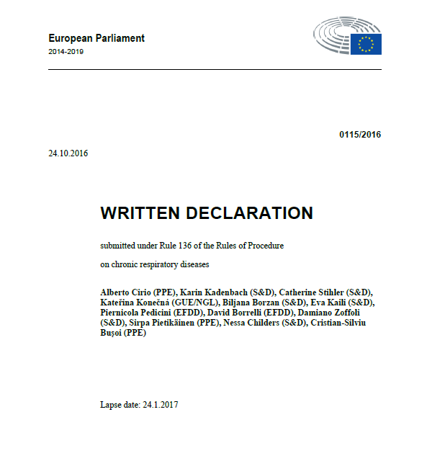
Tackle respiratory diseases through patient-driven policy
Written Declaration on chronic respiratory diseases :
Increase prevention and timely and accurate diagnosis by:
– combating known risk factors such as smoking and environmental aspects;
– strengthening respiratory education for medical students and primary care physicians;
– systematising lung health and allergy tests as part of the existing free health checks for all those at risk of developing chronic respiratory disease
Notes:
We believe in tackling the respiratory diseases through patient-driven policy. Let me give you an example that EFA has done in the past, of a proactive policy influence.
In 2016, EFA has launched a Written Declaration on chronic respiratory diseases. This initiative was patient-led but it was supported by the likes of the European Respiratory Society, the International Primary Care Respiratory Group
To give you some background, a written declaration is a tool to draw the attention of EU policymakers to a matter falling within the competence of the European Union
The text is then launched for a 3-month period to have the Written Declaration signed by the majority of the Members of the European Parliament (which is an impressive 376 MEPs out of 751).
In a nutshell, the asks towards the EU policymakers were to
•Increase prevention and timely and accurate diagnosis by:
– combating known risk factors such as smoking and environmental aspects;
– strengthening respiratory education for medical students and primary care physicians;
– systematising lung health and allergy tests as part of the existing free health checks for all those at risk of developing chronic respiratory disease;

Slide 7
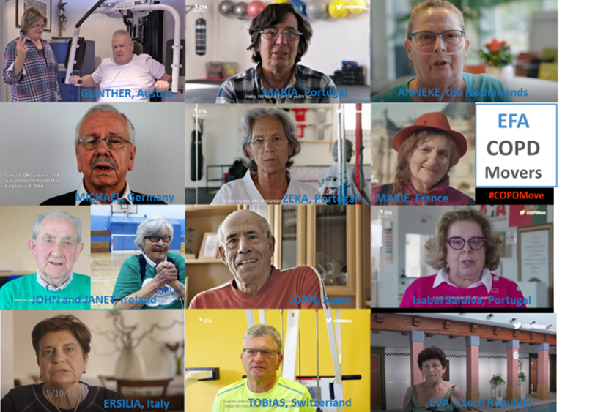
Notes:
Another example of EFA’s work is EFA project COPDMove. This project was created to raise awareness about the benefits of practicing physical activity among COPD patients and to motivate them in taking own initiatives with the aim of slowing down the progression of their disease.
At the beginning of 2017, we started to publish a series of videos where COPD patients show, together with their caregiver, what kind of exercises and sports they do. Patients share what motivates them to keep going and what are the benefits of their activities: engagement with physical activity and regular sport practice helps to improve breathing status and quality of life as well as hope for physical and psychological progress. Moreover, sports groups and support from caregivers make the activities more enjoyable, ensuring continuous trainings and self-steem improvements

Slide 8
Promote lives without tobacco
We ask:
Conversion of all public places into smoke-free areas (including parks and playgrounds);
Stricter tobacco control policies, including plain tobacco packaging and literal mention to respiratory disease
Clearer regulations on selling and consumption of electronic cigarettes and new tobacco products
Higher investments on quitting campaigns and support programmes for ex-smokers
Notes:
Tobacco remains the most significant cause of premature death in the EU, responsible for 700,000 deaths every year.
Patients need to know about the harmful impact of tobacco, it should be made very clear.
Conversely, as patients’ representatives at EFA we advocate for:
• Conversion of all public places across the EU into smoke-free areas (including parks and playgrounds);
• Adoption of stricter tobacco control policies, including plain tobacco packaging in all European countries;
• Clearer regulations on selling and consumption of electronic cigarettes;
• Higher investments on quitting campaigns and support programmes for ex-smokers.
In the picture, you see a campaign by our Member the Dutch Lung Foundation, they start every year a peer programme through social media to help people stop smoking.

Slide 9
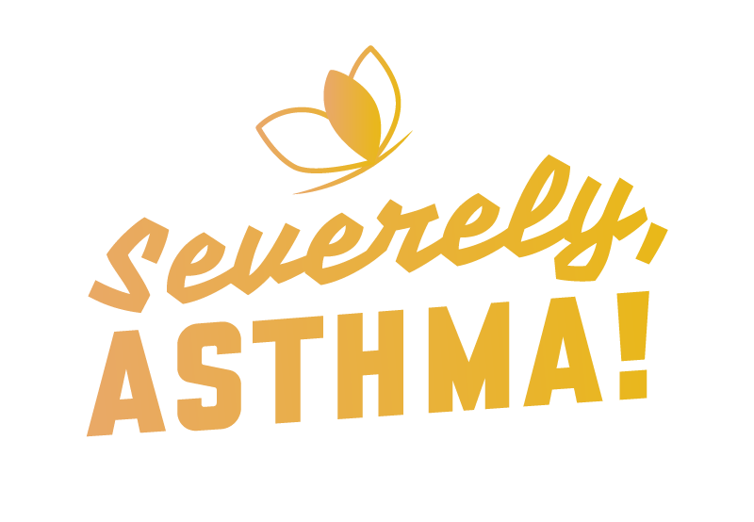
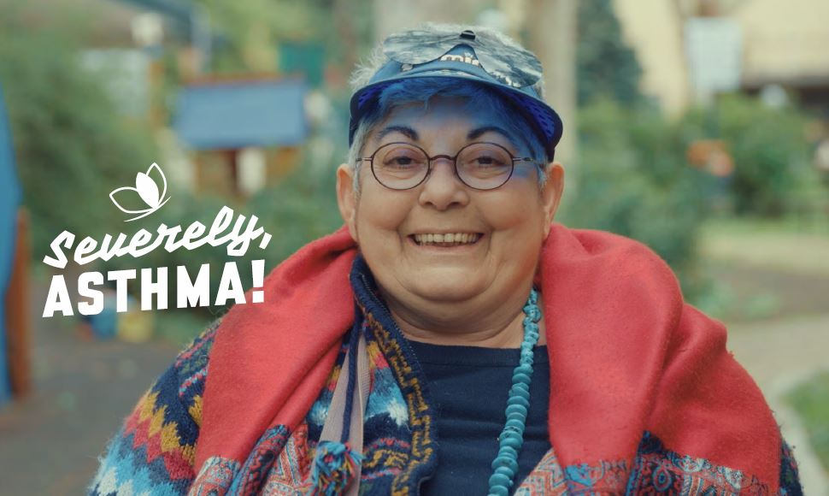
Collective responsibility on air quality
Reducing air pollution concentrations to levels in line with WHO recommendations:
Patients need to have access to updated local information
Allow crowd air quality information
Education about the quality of the air we breathe is of paramount importance
An EU strategy to tackle bad indoor air quality:
Lay-consumer information about what products contain which chemicals and the adverse reactions they can cause
Securing pollen information and forecasting services and surveys
Video series at: #SeverelyAsthma
Notes:
Air pollution is of major concern for respiratory health, and activities involving the burning of fossil fuels, such as certain industrial activities, power generation, vehicle emissions and household heating and cooking, as well as natural phenomena (i.e. volcanic eruptions or dust storms) can potentially cause respiratory diseases.
However, most outdoor air pollution sources remain beyond the control of individuals and require action by regional, national or international policymakers.
As patients we ask to have reduce air pollution concentrations to levels in line with WHO recommendations;
We also want patients to have access to updated local information on air quality,
Allow crowd air quality information
Providing education to patients and citizens about the quality of the air we breathe is of paramount importance
As affected patients, air quality is one of EFA’s areas of work and at EFA we advocate for an EU strategy to tackle bad indoor air quality and by lay-consumer information about what products contain which chemicals and the adverse reactions they can cause
• We are also advocating to secure pollen information and forecasting services and surveys.
On the right side, you will see pictures of the EFA project called “Severely Asthma” . The project is meant to show to policy makers, healthcare professionals, carers and patients that severe asthma can become controlled with the right diagnosis and the right treatment. To do so, EFA launched on World Asthma Day 2018 the first of a series of 6 severe asthma video testimonials to get a real picture of what it is to live with this disease: what are the tricks patients use to keep going with their lives and getting to know their dreams and hopes and expectations for new drugs designed specifically to help them.
The Severely, Asthma! video series will shed light into scientific data about severe asthma and exemplify the data in the daily lives of patients. The videos might help other patients to recognise themselves and their symptoms, to go back to their doctors to request the fitting diagnosis and best available treatment for them.

Slide 10
CONCLUSIONS
Patients deserve better
They have demonstrated, unequivocally, that they are interested in healthcare and rather than discourage them we must do more to democratise medicine by providing tools that support patients’ decisions.
Prevention is better than cure
As a patient organisation representing patients with allergies and airways diseases, we believe that prevention is better than cure.

Slide 11
Questions?
THANK YOU!

