Slide 1

DAVE
ALEX

Slide 2

The EFA contribution to MeDALL
Per-Åke Wecksell, EFA Board Secretary
Susanna Palkonen, Executive Officer
www.efanet.org
26 January 2011 MeDALL kick off meeting Barcelona

Slide 3
EFA mission
Advocate at EU level the needs of people with Allergy, asthma and COPD -> MeDALL
Work more and equally with members
Implement best practice -> MeDALL
Create patient driven projects
Cooperate with health care professionals, scientists and other stakeholders/NGOs -> MeDALL

Slide 4
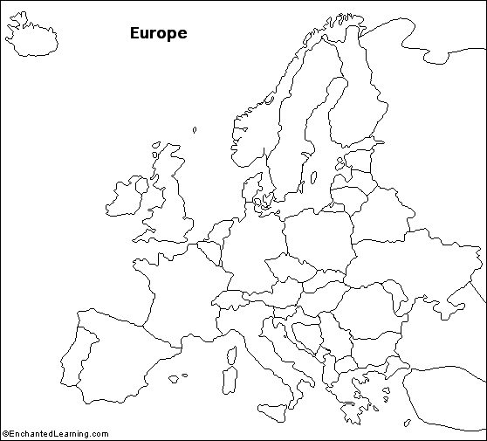


20 countries
34 member organisations
in which over 500.000 patients
& carers
REACH OUT
Notes:
EFA was founded 1991 to give a voice people with allergy and respiratory diseases at European level.
We currently have 34 member organisations in 20 countries, who have over half a million patients and carers as members.

Slide 5
Objectives
For patients
Provides transparent access to information and educational tools in patient-friendly language
Provides opportunities to participate actively in projects
Facilitates communication in patient-friendly language focusing on patient needs
Develops and promotes long term partnership on equal level
Develops training and educational projects
Ensures active participation of patients in all decisions regarding their wellbeing
Acts as liaison between people with allergy, asthma and COPD and EU policy-makers
Negotiates to raise standards of care, environment and research
Communicates and updates about patient needs
For Healthcare
Professionals/
Scientists
  For Policy makers

Slide 6


EFA strategy – meaningful research
Implementation
Care
Environment
New or improved tools
Impact
PATIENT
Needs & expectations & participation
NEW Knowledge
Understanding
Evaluation & gaps in knowledge
RESEARCH
RESEARCH
needs
POLICY EU & national
Research FP7, FP8
Environment
Care

Slide 7
EFA Contribution in brief
Promotion to
  EU institutions
  European and international network of patient groups & EFA partnerships
Dissemination in lay-language on
  project (interim) results
  what they mean for patients
Impact
  In policy
  In care
Patient perspective

Slide 8
CRUCIAL: COMMUNICATION ON WHAT NEW KNOWLEDGE MEANS & HOW IT CAN BE USED BY DIFFERENT TARGET GROUPS
HC PROFESSIONALS – PATIENTS - PUBLIC - POLICYMAKERS

Slide 9
contribution to patients?
Patient questions:
  Why? Why me/my kid? How? What can I do? Can I do something else than taking loads and loads of medicines? Will I always have it? Will my kids get it? Can it get severe? Can I die? Can I live a normal life? How does environment around me affect…..
Increased understanding of allergy
  Adherence
  Early & correct diagnosis
  Better targeted treatment, minimum side-effects
  Prevention?
  Cure?

Slide 10
EFA Contribution WP10: patient perspective & communication
PREVENTION IS BETTER THAN CURE
CURE IS BETTER THAN CARE
IF ALREADY A PATIENT, ACCESS TO APPROPRIATE & TAILORED CARE IS A MUST
Comprehensive national programmes

Slide 11
EFA Contribution WP10: patient perspective & communication
Translational integration of systems biology outcomes into healthcare to propose early diagnosis, prevention and targets for therapy.
  Input from patient perspective on the review paper topics, the papers and workshops
  Link to WP 11 Communication and dissemination in lay language

Slide 12
EFA Contribution WP11 – policy
    Help to make policies at the EU level on best care & prevention
    MeDALL evidence into policy: our core job
    EU advocacy through our involvement in EU working groups and committees & our projects
    Integrating MeDALL evidence into our policy responses
    Collaborating in targeted actions by MeDALL
    Extensive EU press and advocacy database

Slide 13
EFA Contribution WP11 – training
    MeDALL training: patient representatives invitation, EFA AGM in connection of key MeDALL meeting, MeDALL ‘progress report at EFA AGM & Network meeting’
    MeDALL events: liaison between local patient group for local communication

Slide 14
EFA Contribution WP11 – dissemination, & communication
    Our job: dissemination to patients
    Through EFA network/s
    EFA AGM and network meeting
    Press releases
    Fact sheets
    Helping to MeDALL communicate & integrate patient perspectives
    Helping to communicate what results mean for patients
    Promote integration and exchanges within and outside the MeDALL : patient community & EFA partnerships

Slide 15
EFA Memberships & collaborations
    European Patients’ Forum EPF - care
    Health and Environment Alliance HEAL – outdoor & indoor environment
    European Network for Smoking Prevention ENSP – tobacco control & SHS
    Global Allergy and Asthma Patient Platform GA²P
    Global Alliance against Respiratory Diseases GARD
    IPCRG, ERS, ELF, EAACI, WAO

Slide 16
EFA Contribution WP11 – fact sheets
For patients on interim & results
1st fact sheet based on results & paper of this meeting: MeDALL approach to allergy & what do we know
1 fact sheet per 1 MeDALL paper
Dissemination for EFA network & through media alert & project & EFA website
Translations?

Slide 17
EFA Team
Per-Åke Wecksell, EFA Board MeDALL Lead wecksell@hotmail.com
Susanna Palkonen, Executive Officer susanna.palkonen@efanet.org
EU Policy & Project Assistant info@efanet.org
EU Policy & Project Officer – to be reqruited

Slide 18
EFA projects 2011: Allergy
EFA Book on (Respiratory) Allergy in Europe, launch event at EP, Call-to-action
GA²P Global Asthma & Allergy Patient Platform
EFA Campaign to influence EU food allergen labeling: ‘may contain..’, non-prepacked food
Partnership projects: MeDALL, Health Vent Health Based Ventilation Guidelines for Europe, U-BIOPRED

Slide 19
Example EU policy work: EFA patient expertise at EMA
Membership at PCWP – EMA Human Scientific Committees Patient and Consumer Working Party
Experts take part in Scientific Advisory Groups (SAG) meetings when requested
Patient information leaflets and European Public Assessment Reports (PAR’s) review
Dissemination of information recieved from Agency: lay language
Involvement in EMA risk communication
Consultations for EMA work and information for the Public

Slide 20
Example: EMA PCWP role
Contributes in adapting information provided by EMA to patients and consumers needs
Helps to develop appropriate communication tools between the agency and patients and consumers
Contributes to increase awareness of patients in relation to the use of medicines and to promote a rational use of medicines
Gives general advice in relation to product specific matters

Slide 21
MeDALL & EU Health priorities
ALLERGY
Prevention
Inequalities
Health in all policies
Innovation
Chronic diseases
Healthy ageing
Sustainability of health systems & economies

Slide 22
MeDALL & EU Health priorities
ME*
&
DALLI**
Prevention
Inequalities
Health in all policies
Innovation
Chronic diseases
Healthy ageing
Sustainability of health systems & economies
*Allergy patient
**EU Health Comissioner John Dalli

Slide 23
REGULATE HEALTHY INDOOR AIR & ESTABLISH GUIDELINES
REGULATE & ABOLISH TOBACCO & SECOND HAND SMOKE
RESEARCH ON CARE, CURE, PREVENTION and CARE EFFECTIVENESS
SHARE BEST PRACTICES ON CARE & BENCHMARK
PATIENT PARTICIPATION in policy & CORE FUNDING of PATIENT GROUPS!
LABEL FOOD ALLERGENS CLEARLY including recipe changes & REGULATE ‘MAY CONTAIN’
SUPPORT COMPREHENSIVE NATIONAL PROGRAMMES
ENSURE HEALTHY OUTDOOR AIR & MITIGATE CLIMATE CHANGE
ALL PRODUCTS INTRODUCED IN EU safe for people with allergy & respiratory
EFA EU Policy goal
ALLERGY and RESPIRATORY DISEASES in ALL POLICIES
EU role: European strategy &
programme on allergy, asthma & COPD respiratory diseases
Support for 2nd EU Environment & Health Action Plan
Work with all stakeholders

Slide 24
DAVE
ALEX

Slide 25

THANK YOU.
Questions?
Suggestions?
EFA
35 Rue du Congrès
000 Brussels, Belgium
www.efanet.org

