Slide 1
EFA COPD Patients Europe Report ICC Meeting 19th September 2010
Susanna Palkonen, Executive Officer
susanna.palkonen@efanet.org
www.efanet.org

Slide 2
Unprecedented collection of information from patients to policy makers

Slide 3
EFA Book on COPD in Europe
Raise awareness & highlight the gaps and positive highlights
Inform & encourage into collaboration with patient organisations
Prompt into action
Share best practices on care & provide a tool for advocacy, internal & external work
Funding partners GSK and BI

Slide 4
Participating countries
Austria
Belgium
Czech Republic
Finland
France
Germany
Ireland
Netherlands
Portugal
Serbia
UK
Italy

Slide 6
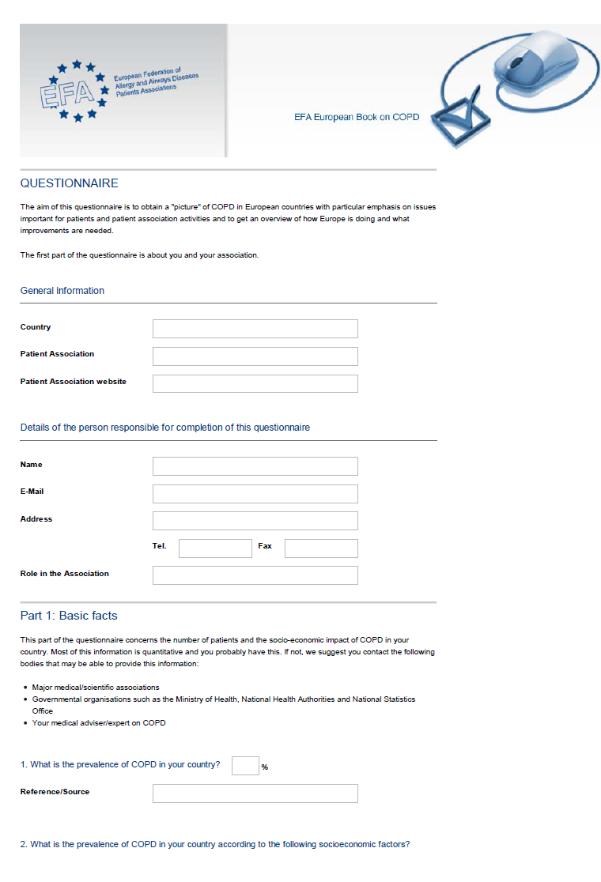
Methods
QUESTIONNAIRE
Quantitative and qualitative information

Slide 7
Contents
EFA Book on COPD in Europe
Basic facts
Access to care
Quality of care
Patients associations practices and policies

Slide 8
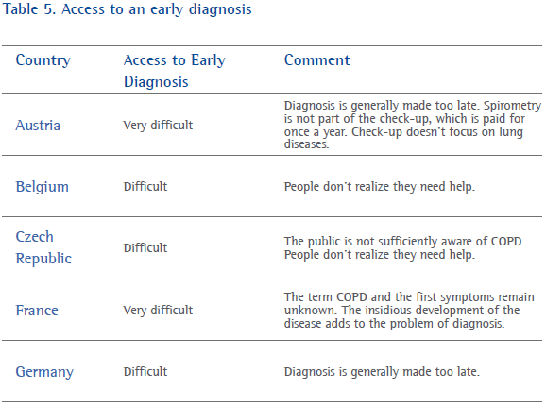
Table 5. Access to an early diagnosis

Slide 9
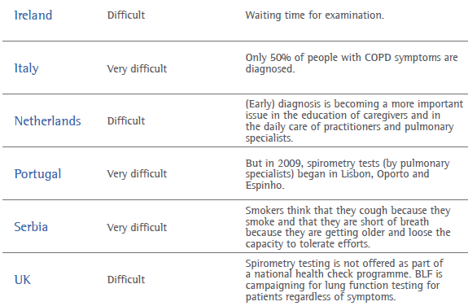
Table 5. Access to an early diagnosis

Slide 10
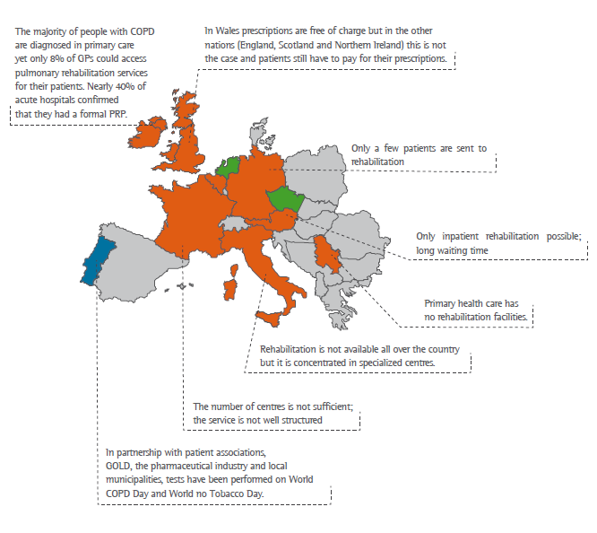
Figure 2. Access to rehabilitation for COPD patients

Slide 11
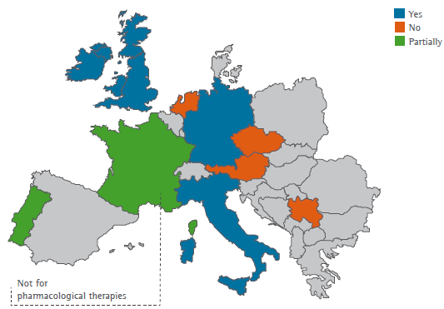
Figure 5. Patients
associations involved
in producing clinical
guidelines.

Slide 12
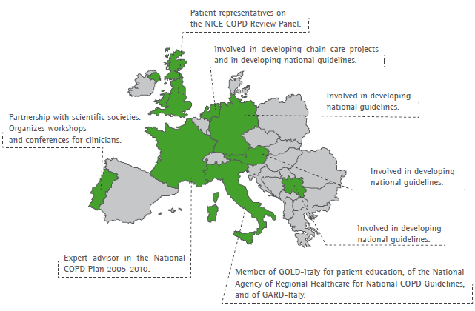

Slide 13
Contents
‘The term COPD [BPCO] remains unknown to most people and is difficult to explain’. France and Italy
‘Diagnosis is generally made too late.’ Germany
‘When I heard I had COPD in 2002, I had no clue what it was.’ European patient with COPD
‘It’s frustrating – you don’t look sick, I can get up and put make-up on but I can’t walk 10 yards without being out of breath." Patient from Ireland
I still remember the day: 2nd of June 1995, and I was diagnosed with COPD. It was at that very moment that I understood the disease and the implications for my daily life. Patient from Portugal

Slide 14
Conclusion: There is an urgent need to recognise COPD as a public health priority and rather than dispersing initiatives and to
develop comprehensive programmes on COPD both at European and at national level and in partnership with all stakeholders including patient groups.
The most important is early diagnosis, judged from difficult-very difficult in 12 countries

Slide 15
Actions: powerful tool for advocacy
12 countries featured: basics, access to care, quality of care, patient involvement, patient stories…
Desk launch World COPD Day 2009
Event at the European Parliament 30 June 2010
5 media outreaches
Call to action with ERS, ELF, IPCRG, ICC, HEAL, ENSP
Distributed to ALL MEPs August 2010 together with the Call by Stihler and EFA
Video of the event to EFA website & events

Slide 16
Actions: powerful tool for advocacy
Being translated into Portuguese and Polish
Questionnaire and concept available for any patient group for replication and local adaptation

Slide 17
Call to Action for Europe – launch 30 June
Will Europe suffocate of breath?
COPD is a leading cause of death, and affects approximately 44 million people in Europe. Despite this, COPD remains insufficiently recognised, diagnosed, prevented and treated in Europe.
We, the undersigned, call upon the European Union (EU) to take the necessary steps to develop a strategic, comprehensive and integrated European approach to respiratory diseases with a focus on COPD which brings all initiatives and actions under one umbrella, and supports the launch of national plans on COPD.

Slide 18
Call to Action for Europe – launch 30 June
Make COPD a political priority
Increase awareness of COPD
Prioritize the early diagnosis of COPD
Support an integrated and multidisciplinary approach to the treatment of COPD to improve the care and management
Prevent COPD
Improve Air Quality
Support research

Slide 19
Call to Action for Europe – Partnerships
European Respiratory Society ERS
European Lung Foundation ELF
International Primary Care Respiratory Group
IPCRG
International COPD Coalition ICC
Health and Environment Alliance HEAL
European Network for Smoking Prevention ENSP

Slide 20
EFA Political Opportunities
Year of the Lung
EFA articles in Parliament Magazine Dec 2009 & 2010
Health Commissioner Dalli focus on patient organisations & commitment to allergy and respiratory diseases at the WHO Europe Ministerial Conference on Environment & Health in March
Sharing best practices on asthma and COPD management and care in EU Public Health Programme

Slide 21
EFA Political Opportunities
EMA: EFA membership at the PCWP & patient experts
EU Health Policy Open Forum by DG SANCO ‘Health in All Policies’ 29-30 June, EFA in the Steering Group and coordinating a workshop on ‘Environment and Health’
EFA COPD Event at the EP 30 June and launch of COPD ‘call-to-action for Europe’
EU Belgium Presidency Pre-Ministerial Conference on Respiratory Diseases by ERS 19 October, EFA partner
New and stenghened partnerships

Slide 22
Conference
EFA Conference: Vilnius, Lithuania: 28‐29 May Towards equal access to health care all over Europe for and with people with allergy, asthma and COPD: The Case of Reimbursement & HTA
EFA members sharing their involvement in reimbursement decisions
Reimbursement agengies sharing reimbursement practise & patient involvement: NL, UK, G, IT, FR
Introduction to HTA & good practice in patient involvement
Patient involvement in HTA today and tomorrow

Slide 23
IAQ Health Based Ventilation Guidelines for Europe
Project funded by the European Commission EU Public Health Programme One project in Public Health Programme
Developing health based ventilation guidelines for Europe to complement the energy efficiency (climate change agenda)
EFA role: patient input, patient needs, disselination for members -> patients

Slide 24
Meet and Greet EU Institutions Training for Members
Improve knowledge on how EU institutions work and affect health of people with allergy, asthma and COPD
Provide opportunity meet and greet in person relevant Commission services, Parliament, Council
Build capacity, improve and motivate in taking part influencing EU policies
Funding partner Novartis

Slide 25
COPD patient expertise at EMA
EFA Experts take part in Scientific Advisory Groups (SAG) meetings when requested
Review Patient information leaflets (PILs) and European Public Assessment Reports (PAR’s) of medicines
Dissemination of information recieved from Agency: lay language
Consultations for EMA work & strategy and information for the Public
involved in risk communication

Slide 26
Patients involment is appreciated
Taking due account of patients views
Training sessions
Travel and accommodation arrangements
Joint PCWP and Health Care Professionals Working Group (HCP WG) meetings
Invitations to expert seminars
Openness, transparency
Double allowance for volunteers

Slide 27
More about patients involvement in EMA work
http://www.ema.europa.eu/Patients/introduction.htm – leaflet in all 27 EU languages

Slide 28
REGULATE HEALTHY INDOOR AIR & ESTABLISH GUIDELINES
REGULATE & ABOLISH TOBACCO & SECOND HAND SMOKE
RESEARCH ON CARE, CURE, PREVENTION and CARE EFFECTIVENESS
SHARE BEST PRACTICES ON CARE & BENCHMARK
PATIENT PARTICIPATION in policy & CORE FUNDING of PATIENT GROUPS!
LABEL FOOD ALLERGENS CLEARLY including recipe changes & REGULATE ‘MAY CONTAIN’
SUPPORT COMPREHENSIVE NATIONAL PROGRAMMES
ENSURE HEALTHY OUTDOOR AIR & MITIGATE CLIMATE CHANGE
ALL PRODUCTS INTRODUCED IN EU safe for people with allergy & respiratory
ALLERGY and RESPIRATORY DISEASES in ALL POLICIES
EU role: European strategy &
programme on allergy, asthma & COPD
respiratory diseases
Work with all stakeholders

Slide 29
THANK YOU.
EFA European Federation of Allergy and Airways Diseases Patients'
Associations is a Partner of the Year of the Lung
in Memory of Mariadelaide Franchi
Subscribe to EFA electronic newsletter at www.efanet.org
Thank you to EFA sustainable funding partners Novartis, GSK, Boehringer Ingelheim, ALK Abelló, Chiesi, Merck
EFA
35 Rue du Congrès
1000 Brussels, Belgium
www.efanet.org
info@efanet.org

Slide 30
THANK YOU.
‘Eleven years ago I got a cold which did not go away,
it turned out to be COPD.
I decided to become a volunteer for the Asthma Foundation.
Since then I have met so many new people, opening up a new world. Sometimes I joke that, in that respect,
COPD is the best thing to ever happen to me.‘
Patient from the Netherlands
http://www.efanet.org/documents/EFACOPDBook.pdf

Slide 31
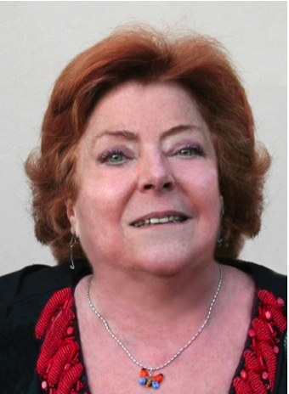
Mariadelaide “Lally” Franchi Editor of the EFA book on COPD in Europe
Founder and President of the Italian Association of COPD Patients
EFA Honorary Member
Honorary President of FEDERASMA Italy
Co-Chairwoman of International COPD Coalition
Initiator, leader, FRIEND

