Slide 1
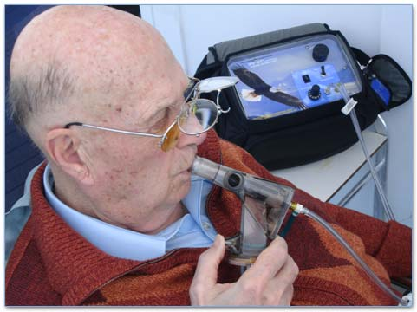
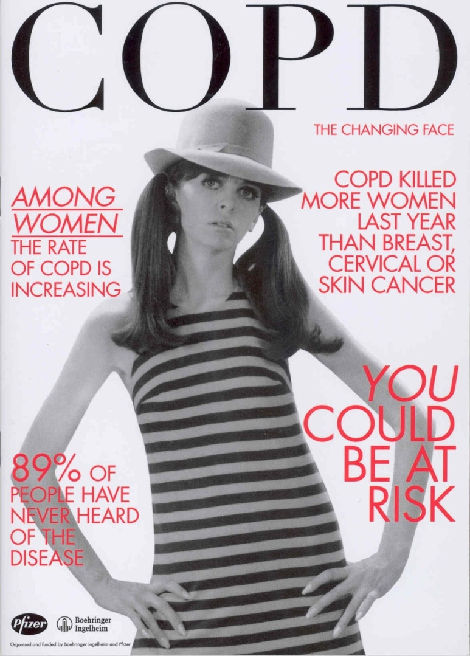

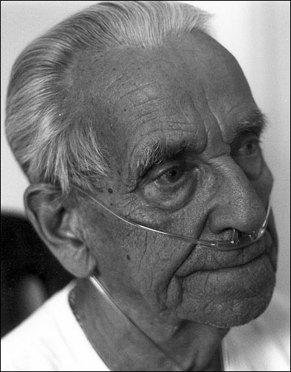
COPD Uncovered
The changing face of COPD
Monica Fletcher
Chief Executive
Education for Health, Warwick
Chair European Lung Foundation

Slide 2
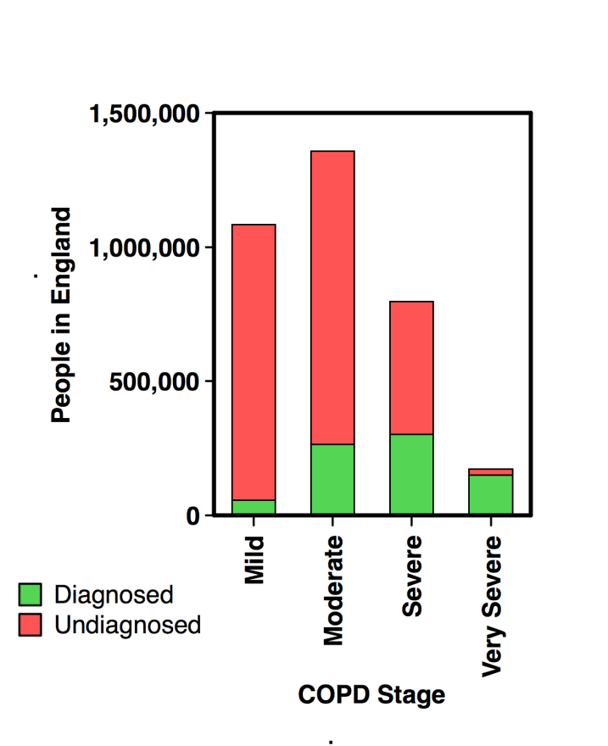

The
Number of COPD patients diagnosed 900,000, but actual
estimated prevalence 3.7million……..
these are the “Missing Millions”
Shawab et al Thorax 2006
(Graph based on DH unpublished estimate, 2009).

Slide 3
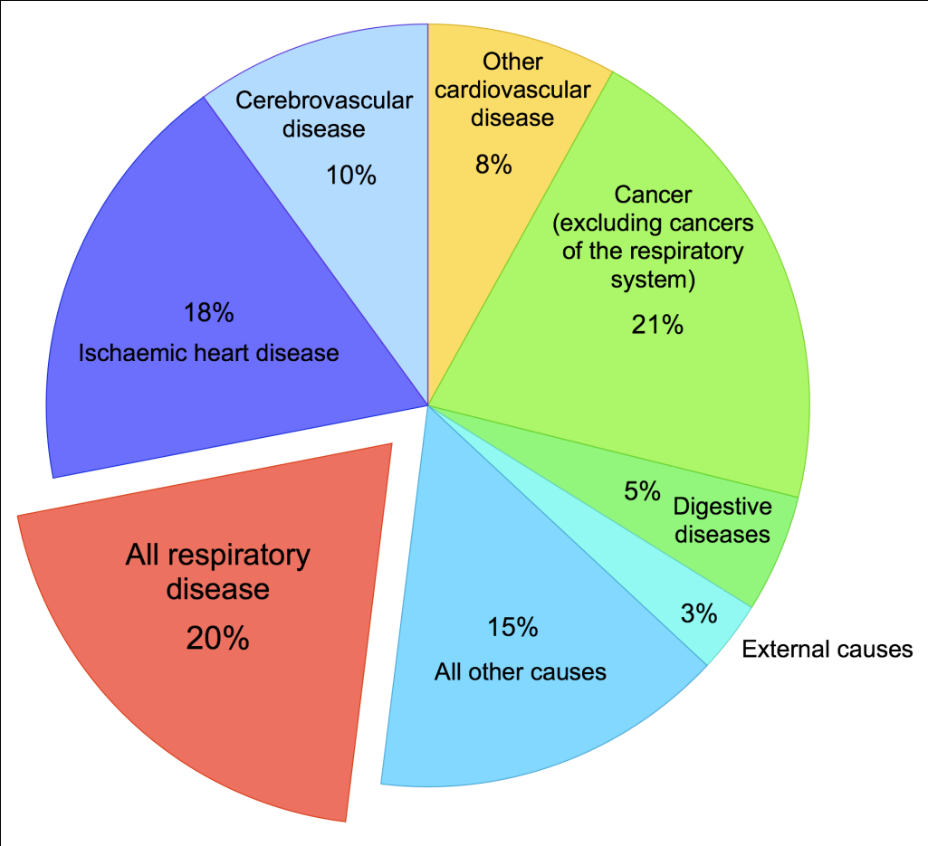
Why COPD?
Awareness and diagnosis is low
In the UK population
  89% of the general population never heard of COPD (Bachmann, 2007)
  85% of smokers had never heard of COPD (BLF, 2007)
Respiratory disease (including COPD) is the second biggest killer in the UK
Notes:
Respiratory disease is the second biggest killer
COPD second biggest cause of costly emergency admissions
33% readmission rate
More than 3 million with condition but only 835,000 diagnosed [DN: Check figures with consultation document]
20-30% misdiagnosis rate
Tremendous human cost for people with the condition

Slide 4
Causes of COPD
80% cases of COPD attributable to smoking
15% occupational or environmental
  US: COPD attributable to work estimated as
    19.2% overall
    31.2% among never-smokers (US NHANES III Survey 1994)
? 5% genetic: Alpha-1antitrypsin deficiency ?
In developing countries 25-40% not due to smoking related

Slide 5
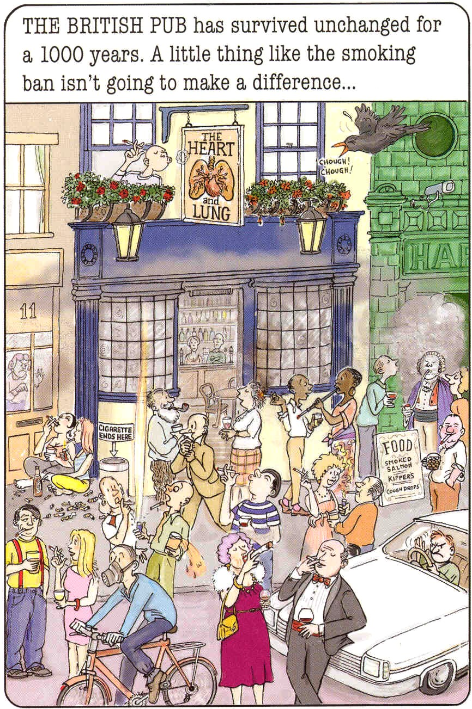
If everyone gave up smoking
Today, it would be decades
before we saw any difference
In the rates of COPD
Mannino D. (Chest 2005)
Let’s not let kid ourselves we
have it cracked it !!

Slide 6
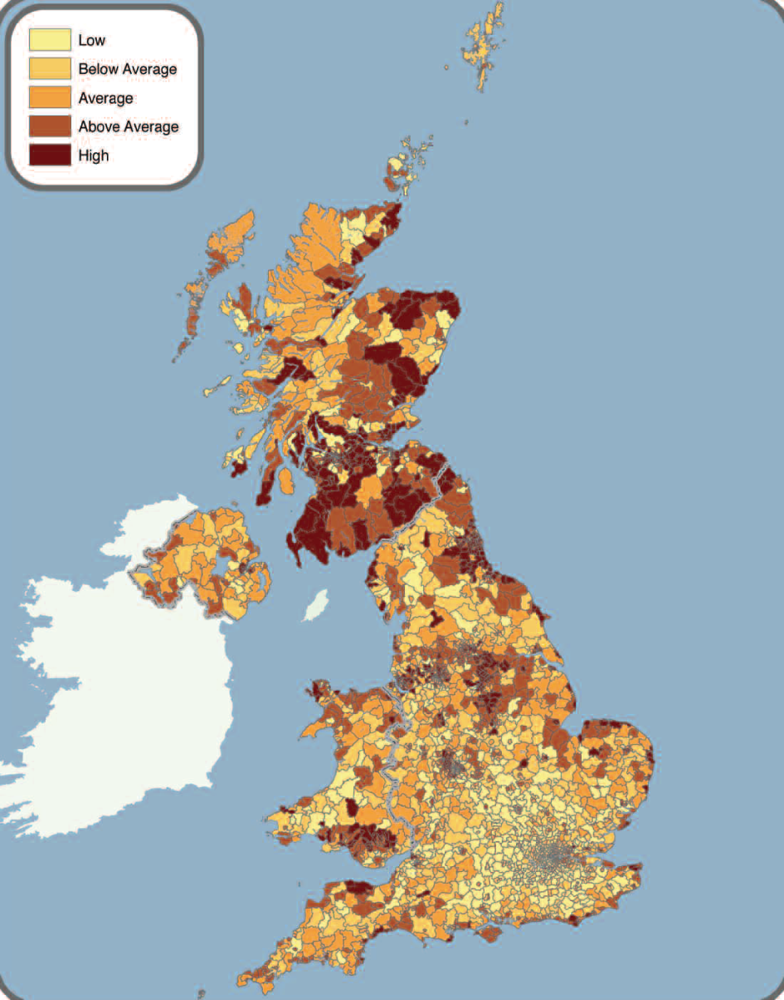
Disparities: COPD
Hotspots
Those at risk of future hospital admission with COPD live mostly in social housing and have, or have had, industrial or semi-skilled jobs, uncertain employment, low levels of disposable income and considerable health problems (British Lung Foundation 2007)
Those of low social economic groups are up to 14 times more likely to have lung disease
Notes:
Double impact on deprived populations (GOLD, 2006; DH, 2007)
Highest prevalence & highest under diagnosis
Important contribution to life expectancy gap between deprived areas & England average (DH, 2007)
Ethnic Disparities
Highest risks of COPD in Black men in deprived urban areas (DH, 2007

Slide 7

Uncovering the burden of COPD for patients
Approximately 10% of the population aged >40 has at least moderate COPD¹
COPD is not exclusively a disease of the elderly^{2,3}
COPD limits the ability of active patients to work and function on a day-to-day basis^{3,4,5}
1. Buist, et al. Lancet 2007; 2. AARC 2003; 3. Hernandez, et al. Respir Med 2009; 4. COPD Uncovered Survey, 2009 5. Fletcher et al 2010 ATS
Notes:
References
Buist S et al. International variation in the prevalence of COPD (The BOLD Study): a population-based prevalence study. Lancet 2007;370:741–50.
AARC. Confronting COPD executive summary. (http://www.aarc.org/resources/confronting_copd/exesum.pdf.
Hernandez P et al. Living with chronic obstructive pulmonary disease: A survey of patients’ knowledge and attitudes. Respir Med 2009;103:1004–12.
COPD Uncovered (Novartis Data on File)

Slide 8
People aged 40–65 drive the global economy
Globally, approximately 1.7 billion people are aged between 40–65¹
  This group makes up one-quarter of the world population
Most are at the peak of their earning and spending power
  In the UK & US, people aged 40–65 earn 2/3 of the total national pay^{2,3}
Of the US population aged 50–64:⁴
  50% are still employed full-time
  Less than one in five women are fully retired
  Six out of ten have given substantial financial assistance to their children and grandchildren over the previous five years
They expect to work beyond the official retirement date so they can continue to support both themselves and their family
Global economies are planning to increase retirement ages
¹ US Census Bureau. World Population Statistics.
² US Census Bureau, Current 2009 Population Survey, 2009 Annual Social and Economic Supplement.
³ Annual Survey of Hours and Earnings, UK Office for National Statistics.
⁴ MetLife Mature Market Institute. Boomer Bookends. Insight into the oldest and youngest boomers, February 2009.
⁵ MetLife Mature Market Institute. Boomers: the next 20 years. Ecologies of Risk, 2008

Slide 9
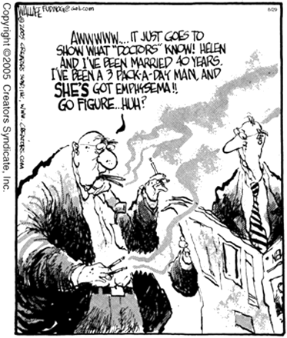
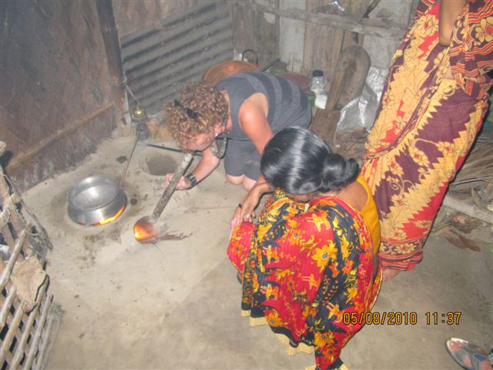


Women are particularly hard hit by COPD
As more women have become smokers, their risk of COPD has increased¹
More women than men are now diagnosed with COPD²
COPD occurs at a younger age in women and at a lower threshold of exposure to cigarette smoke³
Women with COPD also report more symptoms and poorer quality of life than men³
Biomass: Indoor cooking
Increasingly more women have heavy occupational exposures
WHO COPD fact sheet
Staton WG. Chronic Obstructive Pulmonary Disease. Part 1: Epidemiology, Etiology, Pathophysiology, and Diagnosis Medscape Internal Medicine, Published: 09/01/2009.
Carrasco-Garrido P, de Miguel-Díez J, Rejas-Gutierrez J et al. BMC Pulm Med 2009;9:2

Slide 10
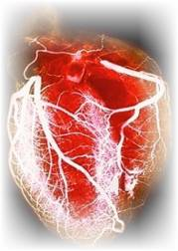
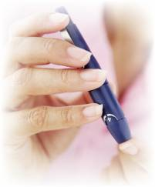

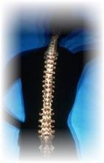

WE KNOW : PATIENTS WITH COPD HAVE COMORBIDITIES
A number of other health issues are commonly associated with COPD adding significantly to the overall burden of disease
About 40% of people with COPD have heart disease¹
About 10% of people with COPD have diabetes²
17–42% of people with COPD have high blood pressure^{3,4}
2–19% of people with COPD have osteoporosis
Twice as common as those without COPD^{2,3}
18–22% of people with COPD have depression
Three times as common as those without the disease³
Anecchino C, Rossi E, Fanizza C et al. Int J Chron Obstruct Pulmon Dis 2007;2: 567–574
Darkow T, Kadlubek PJ, Shah H et al. J Occup Environ Med 2007;49:22–30
Boutin-Forzano S, Moreau D, et al. Int J Tuberc Lung Dis 2007;11:695–702
Holguin F, Folch E, Redd SC, and Mannino DM. Chest 2005;128:2005-2011

Slide 11
Healthcare utilization by disease severity
Health care resource used in preceding 4 weeks due to their COPD | All Severity levels | Mild Mean % (se) n:849 | Moderate Mean % (se) n:1012 | Severe Mean % (se) n:521
Family Practitioner | 50.0 (1.0) n:1214 | 34.3 (1.6) | 55.0 (1.6) | 67.4 (2.1)
Out-patient clinic/specialist | 37.7 (1.0) n:915 | 25.9 (1.5) | 39.6 (1.5) | 54.3 (2.2)
Emergency Department | 10.8 (0.6) n:262 | 3.3 (0.6) | 11.4 (1.0) | 22.5 (1.8)
Hospital in-patient | 11.9 (0.7) n:289 | 4.5 (0.7) | 11.5 (1.0) | 25.3 (1.9)
Pulmonary rehabilitation | 12.3 (0.7) n:298 | 4.7 (0.7) | 12.5 (1.0) | 25.0 (1.9)
2426 people with COPD participated; in 2382 disease severity was assessed
MJ Fletcher et al Primary Care Respiratory Journal (2010); 19(2): A1-A25

Slide 12
Healthcare resource burden - monthly
Healthcare resource | Cost per resource | COPD population | Proportion who require resource | Total cost
GP visits | £52 | 2,424 | 50.1% | £63,128
Hospital out-patients | £132 | 2,425 | 37.7% | £120,780
Emergency departments | £111 | 2,425 | 10.8% | £29,082
Hospital in-patients | £2,304 | 2,426 | 11.9% | £665,856
Monthly economic burden
MJ Fletcher et al Primary Care Respiratory Journal (2010); 19(2): A1-A25

Slide 13
Work Productivity
71% were not longer working
Of these 26% reported giving up work because of COPD
Or 40% of those who chose to work were unable to do so
Mean age for those retiring early was 58.3 years

Slide 14
COPD Uncovered : Work Productivity
WAPI | 45–54 years | 55–64 years | 65-68 years | Total
Absenteeism (% who missed work due to COPD in the last week) | 3.20% | 6.52% | 10.68% | 4.65%
Presenteeism ( % who were impaired while working) | 8.81% | 11.74% | 14.85% | 10.04%
Regular activities (% with activity impairment) | 10.67% | 15.43% | 28.48% | 13.04%

Slide 15

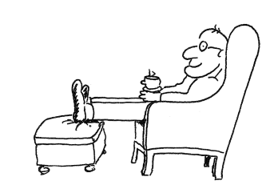
Impact on working age population
29% of respondents (n:710) were in paid work; 22.9% of whom reported a negative impact on their productivity as a result of their COPD
Annual financial losses of absenteeism were calculated as £1,170 ($1,808) per person, and lifetime losses were £12,779 ($19,743.50)
Respondents also reported a significant impact on their daily lives, their ability to maintain the same lifestyle and plan for the future, as a result of COPD
MJ Fletcher et al. (2010) American Thoracic Society Annual Meeting. May 19th-23^{rd.} New Orleans, LA.
Study conducted by Education for Health with a research grant from Novartis

Slide 16
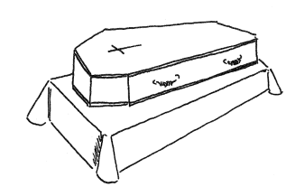
Less productivity due to: less working, early retirement and death. Total of £965m
Summary annual costs relating to impaired and lost productivity:
 |  | Men |  |  | Women |  | All
 | Impaired productivity in working individuals, COPD
 | Annual impaired productivity, COPD patients aged 45–64 years, not retired, UK |  |  | £93.7m | £30.4m | £124.1m
 | Lost productivity costs due to early retirement, COPD
 | Cross-sectional estimate: lost productivity due to early retirement among UK COPD patients aged 45–64 years |  | £371.2m |  | £151.7m | £522.9m
 | Excess mortality
 | Annual impaired productivity from mortality due to COPD in patients 45–64 years, UK |  | £228.2m |  | £89.7m | £317.9m
70% average earnings used in the analysis; 2009 monetary values
Notes:
Where is this productivity being lost.

Slide 17
Costs to Government
Summary outgoing annual costs to government:
 | Men | Women | All
Healthcare utilization costs
Total annual healthcare costs, COPD patients aged 45–64 years, UK | £152.3m | £125.4m | £277.7m
State benefit paid
Disability benefits paid, early retirement due to COPD, UK | £108.6m | £160.4m | £268.9m
Summary annual lost tax due to early retirement in COPD:
 | Men | Women | All
Tax revenue lost
Tax revenue lost, early retirement due to COPD, UK | £50m | £22.1m | £72.1m
Total: £619m
70% average earnings used in the analysis; 2009 monetary values

Slide 18

Public consultation in February/March 2010
24 national recommendations to improve care
Followed review of evidence and advice from expert reference group
Ministers currently considering how to turn it into an outcomes based strategy

Slide 19
What have we done in England ?
Published national consultation document
Developed clinical leadership and joint partnership working including with industry and patient organisations
Gathered evidence on what is working well
Testing different models of care
Introduced measurement of performance
Changes to system levers and incentives
Funded pilot and research studies
Aligned with new and emerging policies

Slide 20
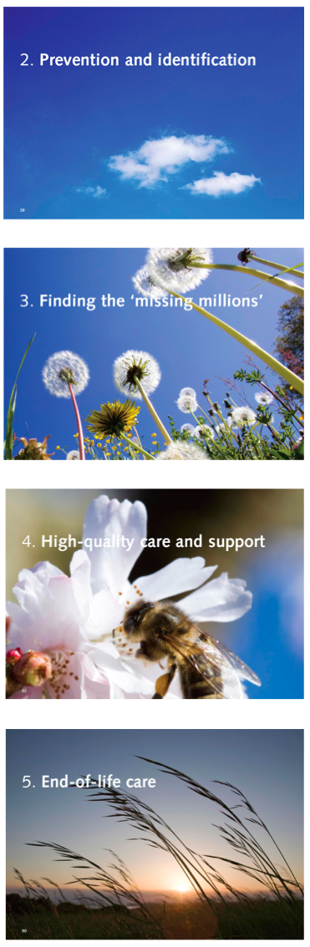
DH focus for improving outcomes
Prevention & Health improvement
Early Accurate Diagnosis and Assessment
Chronic disease management including self management, exacerbations and treatment
Palliative and ‘End of life’ care
Earlier identification: More proactive management: Care closer to home: Integrated care
Notes:
20
20
Prevention - through behaviour change
Early identification – so people recognise symptoms and seek help
Good quality early diagnosis – quality assured and clear differentiation between COPD, Asthma and other diseases. Coupled with good quality information throughout care
High quality care and support following diagnosis – organised, proactive, multidisiplinary care with specialist respiratory assessment to ensure people are on the right pathway
Improving access to end-of-life care services – ensuring equity in care provision, regardless of setting

Slide 21
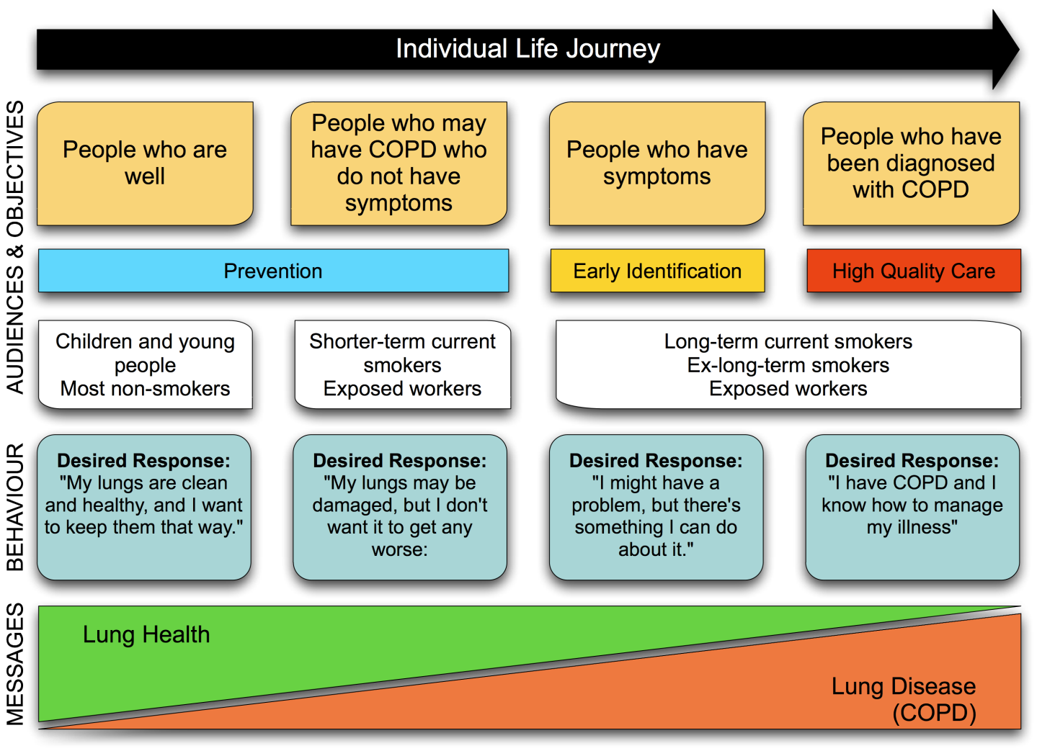
Prevention & early identification
- changing the burden of disease with different interventions and messages for different risk groups
Notes:
The burden of disease can be reduced by behaviour change in 2 ways
People can take action to avoid the causes and exacerbating factors of COPD such as cigarette smoke, workplace dusts and gases
People can promptly recognise the symptoms of the disease and seek help
However changing behaviour is a huge and complex challenge. Simply raising awareness of copd will not be enough
Range of approaches required to find specific triggers across a diverse range of audiences

Slide 22
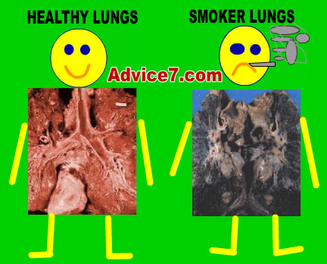
Prevention & early identification
Recommendation 2 & 3:
The importance of lung health should be understood and people should take the appropriate action to maintain good lung health.
People need to understand risks and recognise symptoms of lung disease
Notes:
Need to support behavioural change and avoid causes
Smoking, workplace dust and gases
Need a diverse range of interventions: easy to say give up smoking

Slide 23
Reducing Variation and Value across England
Aim to reduce unwarranted variation
  underuse, overuse, under co-ordination
Improve outcomes for patients
  provide best value health care
  reduce waste, drive up quality
Introduce benchmarking to provide comparison across local healthcare services
Health investment analysis with programme budgeting tools

Slide 24
Summary of DH work
National strategy developed – reliant on clinical evidence
Models of care being developed based on integration
Implementation plan in place, delivered within existing financial resources
Stakeholders aligned with the strategy
Importance of clinical leadership recognised
Challenge is to change burden of disease
‘whole health system approach with a focus on value for money and improved outcomes for patients and local populations ‘
transferable principles for adoption in other health systems

