Slide 1
Presentation of EFA and Most Recent Activities
David Brennan
EU Policy and Programme Assistant
info@efanet.org
www.efanet.org

Slide 2
What is EFA?
The European Federation of Allergy and Airways Diseases Patients’ Associations (EFA) is a non-profit network of allergy, asthma and COPD patients organisations, representing 35 national associations in 21 countries and over 400.000 patients.
EFA is an independent non-profit organization founded in 1991 in Stockholm, Sweden with its central office currently located in Brussels, Belgium.
EFA represents its members at the European level and engages with the policymakers and shares best practice and patient perspective through projects.

Slide 3
EFA’s Mission
EFA is dedicated to making Europe a place where people with allergies, asthma and COPD have the right to best quality of care and safe environment, live uncompromised lives and are actively involved in all decisions influencing their health.
EFA aims to become a powerful European network of allergy, asthma and COPD patients organizations that:
Advocates at the EU level the needs of people with allergy, asthma and COPD
Values all members equally
Implements best practice
Creates patient driven projects
Cooperates with healthcare professionals, scientists and other stakeholders/NGOs

Slide 4
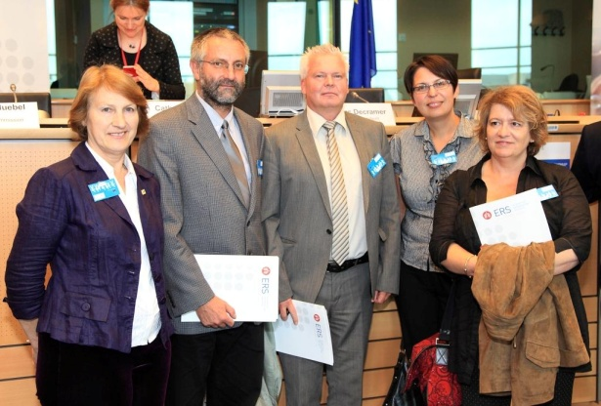
EFA Governance and Operations
The EFA Board:
President: Breda Flood, Asthma Society of Ireland, Ireland
Vice President: Christine Rolland, Asthma & Allergies (France)
Treasurer: Ondrej Rybnicek, Czech Initiative for Asthma
Board Member: Lina Buzermaniene, Lithuanian Council of Asthma Clubs
Secretary: Per-Ake Wecksell, Swedish Asthma and Allergy Association
The EFA Office:
Executive Officer: Susanna Palkonen
Project and Fundraising Officer: Antje Fink-Wagner
EU Policy and Project Officer: Roberta Savli
EU Policy and Project Assistant: David Brennan

Slide 5
EFA Events and Activities
Annual General Meetings (AGMs)
All EFA members meet annually to elect board members, review activites of the preceding year and discuss strategic objectives for an annual plan;
Network Meetings
Usually occurs day after the AGMs as means for EFA members to convene working groups and share best practices while creating work plans for the upcoming year;
EFA Board Meetings
Board members convene to discuss and decide upon administrative matters, implement annual plans and continue planning ahead;
Working Groups for Allergy and COPD
EFA members convene in thematically specific groups either through the internet, teleconference or face-to-face meetings;
EFA Meet and Greet EU Institutions Training in Brussels
EFA members are invited to Brussels for an opportunity to overview of how the EU works, further understanding of EU policies in their fields of interest and greet EU policymakers;

Slide 6
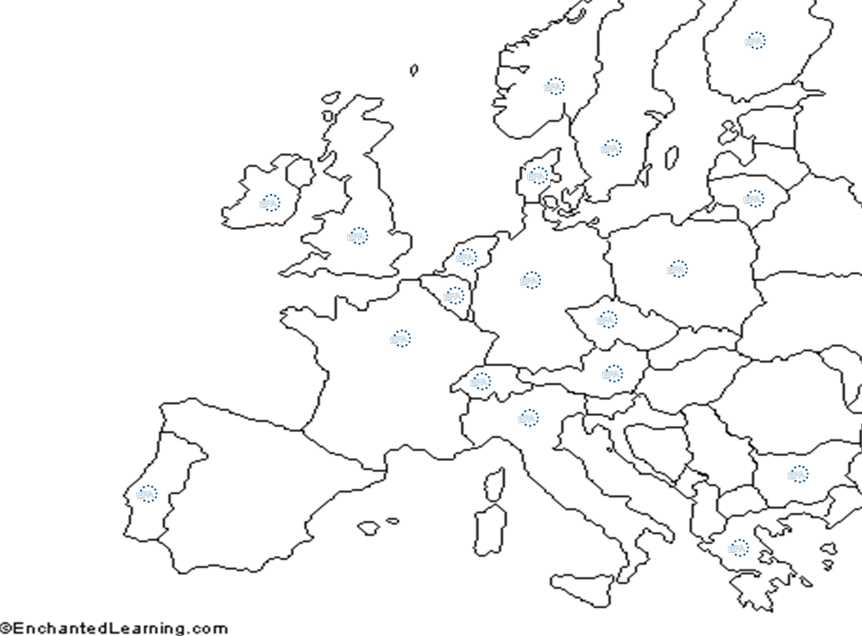
EFA Members

Slide 7
EFA Membership
Each full member pays an annual fee of 500 EUR;
Each member has one vote for elections at the AGMs;
Current EFA member coalitions may continue as coalitions if need be;
Membership Criteria:
Be a patient/carer organization - membership or participation of patients;
Accountability and transparency;
Working towards EFA’s aims and objectives - willingness to cooperate with other EFA organizations;
Legitimacy - legal status, registered as a not for profit organization;
Independence – self-governed;
Democracy – governing bodies elected by members or incorporation of patient perspective in a democratic way;

Slide 8
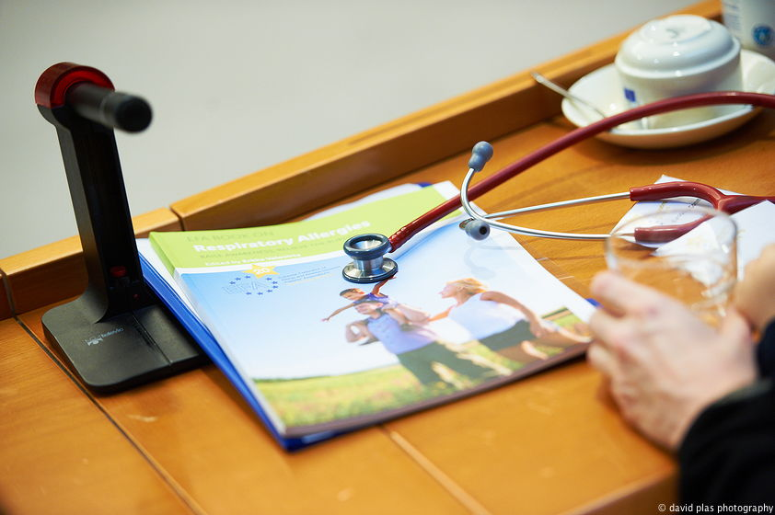
EFA’s Ongoing Projects
EFA Respiratory Allergy Project
EFA identified allergies as requiring a four year project with objectives:
To raise awareness of allergies as chronic diseases and major issue areas;
To increase the ability of identifying early symptoms and diagnosis;
To encourage European level guidance on appropriate management and control of exacerbations for both patients and medical professionals
EFA Book on Respiratory Allergy launch event at the European Parliament (22 Nov 2011) joined EU policymakers and the European allergy community
Current trend: 1 in 2 Europeans may suffer from an allergy by 2015

Slide 9
EFA’s Ongoing Projects (cont.)
EFA Chronic Obstructive Pulmonary Disease Project
Starting in 2009, EFA has worked to further promote public awareness of COPD in Europe with a publication and a series of events
EFA Book on Chronic Obstructive Pulmonary Disease in Europe ‘Sharing and Caring’ collecting information about the disease, urging immediate actions to improve diagnosis, care and living environment for COPD patients;
EFA’s Call to Action event at the European Parliament 30 June, 2010 presented findings in the book and urged the EU to develop a European approach to chronic respiratory diseases;
Two successful EFA COPD Workshops at the European Parliament (6 June and 9 Nov 2011) with researchers, policymakers and patients, focusing on prevention and diagnosis as well as care and research respectively.

Slide 10
Involvement in EU Projects
U-BIOPRED
Research project to understand more about severe asthma, involving scientists from universities, research institutes, the pharmaceutical industry and small companies;
Most recent annual meeting in Barcelona 23 – 24 January 2012;
Participation in multiple work packages, specifically Ethics and Dissemination of Information, to ensure patient perspective on these components of the project;
AIRPROM
Research project with objective of modeling the human lung and generating its potential reactions to asthma and COPD medications;
Ultimate goal is to customize such models for individual patients to project personalized reactions to the prescription of medications;

Slide 11
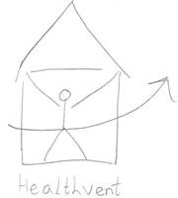
Involvement in EU Projects (cont.)
MeDALL
Aims at improving the health of European citizens by investigating the causes of allergy;
Results will help improve the quality of life of people with allergy across Europe through helping to improve early diagnosis, the targeting of primary and secondary prevention strategies and development of cost-effective treatments for allergy;
HealthVent
Interdisciplinary project from the EU Health Programme;
Concentrates on improving indoor air quality through health-based ventilation guidelines for Europe;

Slide 12
THANK YOU.
EFA European Federation of Allergy and Airways Diseases Patients'
Associations
EFA
35 Rue du Congrès
1000 Brussels, Belgium
www.efanet.org

