Slide 1

Forward from European Parliament President Jerzy Buzek

Slide 2
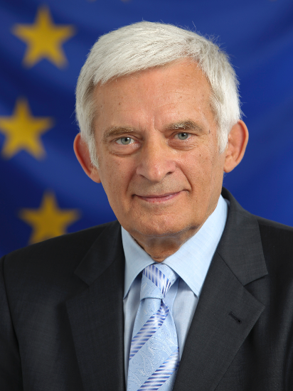
The European Parliament support on COPD
“ The European Parliament agreed to host this event, which shows the support of our institution to the initiative of this sort”
“ Breathing is life for most of us, we take breathing for granted and we rarely appreciate or even perceive the miracle of taking a breath of life”
“ I could not be more sympathetic to the objectives of your Call to Action”

Slide 3
The European Parliament support on COPD
The European Parliament has taken actions and initiatives to reduce pulmonary diseases aimed at:
- reducing the incidence of smoking in the population
- minimising the major environmental factors such as heavy exposure to occupational dusts and chemicals
- reducing indoor and outdoor pollution

Slide 4
The European Parliament support on COPD
The EP is committed to :
- contributing to the epidemiologic understanding of respiratory diseases and their determinants through its work on the EU Framework Programmes for Research
- supporting better medicines for asthma, allergies and COPD
- supporting the inclusion of “Health in All Policies”

Slide 5
The European Parliament support on COPD
“Lets us contribute to minimise the suffering of our fellow human beings both through the sum of our responsible individual decisions and collectively through policies aimed at a healthier environment, therefore healthier, more creative and happy lives”.
Jerzy Buzek, President of the European Parliament

Slide 6

THANK YOU.
EFA European Federation of Allergy and Airways Diseases Patients'
Associations is a Partner of the Year of the Lung
in Memory of Mariadelaide Franchi
EFA
35 Rue du Congrès
1000 Brussels, Belgium
www.efanet.org

